Slide 1
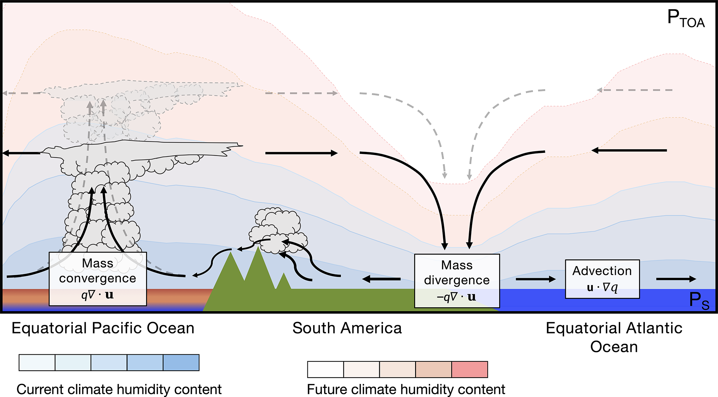
Observed changes in hydroclimate attributed to human forcing
Herrera, D. A., Cook, B. I., Fasullo, J., Anchukaitis, K. J., Alessi, M., Martinez, C. J., ... & Taylor, M. A. (2023). Observed changes in hydroclimate attributed to human forcing. PLOS Climate, 2(11), doi: 10.1371/journal.pclm.0000303.
OBJECTIVE
The goal of this work is to analyze the recent literature on the observed changes in hydroclimate attributable to anthropogenic forcing, the physical and biological mechanisms underlying those changes, and the advantages and limitations of current detection and attribution methods.
APPROACH
This commentary performs a review of recent literature.
IMPACT
Changes in the magnitude and spatial patterns of precipitation minus evaporation are consistent with increased water vapor driven by higher temperatures. While thermodynamics explains most observed changes, the contribution of dynamics is not yet well constrained, especially at regional and local scales, due to limitations in observations and climate models. Climate change has also increased the severity and likelihood of contemporaneous droughts in southwestern North America, southwestern South America, the Mediterranean, and the Caribbean. An increased frequency of extreme precipitation events and shifts in phenology has also been attributed to anthropogenic climate change.
Representation of the dynamic and thermodynamic changes associated with the intensified water cycle. This diagram depicts changes with an El Niño-like pattern. As the climate warms, the atmosphere's water-holding capacity increases further (reddish colors). That causes higher mass convergence and lower mass divergence (dashed gray lines), increasing the contrast between areas dominated by a convergent flow (e.g., equatorial Pacific Ocean) and the opposite in areas dominated by a divergent flow (subtropics). That, in turn, may increase the intensity of hydroclimate extremes: first, higher mass convergence is associated with higher precipitable water, and second, lower humidity in a warmer climate could increase the risk of drought, especially flash droughts. The implications of such changes are critical to understand the effects and teleconnection patterns of climate modes of variability, such as El Niño-Southern Oscillation (ENSO) in a changing climate.

