Slide 1
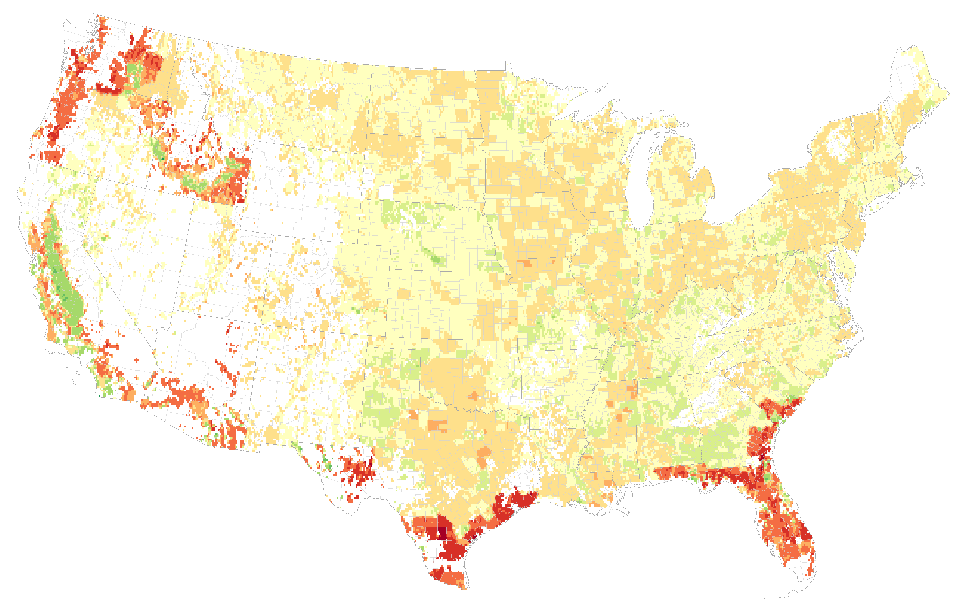
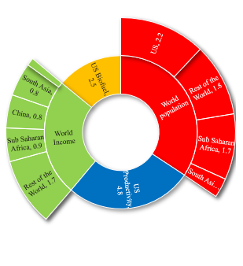
Global drivers of local water stresses and global responses to local water policies in the United States
Figure: (a) Decomposing the drivers of changes in the US groundwater withdrawals from 2010–2050 as computed by SIMPLE-G-US-Allcrops, based on SSP2 (Shared Socioeconomic Pathways, middle of the road), in absence of climate change. Improvement in global productivity can completely offset the impacts of increased population and income, conditional to sufficient investments. Also, rebound effect of domestic productivity growth causes increase in groundwater withdrawals.
(b) Impacts of groundwater sustainability policy in the US. Depending on land suitability, water availability, and institutions, production moves around within the U.S. The production is projected to decline in the target grid cells due to large reductions in the irrigated area. This reflects the extremely high yields on US irrigated croplands which must be replaced by production elsewhere to meet global food demands.
a
Objective
As irrigation becomes more important for agricultural output in the United States, sustainable groundwater withdrawal restrictions are encouraged due to limited water resources. It is critical to quantify the impact of these limits on food production and the environment in other countries, alongside evaluating the future environmental strain in the U.S. prompted by global food demand and population growth.
Drivers of change in the groundwater withdrawals
2010- 2050
Approach
We use SIMPLE-G, a gridded economic model, for (a) a multi-scale assessment of global changes and their contributions to U.S. water stress, and (b) a gridded economic analysis of the spillover effects of U.S. groundwater sustainability restrictions.
b
Impact
Increased global commodity demand is expected to fuel more than half of the U.S. environmental pressures by 2050. Local water policies may unintentionally exacerbate global land and water stress by shifting crop activity. Agricultural productivity improvements via research and development investments will be needed to alleviate sustainability pressure.
Haqiqi I., Bowling L., Jame S., Baldos U.,Liu J. and Hertel T. (2023) Global drivers of local water stresses and global responses to local water policies in the United States. Environmental Research Letters 18: 065007. https://doi.org/ 10.1088/1748-9326/acd269

