Slide 1
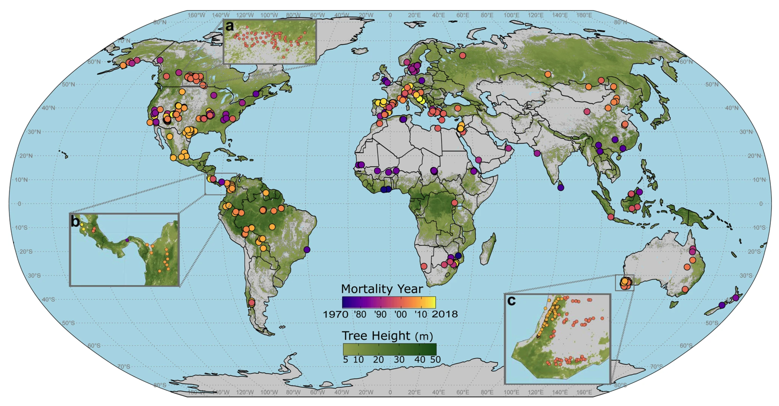
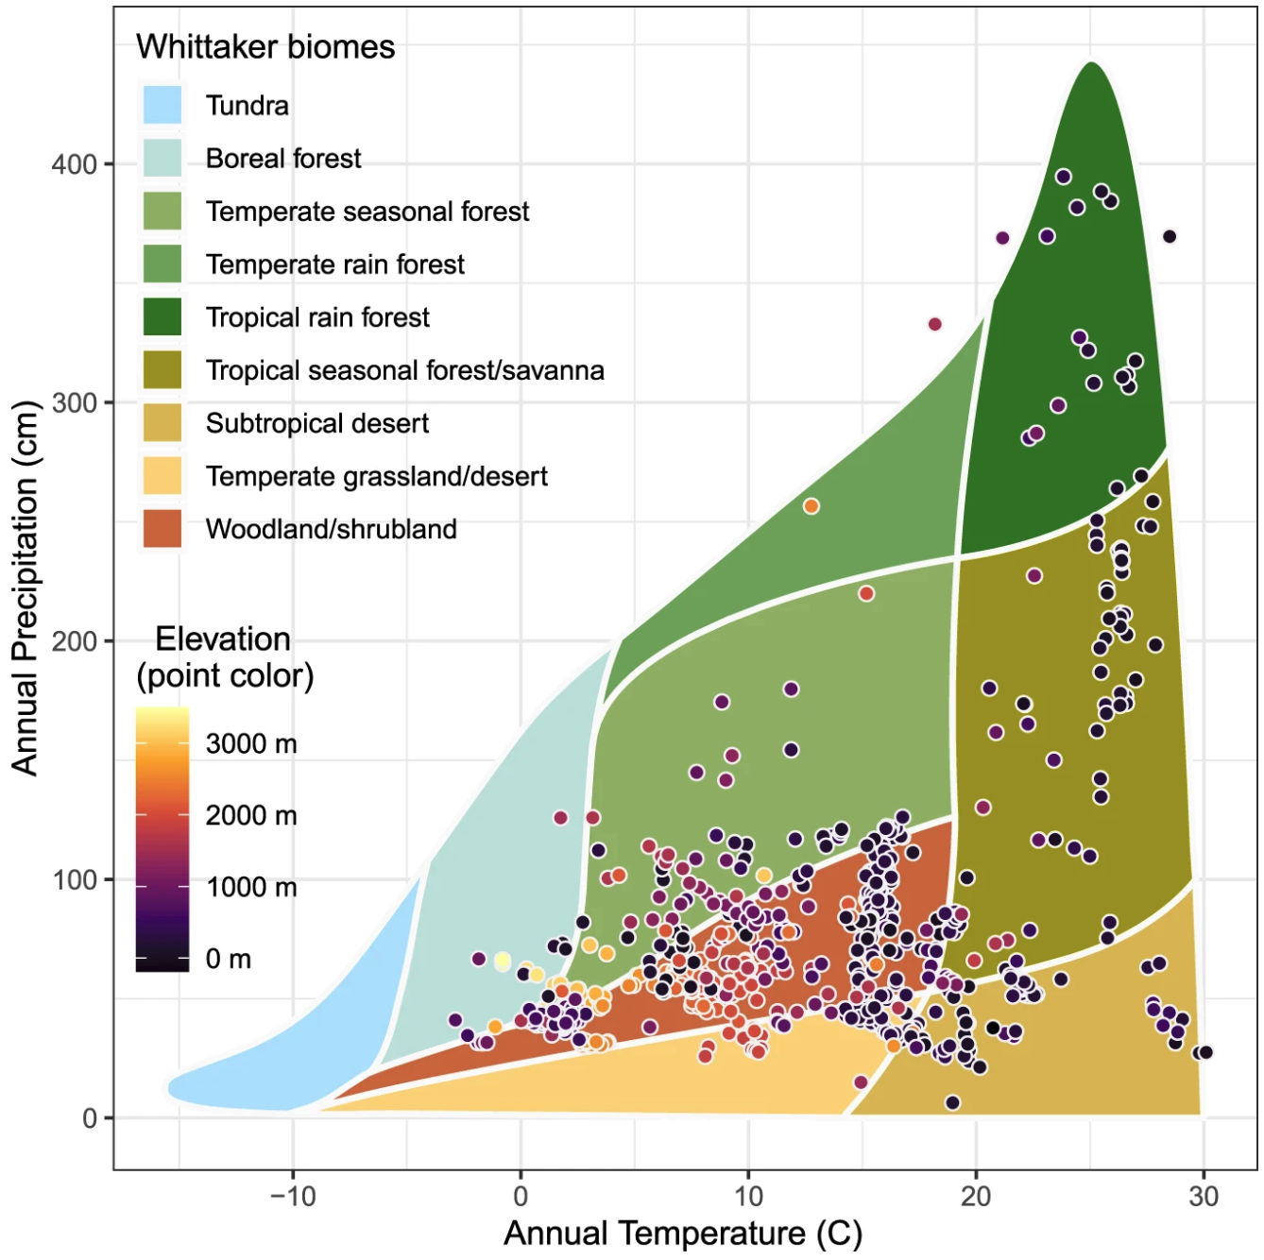
Global field observations of tree die-off reveal hotter-drought fingerprint for Earth’s forests
Hammond, W.M., Williams, A.P., Abatzoglou, J.T. et al., 2022, Nature Communications, 13, 1761.
Objective
Earth’s forests face grave challenges in the Anthropocene, including hotter droughts increasingly associated with widespread forest die-off events. But despite the vital importance of forests to global ecosystem services, their fates in a warming world remain highly uncertain. Lacking is quantitative determination of commonality in climate anomalies associated with pulses of tree mortality—from published, field-documented mortality events—required for understanding the role of extreme climate events in overall global tree die-off patterns.
Figure. (Top) Geo-referenced tree mortality plots (n = 1303) in the database. Dots are color coded according to the year of mortality. Insets show examples of dense plot networks in Canada, Central America, and Southwest Australia. (Bottom) Whittaker biome plot of database locations, showing the mean annual temperature (°C) and mean annual precipitation (cm) for all 1303 database plots. Each point represents a plot from the global database where climate-induced tree mortality happened.
Approach
The study establishes a geo-referenced global database documenting climate-induced mortality events spanning all tree-supporting biomes and continents, from 154 peer-reviewed studies since 1970.
Impact
The study quantifies a global “hotter-drought fingerprint” from tree-mortality sites—effectively a hotter and drier climate signal for tree mortality—across 675 locations encompassing 1,303 plots. Frequency of these observed mortality-year climate conditions strongly increases nonlinearly under projected warming. The study also provides footing for further community-developed, quantitative, ground-based monitoring of global tree mortality.

