Slide 1
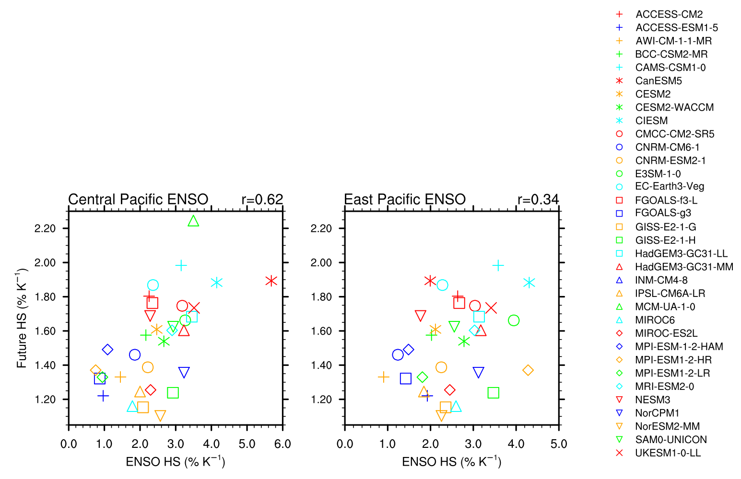
El Niño and La Niña events in Central Pacific are a good proxy for future global precipitation increase
Scientific Achievement
The rate of global hydrological intensification under future warming (hydrologic sensitivity, HS) is highly uncertain among climate models. Here, we show that it may be constrained by using El Niño and La Niña events as an observable analogue in the historical climate.
El Niño and La Niña events centered in the Central Pacific are a proxy for future HS, but those centered in the East Pacific are not.
Significance and Impact
Climate models all appear to underestimate HS, meaning that global precipitation is likely to intensify at a greater rate than previously predicted.
With the observational record of global precipitation anomalies under El Niño and La Niña ever increasing, we will develop increasingly robust estimates for this metric, and thus for the rate of future global precipitation intensification.
Research Details
For all available models in CMIP6 we calculated HS, both under El Niño and La Niña events of given thresholds (evaluated in piControl), and under future warming (evaluated in 1pctCO2, abrupt-4xCO2, and scenarioMIP).
We performed the same analysis for satellite-era observations, using all available El Niño and La Niña events.
Global hydrologic sensitivity (HS) evaluated under El Niño and La Niña events, centered in (left) Central and (right) East Pacific, versus HS under future warming.
Norris, J., A. Hall, C. W. Thackeray, D. Chen, and G. D. Madakumbura, 2022: Evaluating hydrologic sensitivity in CMIP6 models: anthropogenic forcing versus ENSO, Journal of Climate, doi:10.1175/JCLI-D-21-0842.1

