Slide 1
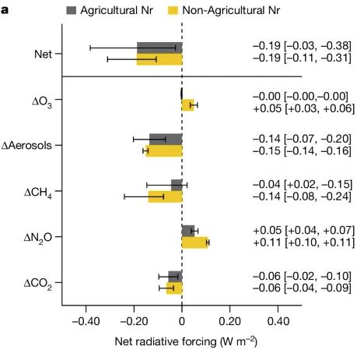
Global net climate effects of anthropogenic reactive nitrogen
Scientific Achievement
The study finds that in 2019, anthropogenic N₂O caused a net negative direct radiative forcing of -0.34 W m⁻² compared to 1850, indicating a cooling effect.
This net cooling is a result of increased aerosol loading, reduced methane lifetime, and enhanced terrestrial carbon sequestration, although there are clear warming effects of increased atmospheric N₂O.
Significance and Impact
This work provides a comprehensive assessment of the global climate effects of anthropogenic N₂O, highlighting a current net cooling effect due to various atmospheric and land processes.
However, this cooling effect is expected to diminish in the future, necessitating stronger reductions in greenhouse gas emissions to meet climate change mitigation goals
Research Details
This work quantifies the net climate effects of anthropogenic N₂O, considering both warming and cooling influences, by integrating terrestrial biogeochemistry models and atmospheric chemistry transport models
Fig. Global direct radiative forcing associated with anthropogenic N₂O from agricultural and non-agricultural sources.
Gong, C., et al. Global net climate effects of anthropogenic reactive nitrogen. Nature (2024). https://doi.org/10.1038/s41586-024-07714-4.
Work is supported by Reducing Uncertainties in Biogeochemical Interactions through Synthesis and Computation (RUBISCO) Scientific Focus Area Project.

