Slide 1
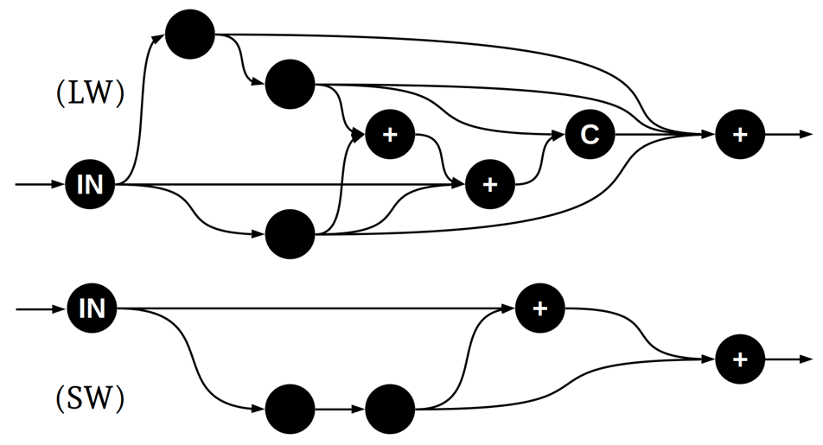
Emulating Interactions Between Atmospheric Particles and Light with Machine Learning
Objective
Use machine learning to develop a new, significantly more accurate representation of aerosol optical properties for the Energy Exascale Earth System Model (E3SM).
Approach
Model the optical properties of a representative range of aerosol populations that might occur in E3SM using computationally expensive, but accurate, Mie theory.
Train a deep neural network to emulate the optical properties computed using Mie theory.
Use a novel architecture search scheme to find a neural network that provides a good balance between accuracy and computational expense.
Impact
Aerosols are a significant source of uncertainty in climate simulations and accurately representing how aerosol populations interact with atmospheric radiation is critical for overall model results.
Machine learning can enable significantly more accurate representation of direct aerosol radiative effects.
This approach lays the groundwork for future integration of more sophisticated representations of aerosol optical properties into E3SM.
A randomized search of neural network architectures was used to identify optimal models for representing aerosol optical properties. The neural networks can significantly improve the accuracy of simulated aerosol optical properties in E3SM with minimal computational cost.
A. Geiss, P.-L. Ma, B. Singh, and J. C. Hardin, “Emulating aerosol optics with randomly generated neural networks.” Geoscientific Model Development 16, 2355–2370 (2023). [DOI: 10.5194/gmd-16-2355-2023]

