Slide 1
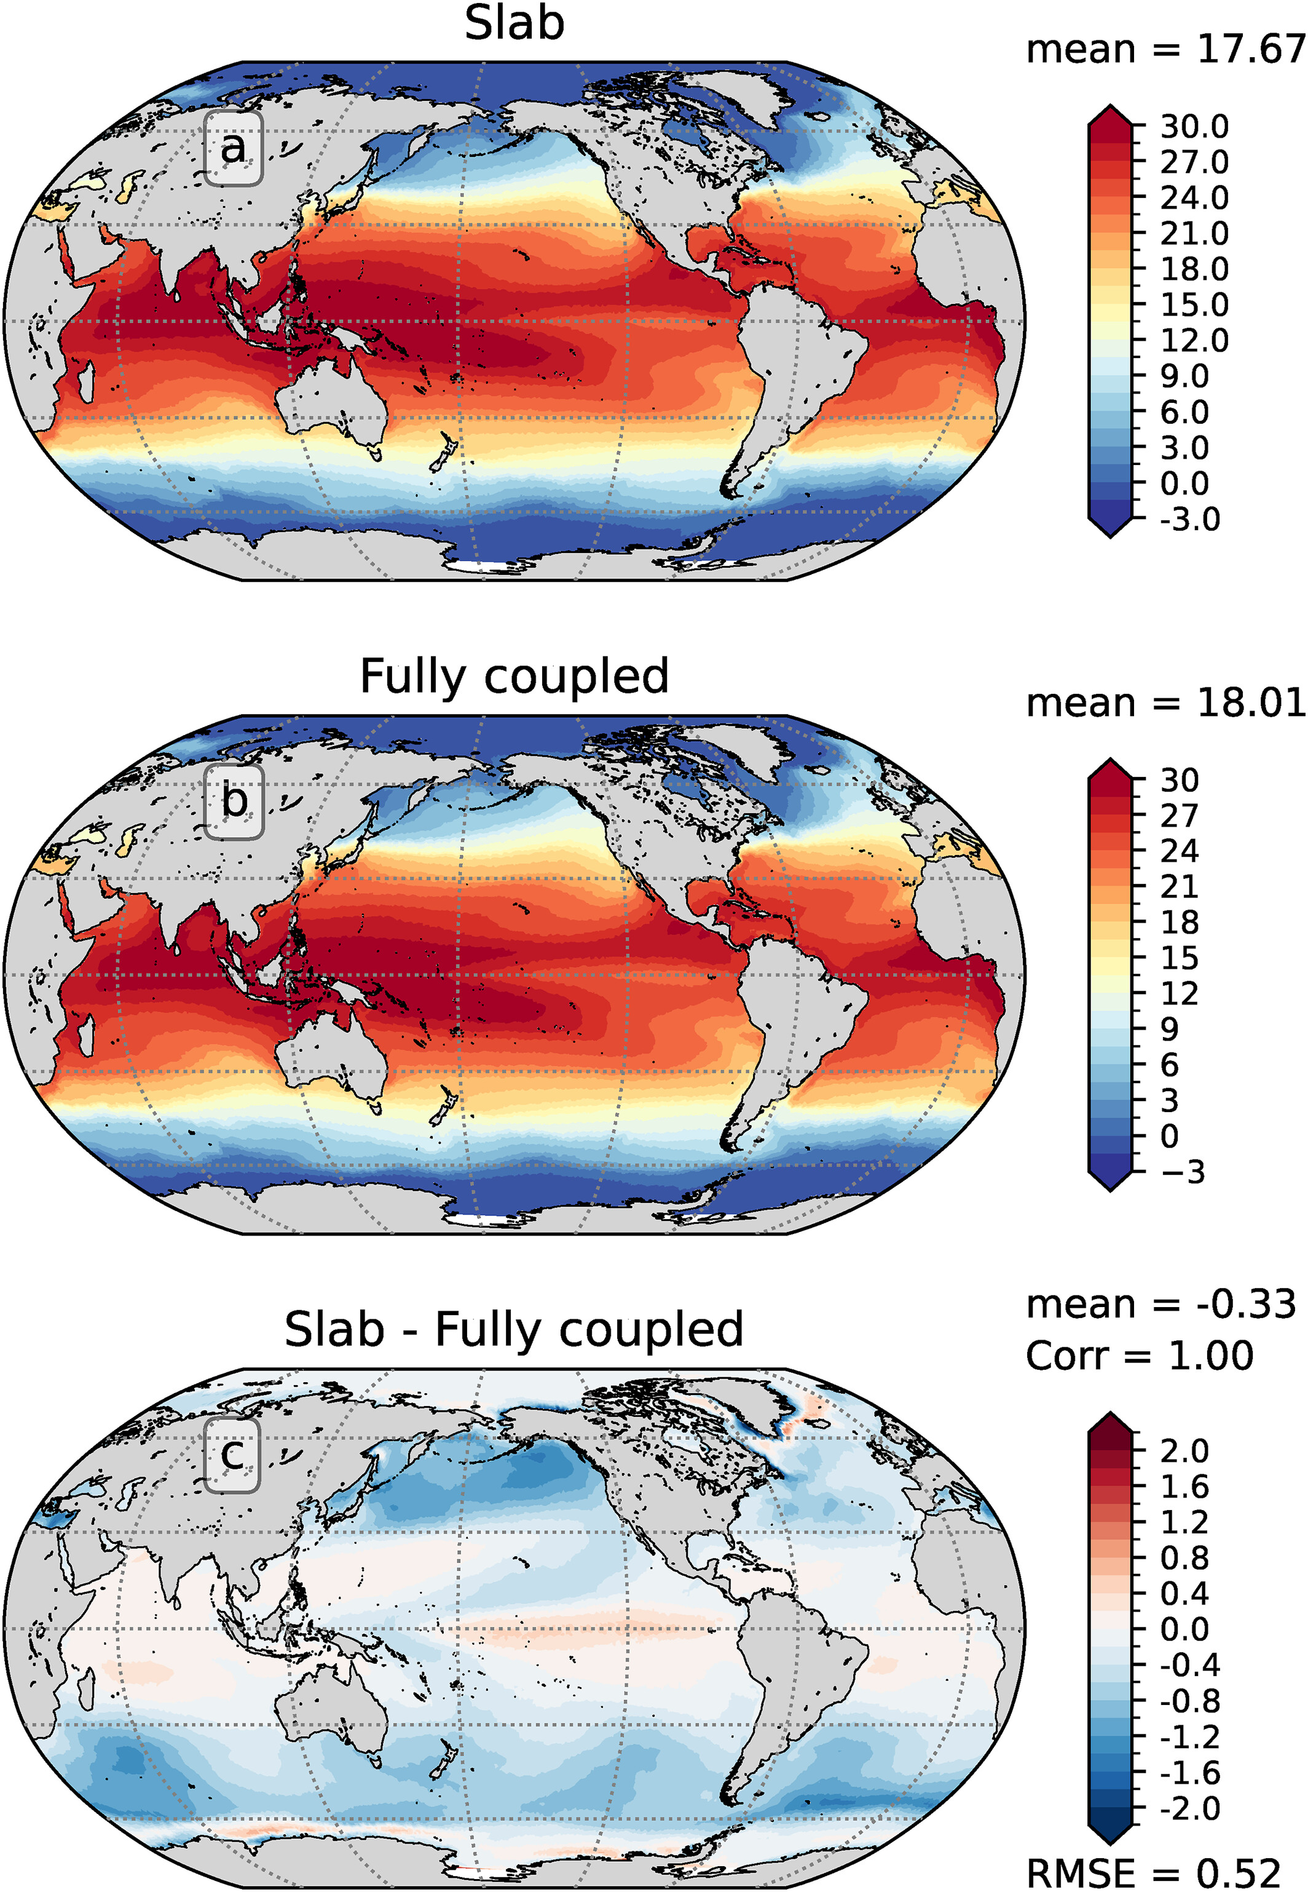
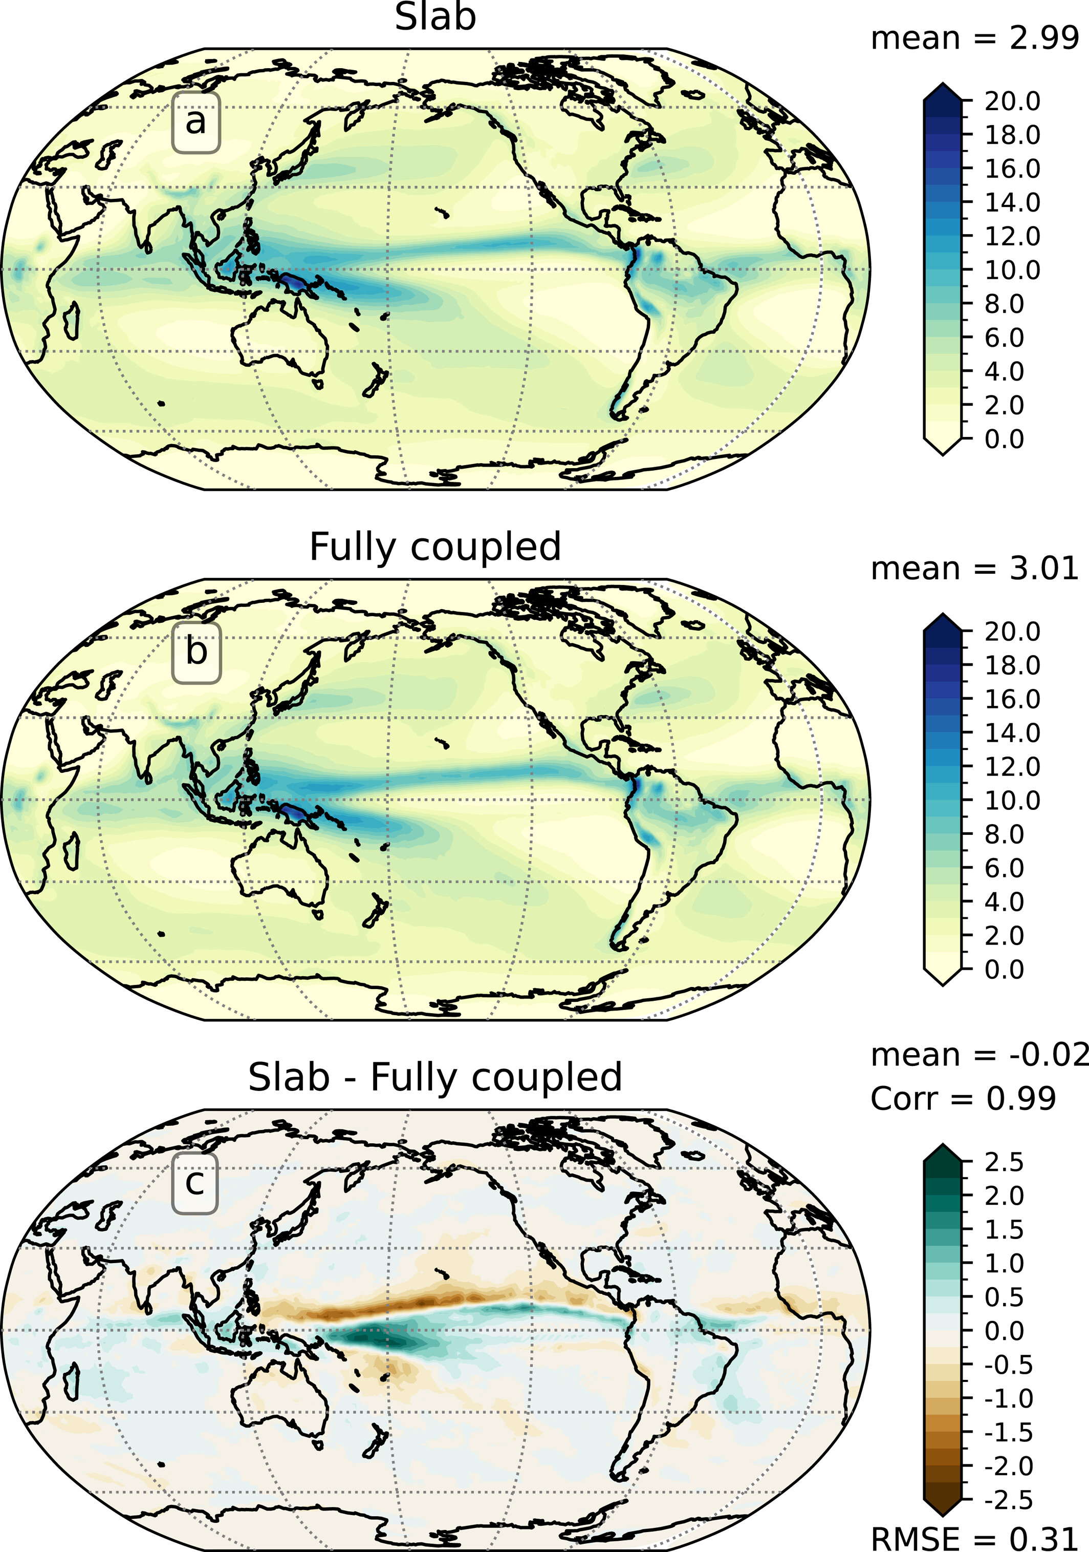
Slab Ocean Model Shows Efficient, Accurate Way of Assessing Ocean Temperature Changes
Objective
Evaluate and demonstrate the use of the Slab Ocean Model (SOM) capability in the Energy Exascale Earth System Model version 2 (E3SMv2)
Approach
Implement the SOM capability within the Model for Prediction Across Scales Ocean (MPAS-O) dynamic ocean model framework of E3SMv2
Evaluate the SOM by comparing the equilibrium baseline climate and climate sensitivity in the E3SMv2-SOM with those of the fully coupled E3SMv2 that uses its dynamic ocean model component MPAS-O
Use E3SMv2-SOM sensitivity experiments to test the response of modeled climate to varying ocean heat transport strengths
Impact
E3SMv2-SOM reproduces the equilibrium baseline climate and sea surface temperature warming to CO₂ doubling that is simulated in the E3SMv2 model with the dynamic ocean model
E3SMv2-SOM sensitivity experiments indicate E3SMv2 has a large sensitivity to ocean heat transport change due to marine low-level cloud changes
The E3SMv2-SOM adds a new capability to the hierarchical modeling framework of E3SM
E3SMv2 slab ocean model (SOM) can reproduce sea surface temperature (left) and precipitation (right) as well as sea ice extent and volume of the fully coupled E3SMv2 with a dynamic ocean model
Garuba, O., Rasch, P. J., Leung, L. R., Wang, H., Hagos, S., & Singh, B. (2024). Slab ocean component of the energy exascale Earth system model (E3SM): Development, evaluation, and application to understanding Earth system sensitivity. Journal of Advances in Modeling Earth Systems, 16, e2023MS003910. https://doi.org/10.1029/2023MS003910
Notes:
http://www.pnnl.gov/science/highlights/highlights.asp?division=749

