Slide 1
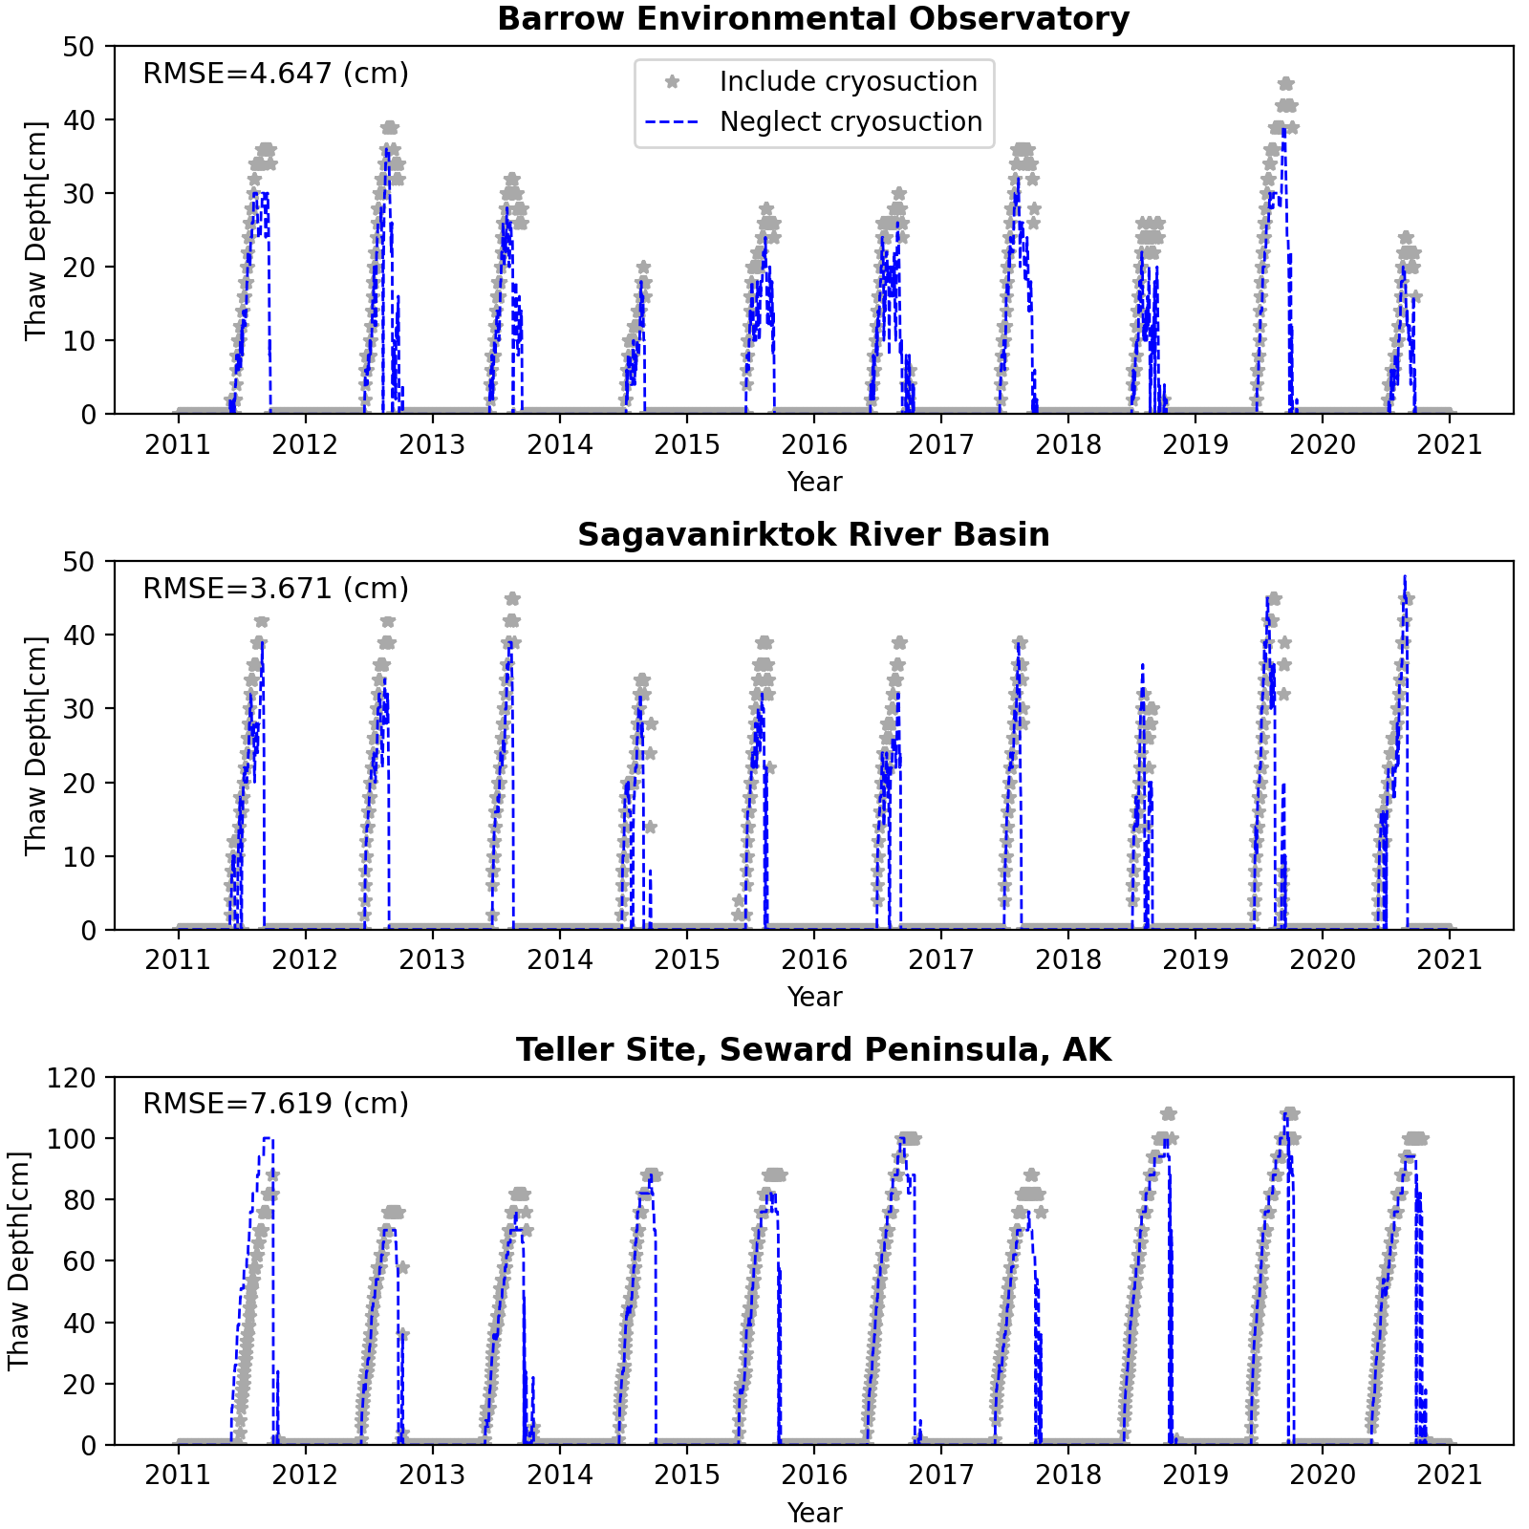
Quantifying the Importance of Cryosuction in Permafrost-Rich Soils
High-Impact Publication: Cryosuction is a crucial yet commonly ignored process in field-scale permafrost modeling.
Objective | Assess the validity of several physical process simplifications that are commonly used in permafrost modeling
New science | Cryosuction – whereby water is pulled into a freezing front in unsaturated soils – was found to have a crucial role in field-scale permafrost predictions: neglecting cryosuction causes significant biases in evaporation, discharge, and thaw depth. Accurately capturing ice density and heat advection at field-scales were found to be less important when modeling key hydrological metrics under varying sites conditions.
Impact | This study provides key information for permafrost modelers to understand how model process uncertainty governs field-scale hydrologic predictions. It challenges the commonly held assumption that cryosuction is not a strong control on field-scale metrics, suggesting a need for more measurements and models to quantify cryosuction in ice-rich soils.
Gao, B. and Coon, E. T.: Evaluating simplifications of subsurface process representations for field-scale permafrost hydrology models, The Cryosphere, 16, 4141–4162, https://doi.org/10.5194/tc-16-4141-2022, 2022.
A comparison of thaw depth across three sites shows that neglecting cryosuction results in a clear bias where thaw depth is systematically underpredicted by 10-30% (4-12 cm). This bias would result in a comparable underprediction of carbon decomposition and other cascading errors.

