Slide 1
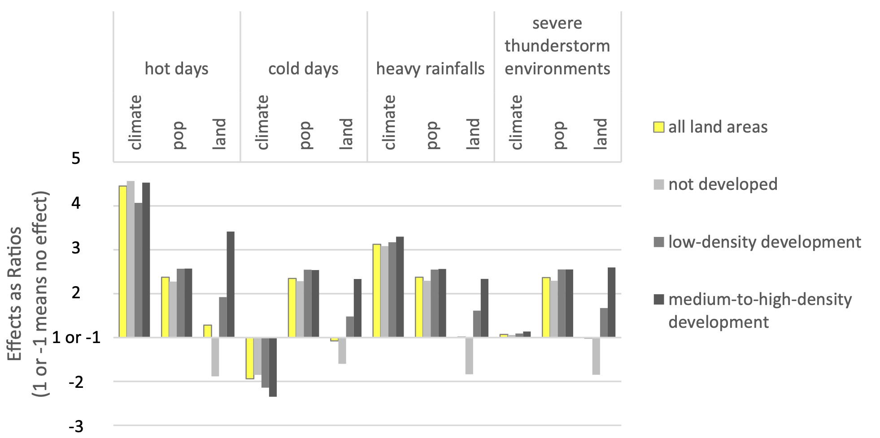



Urban Land Patterns Can Moderate Population Exposures to Climate Extremes
Objective
We examine how two factors – climate change and urbanization – influence the future population exposure to four types of climate extremes in the continental U.S.: hot days, cold days, heavy rainfalls, and severe thunderstorm environments. Unlike previous studies, we consider how urban land change affects regional climate projections nationally.
Approach
We analyze three future scenarios combining different climate, land use, and population conditions at the end of the 21st century (EOC; 2075–2100) for SSP5-RCP8.5 vs. historical conditions (1980-2005), and we examine national, regional, and city-scale exposures.
Impact
Importantly, we find that urban land effects can decrease as well as increase population exposures to climate extremes, and urban land effects can decrease population exposures in urban centers where climate effects increase exposures, including for heat extremes at the city-scale. We also conclude that the city-scale urban effect seen here can only be a result of urban land patterns and changing climate-urban-land interactions.
Next steps include identifying the characteristics of the spatial arrangement of a city that makes it more or less resilient to future climate extremes so that this information can be used in future urban planning.
Fig. 1. U.S. national average effects of 21st-century climate, population, and urban land changes on population exposures to four climate extremes in areas with different urban land development densities. For example, the climate effects for hot days across all land development densities is 4.5, meaning that, over the 21st century, climate change alone increases the U.S. total population exposure to hot days to 4.5 times the historical total exposure; in contrast, the climate effects for cold days across areas with low development densities is −2.1, meaning that, over the 21st century, climate change alone reduces population exposure to cold days in areas with low-density development by 1/2.1, i.e., about half. A ratio of 1 or −1 means there is no change in exposure counts, i.e. no effect.
Gao, J., Bukovsky, M.S., 2023: Urban land patterns can moderate population exposures to climate extremes over the 21st century. Nature Communications, 14, 6536. https://doi.org/10.1038/s41467-023-42084-x

