Slide 1
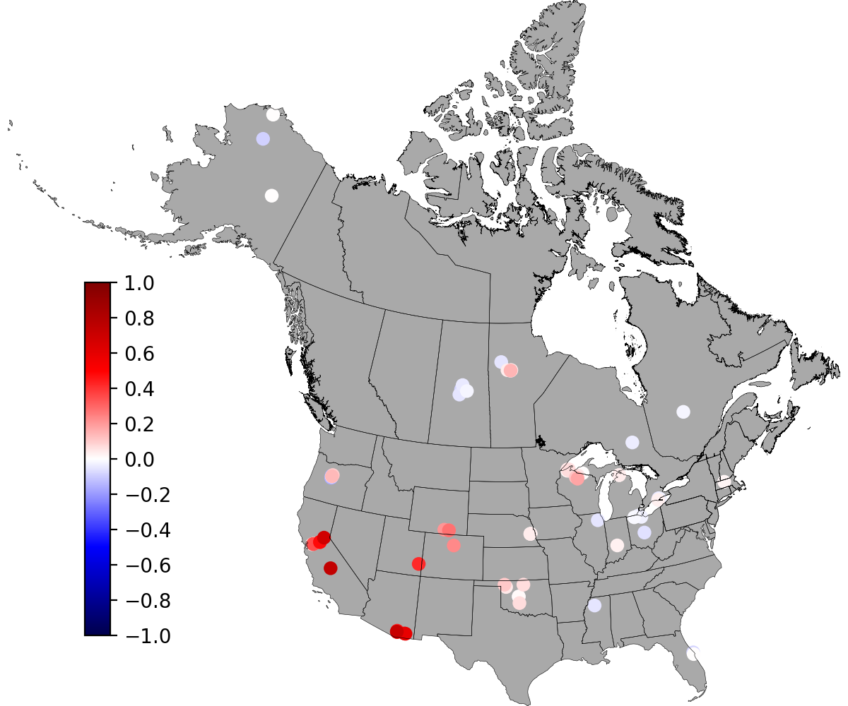
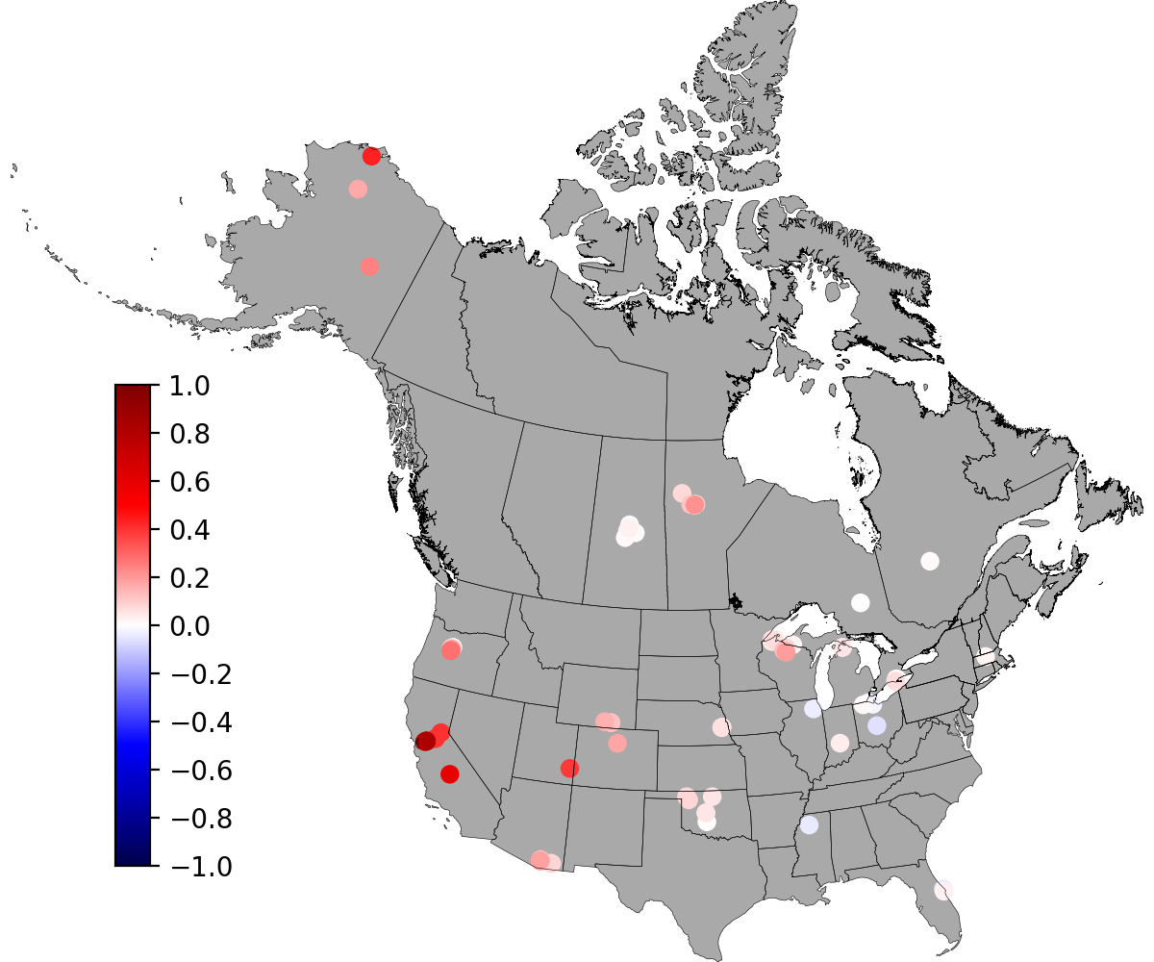
Estimating Atmospheric Water Vapor Pressure Using Machine Learning
Scientific Challenge
As an essential meteorological control on hydrologic processes, the water vapor pressure (or relative humidity) ﻿is usually derived through empirical formulations by assuming equivalent dewpoint and minimum air temperature or by additionally applying an aridity correction. Both methods result in questionable accuracy across space and time.
Approach and Findings
﻿An interpretable Long Short Memory (iLSTM) network configured with static attributes was utilized to derive the atmospheric vapor pressure at 83 FLUXNET sites in the US and Canada.
﻿The iLSTM network ﻿noticeably improves the estimation accuracy by decreasing the failure rate (KGE < 0.7) from 32% of sites by empirical methods to 19.4% of sites without static attributes, and 16.5% and 10.9% when taking mean precipitation and leaf area index as the static attribute, respectively.
(1) KGE of iLSTM vs. T_{dew}=T_{min}
(2) iLSTM vs. T_{dew}=T_{min} with aridity
﻿Difference of KGE (a measure of accuracy where 1 indicates a perfect fit) between iLSTM and two empirical methods: T_{dew}=T_{min} (Fig. 1) and aridity corrected T_{dew}=T_{min} (Fig. 2) for vapor pressure estimation at 83 study sites. Red points show sites where the KGE of iLSTM is better than that of empirical methods; blue shows the reverse.
Significance and Impact
iLSTM networks ﻿can significantly improve empirical algorithms for estimating vapor pressure, and can be leveraged to improve gridden vapor pressure products across space and time.
Gao, B., Coon, E. T., Thornton, P. E., & Lu, D. (2024). Improving the estimation of atmospheric water vapor pressure using interpretable long short-term memory networks. Agricultural and Forest Meteorology, 347, 109907. https://doi.org/10.1016/j.agrformet.2024.109907
Department of Energy • Office of Science • Biological and Environmental Research
Notes:
Word highlight text here.

