Slide 1
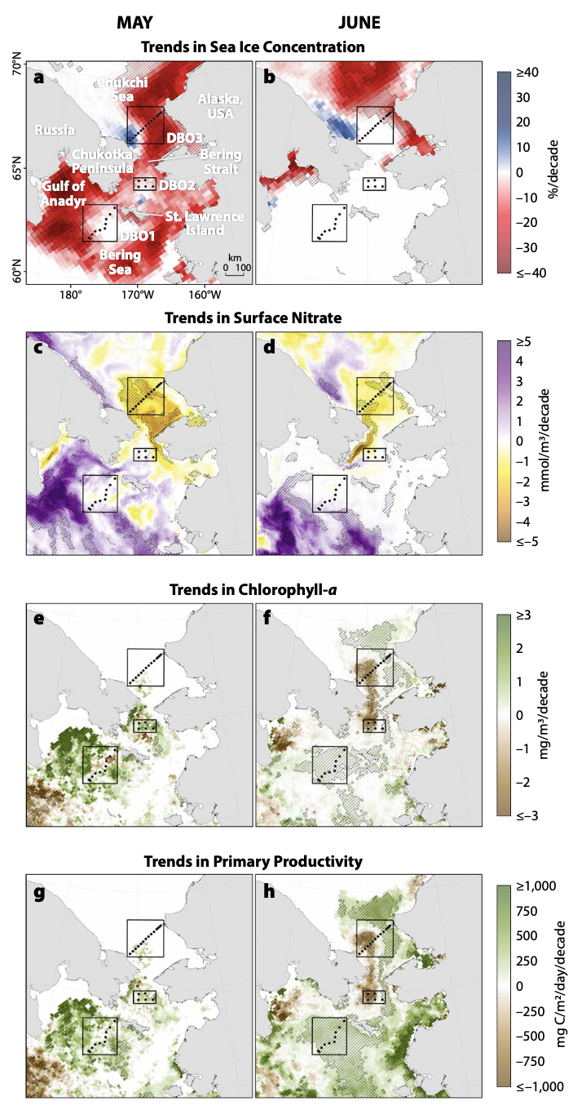
Observations of Declining Primary Production in the Western Bering Strait
Objective
Observations of trends in primary production are combined with modeled nutrient concentration trends in the Bering Strait region to understand mechanisms causing changes.
Research
To investigate recent biological change in the Bering Strait, we compiled a satellite-based time series of chlorophyll-a concentrations derived from Aqua-Moderate Resolution Imaging. Spectroradiometer (Aqua-MODIS)
Modeled chlorophyll-a, primary production, and surface nitrate concentrations were obtained from the Regional Arctic System Model to provide insight into the mechanisms causing changes seen in the observations.
Impact
The early season declines in primary productivity in the western Bering Strait have important consequences for the further downstream.
Changes in the seasonal and spatial distribution of spring phytoplankton blooms in the Pacific Arctic will also likely have important effects on pelagic-benthic coupling in a region with historically high benthic biomass and large populations of seabirds and marine mammals that depend upon benthic prey for survival.
Decadal Theil-Sen median trends for May/June over the years 2003–2020 in (a,b) sea ice concentrations, (c,d) surface nitrate concentrations, (e,f) chlorophyll-a concentrations, and (g,h) primary productivity. Hatched regions indicate statistically significant (p < 0.1) trends, determined using the Mann-Kendall test for trend.
Frey, K. E., J. Clement Kinney, L. V. Stock, R. Osinski (2022) Observations of Declining Primary Production in the Western Bering Strait, Oceanography, 35(2), https://doi.org/10.5670/oceanog.2022.123

