Slide 1
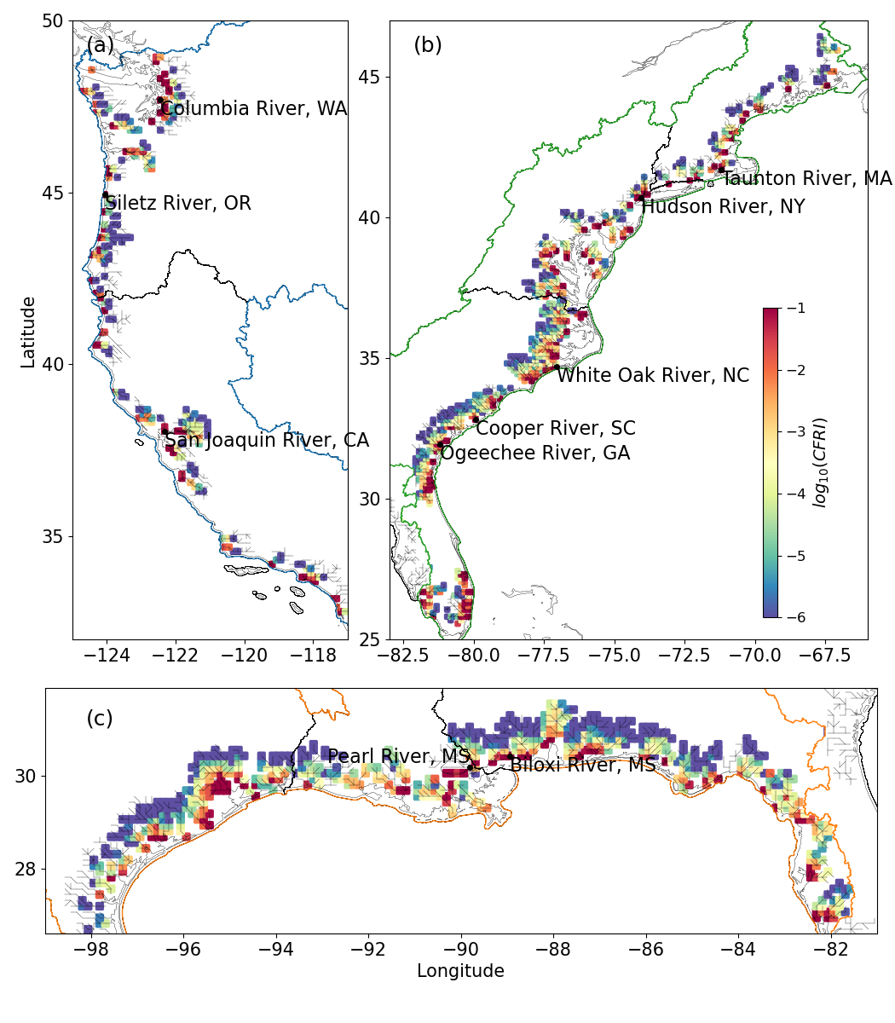
Investigating compound flood risk for the coastal United States
Objective
Develop a holistic framework that uses integrated modeling tools and statistical approaches to evaluate the combined exposure and hazard risks of compound flooding (CF) along the the coast of the contiguous United States.
Approach
Drive the Model for Scale Adaptive River Transport (MOSART) with a global ocean reanalysis dataset to evaluate the CF exposure related to the coastal backwater effects on river basins.
Generate spatially distributed data for analyzing the CF hazard using a bivariate statistical model of river discharge and storm surge.
Implement detailed uncertainty assessments within both statistical and numerical models to identify the sources of error.
Impact
The estimated CF risk shows remarkable inter- and intra-basin variabilities along the contiguous United States coast with more variabilities in the CF hazard over the west and Gulf coastal basins.
Our results highlight the need to weigh CF risk assessments from different statistics- or hydrodynamics-based approaches to reduce uncertainty.
The uncertainty analysis enhances the reliability of CF risk assessments by accounting for variability in flood drivers and the complex interactions between river and coastal processes.
A comprehensive compound flood risk assessment map delineated using MOSART and a global ocean model that considers risks from both flood frequency and intensity.
Feng, D., Tan, Z., Xu, D., and Leung, L. R. 2023. “Understanding the compound flood risk along the coast of the contiguous United States.” Hydrology and Earth System Sciences, 27(21), 3911-3934. DOI: 10.5194/hess-27-3911-2023
Notes:
http://www.pnnl.gov/science/highlights/highlights.asp?division=749

