Slide 1
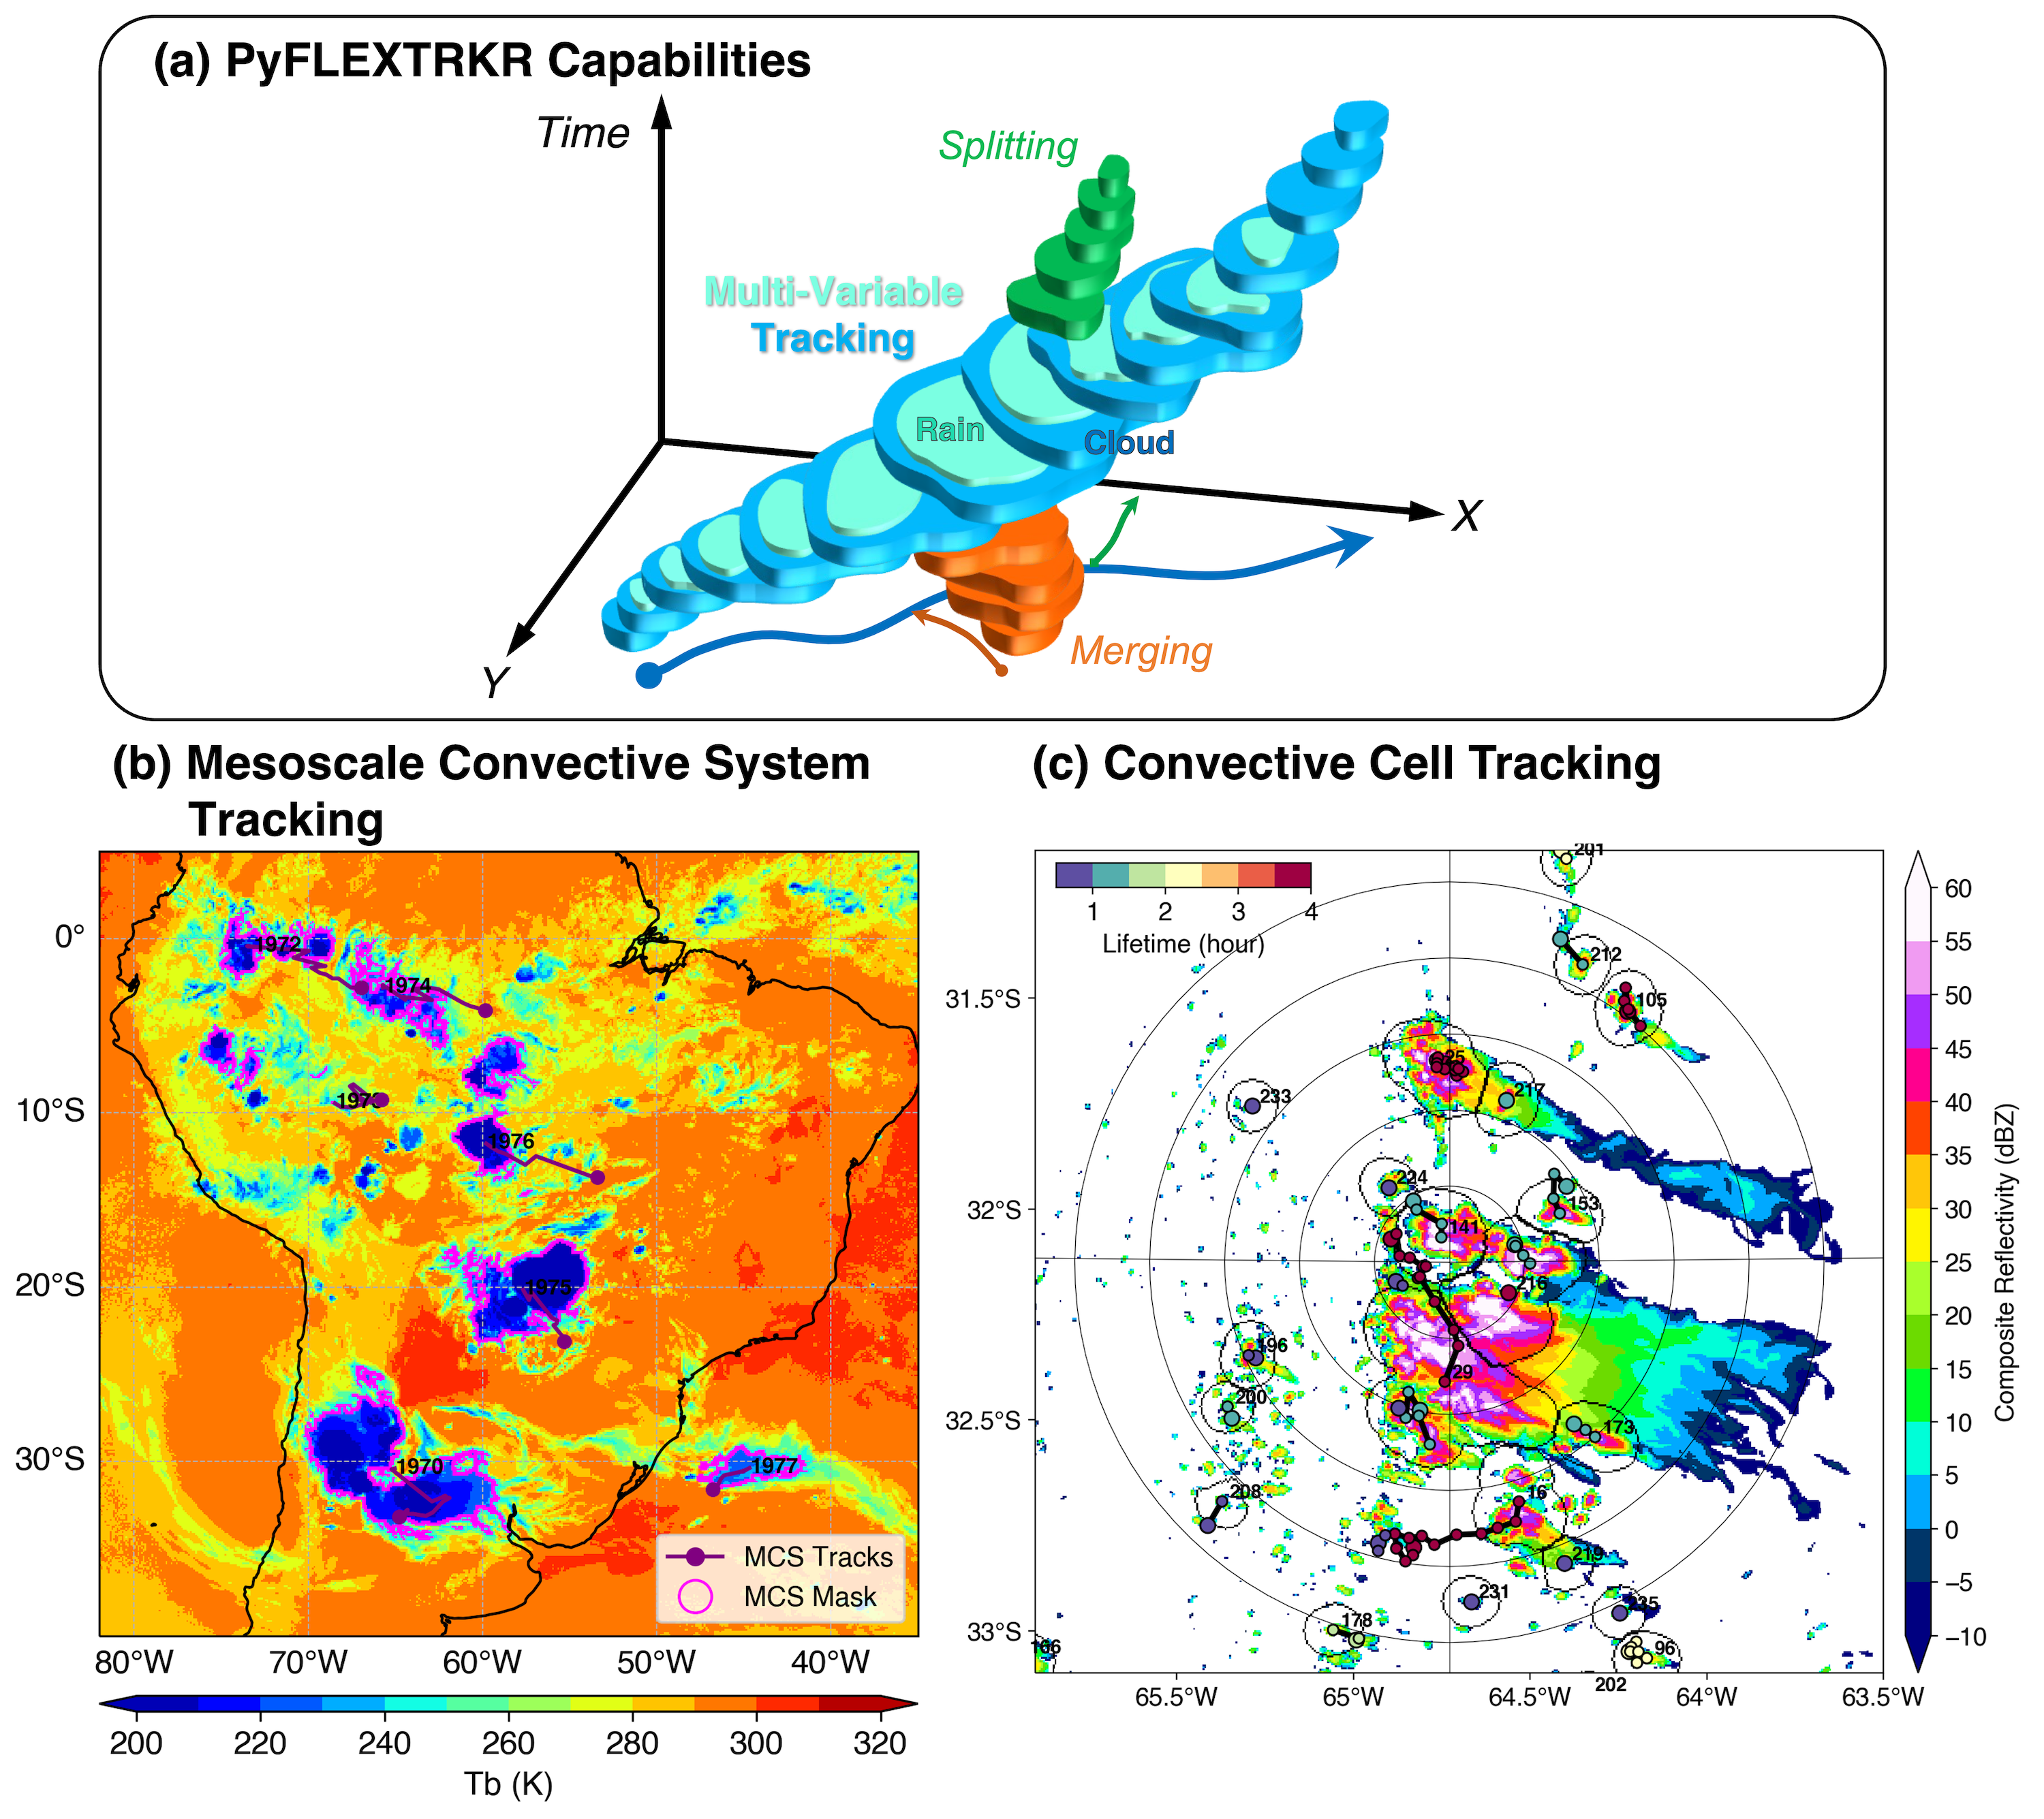
A Flexible Feature Tracking Package for Climate Science
Objective
Develop a novel feature tracking package, PyFLEXTRKR (Python FLEXible object TRacKeR) to facilitate scientific discovery, advanced model evaluation, and model development efforts.
Approach
Develop an open-source Python framework with a modular design that is easy to adapt to tracking different features at any resolution.
Optimize performance on large datasets with scalable parallelization, provide visualization, post-processing, and statistical analysis tools.
Impact
PyFLEXTRKR can track 2-D atmospheric objects at any resolution and handle merging and splitting.
The package has a collection of multi-object identification algorithms and is optimized for large datasets, such as global kilometer-scale satellite and model simulation data.
The work provides examples of convective cell tracking in radar observations and large-eddy simulation outputs, as well as mesoscale convective system tracking in satellite observations, kilometer-scale models and global climate models.
(a) PyFLEXTRKR has specialized capabilities for tracking convective clouds with multiple variables. (b) Example of tracking mesoscale convective systems to evaluate kilometer-scale regional climate model and (c) example of tracking convective cells to understand storm formation processes in large-eddy simulation model.
Z. Feng, J. Hardin, H. C. Barnes, J. Li, L. R. Leung, A. Varble, and Z. Zhang. “PyFLEXTRKR: a flexible feature tracking Python software for convective cloud analysis,” Geosci. Model Dev., 16(10), 2753-2776 (2023). [DOI:10.5194/gmd-16-2753-2023]

