Slide 1
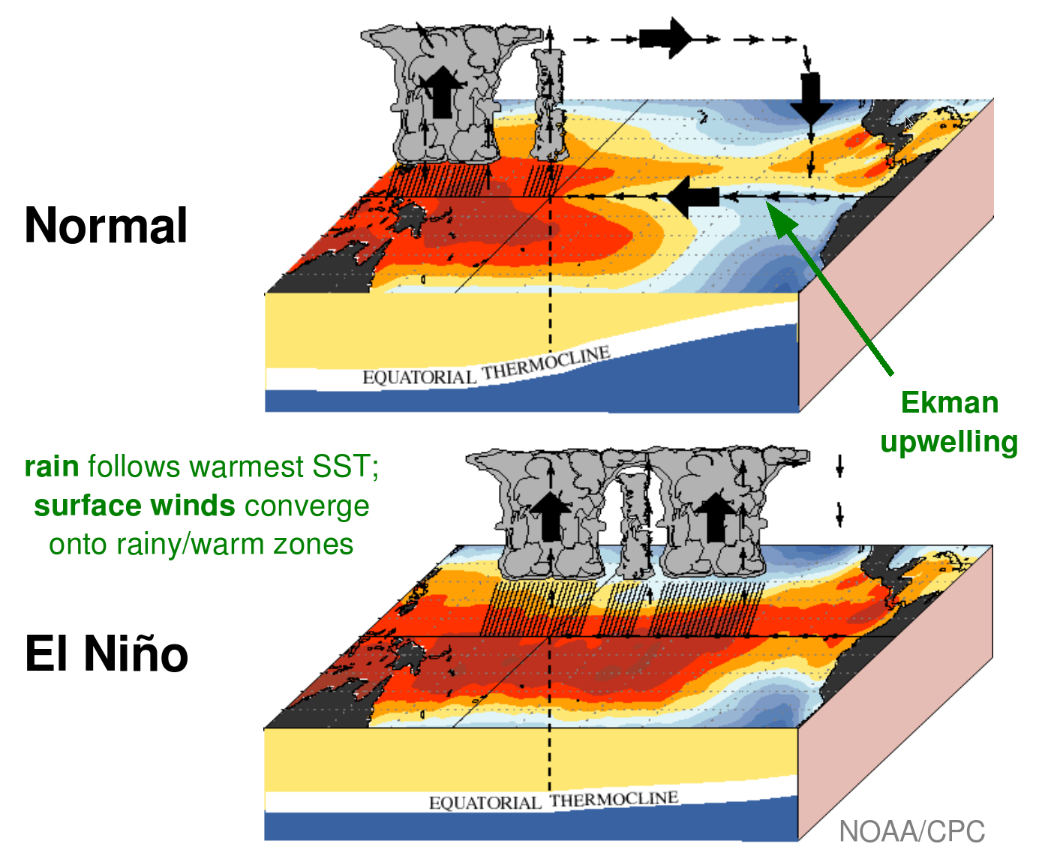
The Influence of Anomalous Biomass Emissions on ENSO in CESM2
Fasullo, J. T., N. Rosenbloom, R. Buchholz, Journal of Climate, doi: 10.1175/JCLI-D-24-0148.1.
OBJECTIVE
The El Niño / Southern Oscillation (ENSO is the dominant mode of interannual climate variability. Traditional descriptions of ENSO incorporate coupled interactions between the atmosphere and ocean but fail to incorporate feedbacks with terrestrial processes such as biomass burning emissions. In this work the influence on ENSO of observed anomalies in emissions is explored in CESM2.
APPROACH
We use CESM2 ensembles to identify initial states predisposed to evolve into either El Niño or La Niña events and compare the evolution of events using a control ensemble in which emissions are held constant, and a sensitivity ensemble in which observed biomass burning emissions during satellite-era ENSO events are imposed.
🔥
🔥
IMPACT
The inter-ensemble differences reveal a subtle but important influence of biomass burning emissions in reduced ENSO biases in CESM2, characterized mainly by a decrease in La Niña intensity. In doing so the emissions reduce CESM2 biases including excessive ENSO power, diversity, and asymmetry. Biomass emissions over Indonesia are particularly sensitive to ENSO and contributions from emissions in the Amazon and northern hemisphere extratropics also play a role in modifying aerosol burdens, clouds and radiation. The analysis adds to recent work assessing the impacts of the 2019-20 Australian wildfire season and underscores the importance of wildfire in seasonal prediction of ENSO.
🔥
Canonical Description of ENSO modified to include fire.
(A) Mean Walker circulation and its ties to winds, upwelling, and the equatorial thermocline, and (B) canonical anomalies during El Niño with the addition of canonical fire anomalies assessed in this work.

Slide 2
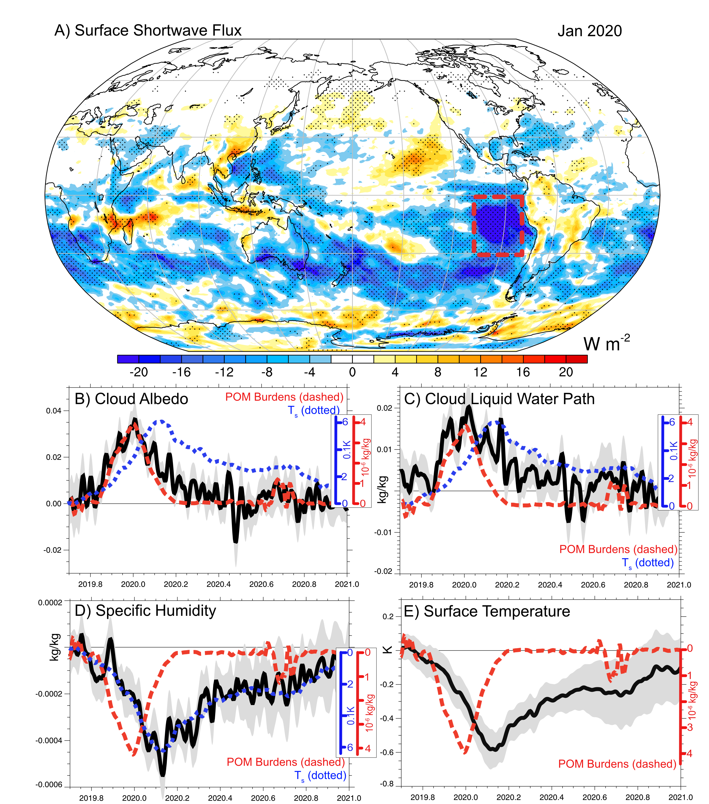
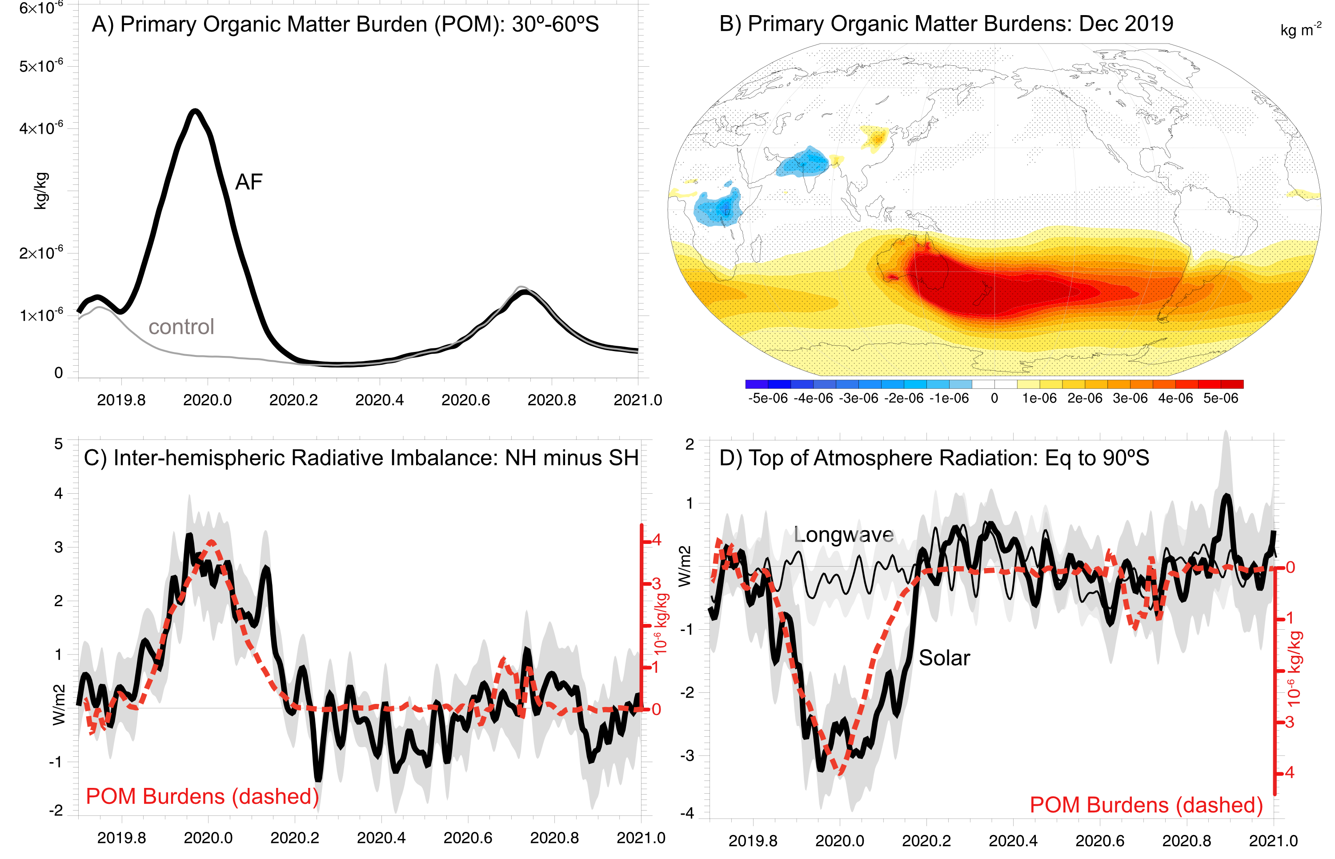
Large-Scale Responses
Eastern Pacific Responses

Slide 3
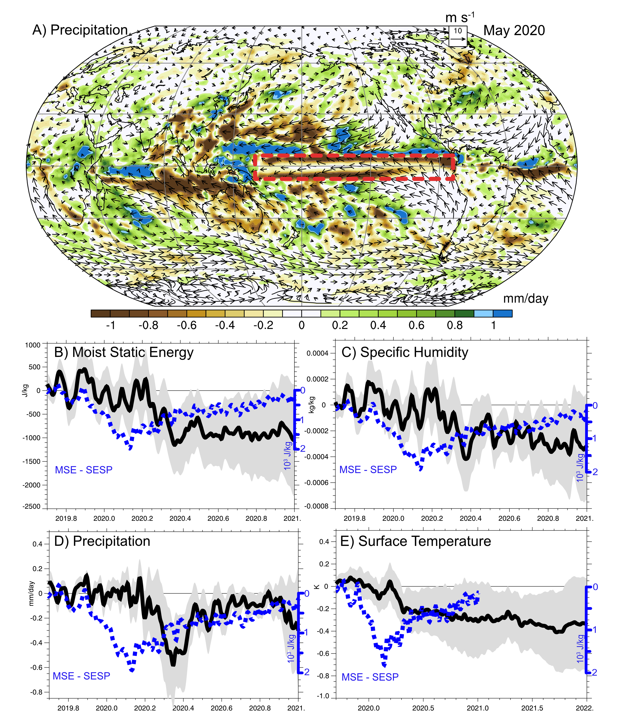
Equatorial Pacific Responses

