Slide 1
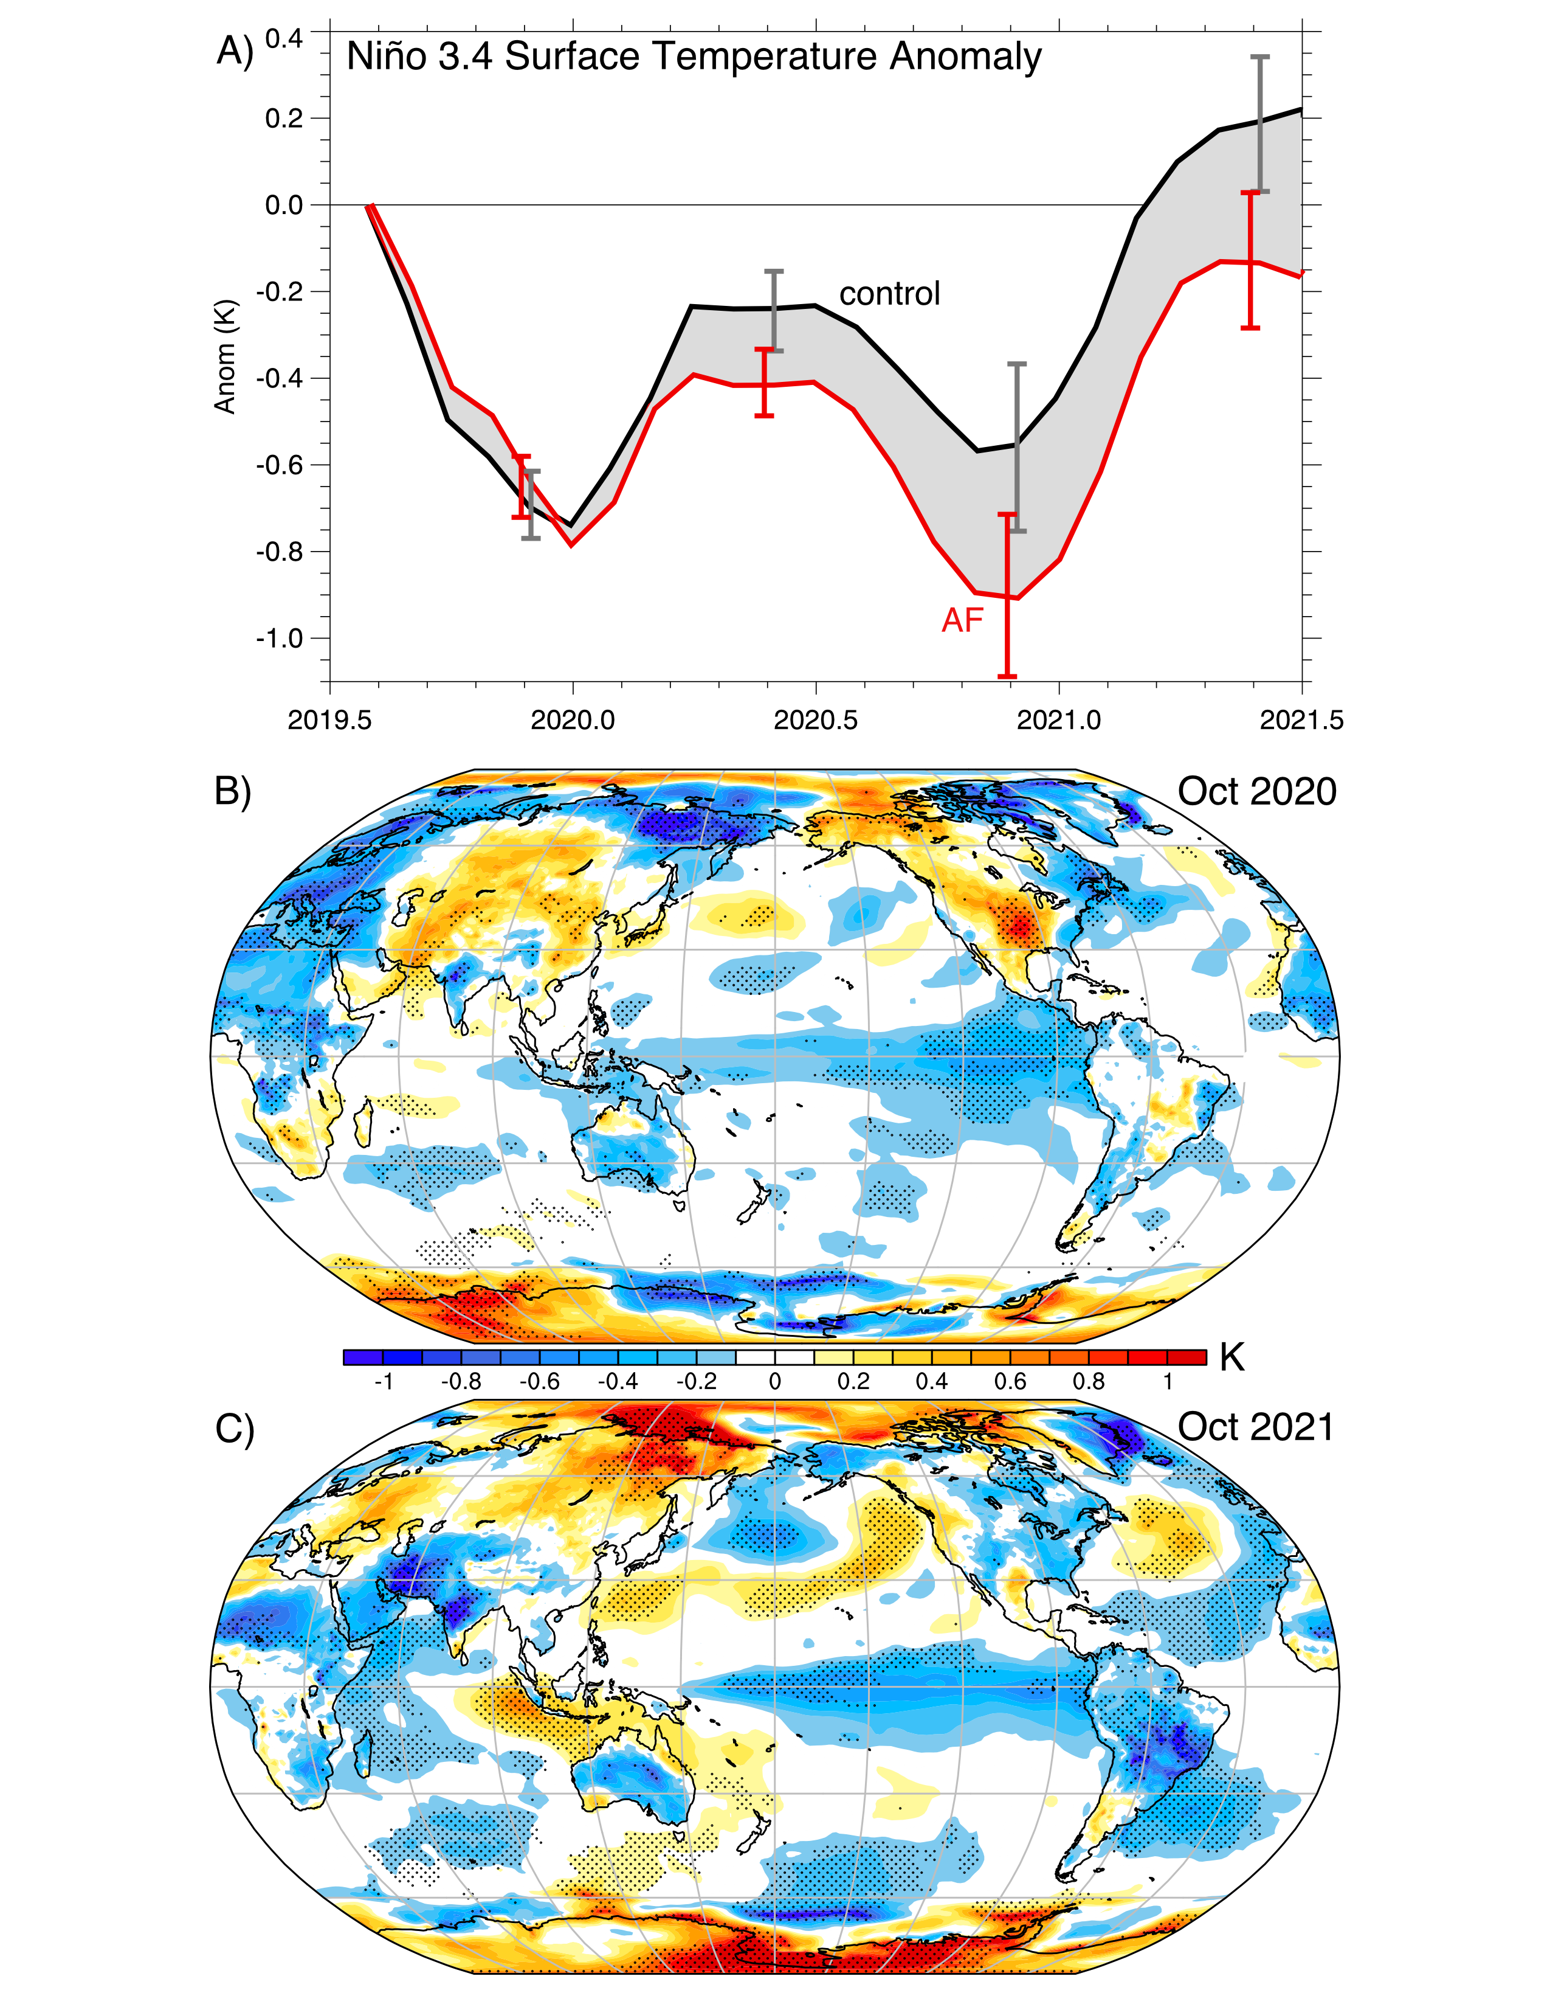
A Multi-Year Tropical Pacific Cooling Response to Recent Australian Wildfires in CESM2
Fasullo, J. T., N. Rosenbloom, R. Buchholz, A Multi-Year Tropical Pacific Cooling Response to Recent Australian Wildfires in CESM2, Science Advances, 9, (19) doi: 10.1126/sciadv.adg1213.
OBJECTIVE
The Australian bushfire season of 2019-20 was exceptional in size and duration. It also preceded an exceptionally long and poorly forecast La Niña event lasting from 2020 to 2023. This work explores the climate response to the fires and explores their potential links to La Niña.
APPROACH
We use CESM2 ensembles to simulate response to the fires, an increase in biomass aerosol burdens across the southern hemisphere is simulated through late 2019 and early 2020, accompanied by an enhancement of cloud albedo, particularly in the southeastern subtropical Pacific Ocean (SESP). A subsequent multi-year ensemble-mean cooling of the tropical Pacific is simulated through the end of 2021, suggesting an important contribution to the prolonged La Niña event in nature.
Responses in the tropical Pacific Ocean. (A) The ensemble mean control (black) and
AF (red) projections are shown for sea surface temperature anomalies in the Niño3.4 region
over the period for which drift correction is available (see Materials and Methods). Maps of the spatial structure of differences in surface temperature are also shown for (B) Oct 2020 and (C)
Oct 2021.
IMPACT
The analysis reveals a previously unrecognized climate response to large wildfires that involves multiple mechanisms, including cloud microphysical responses to biomass emissions, advection from the southern hemisphere into the deep tropics, and the triggering of coupled feedbacks involved in La Niña. In doing so, the work reveals previously unrecognized sources of ENSO predictability that, in instances, hold the promise of significantly increasing the skill of ENSO prediction systems. Processes involved in climate change are also suggested, motivating multiple paths of future research.

Slide 2
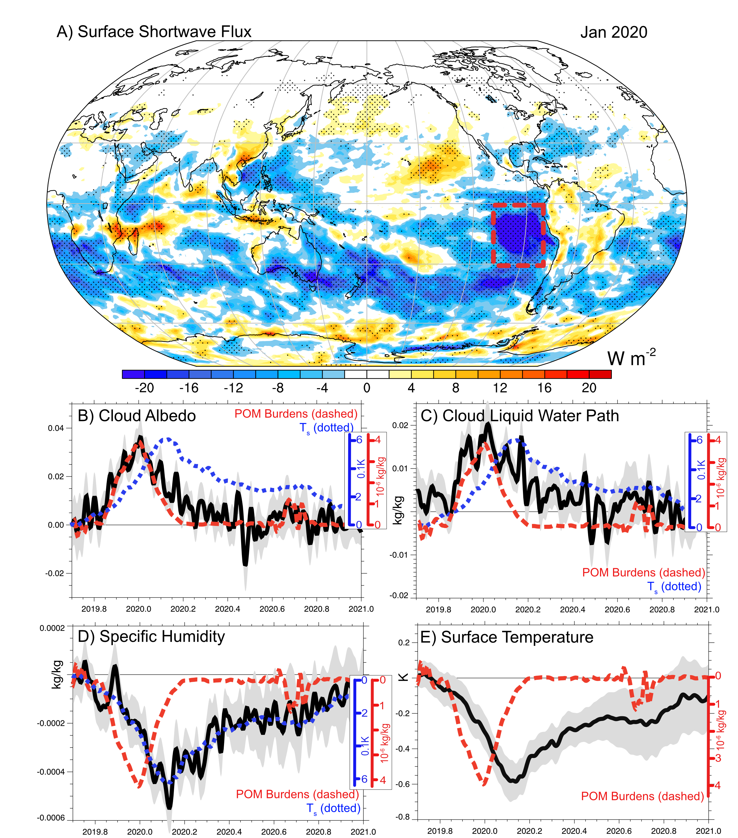
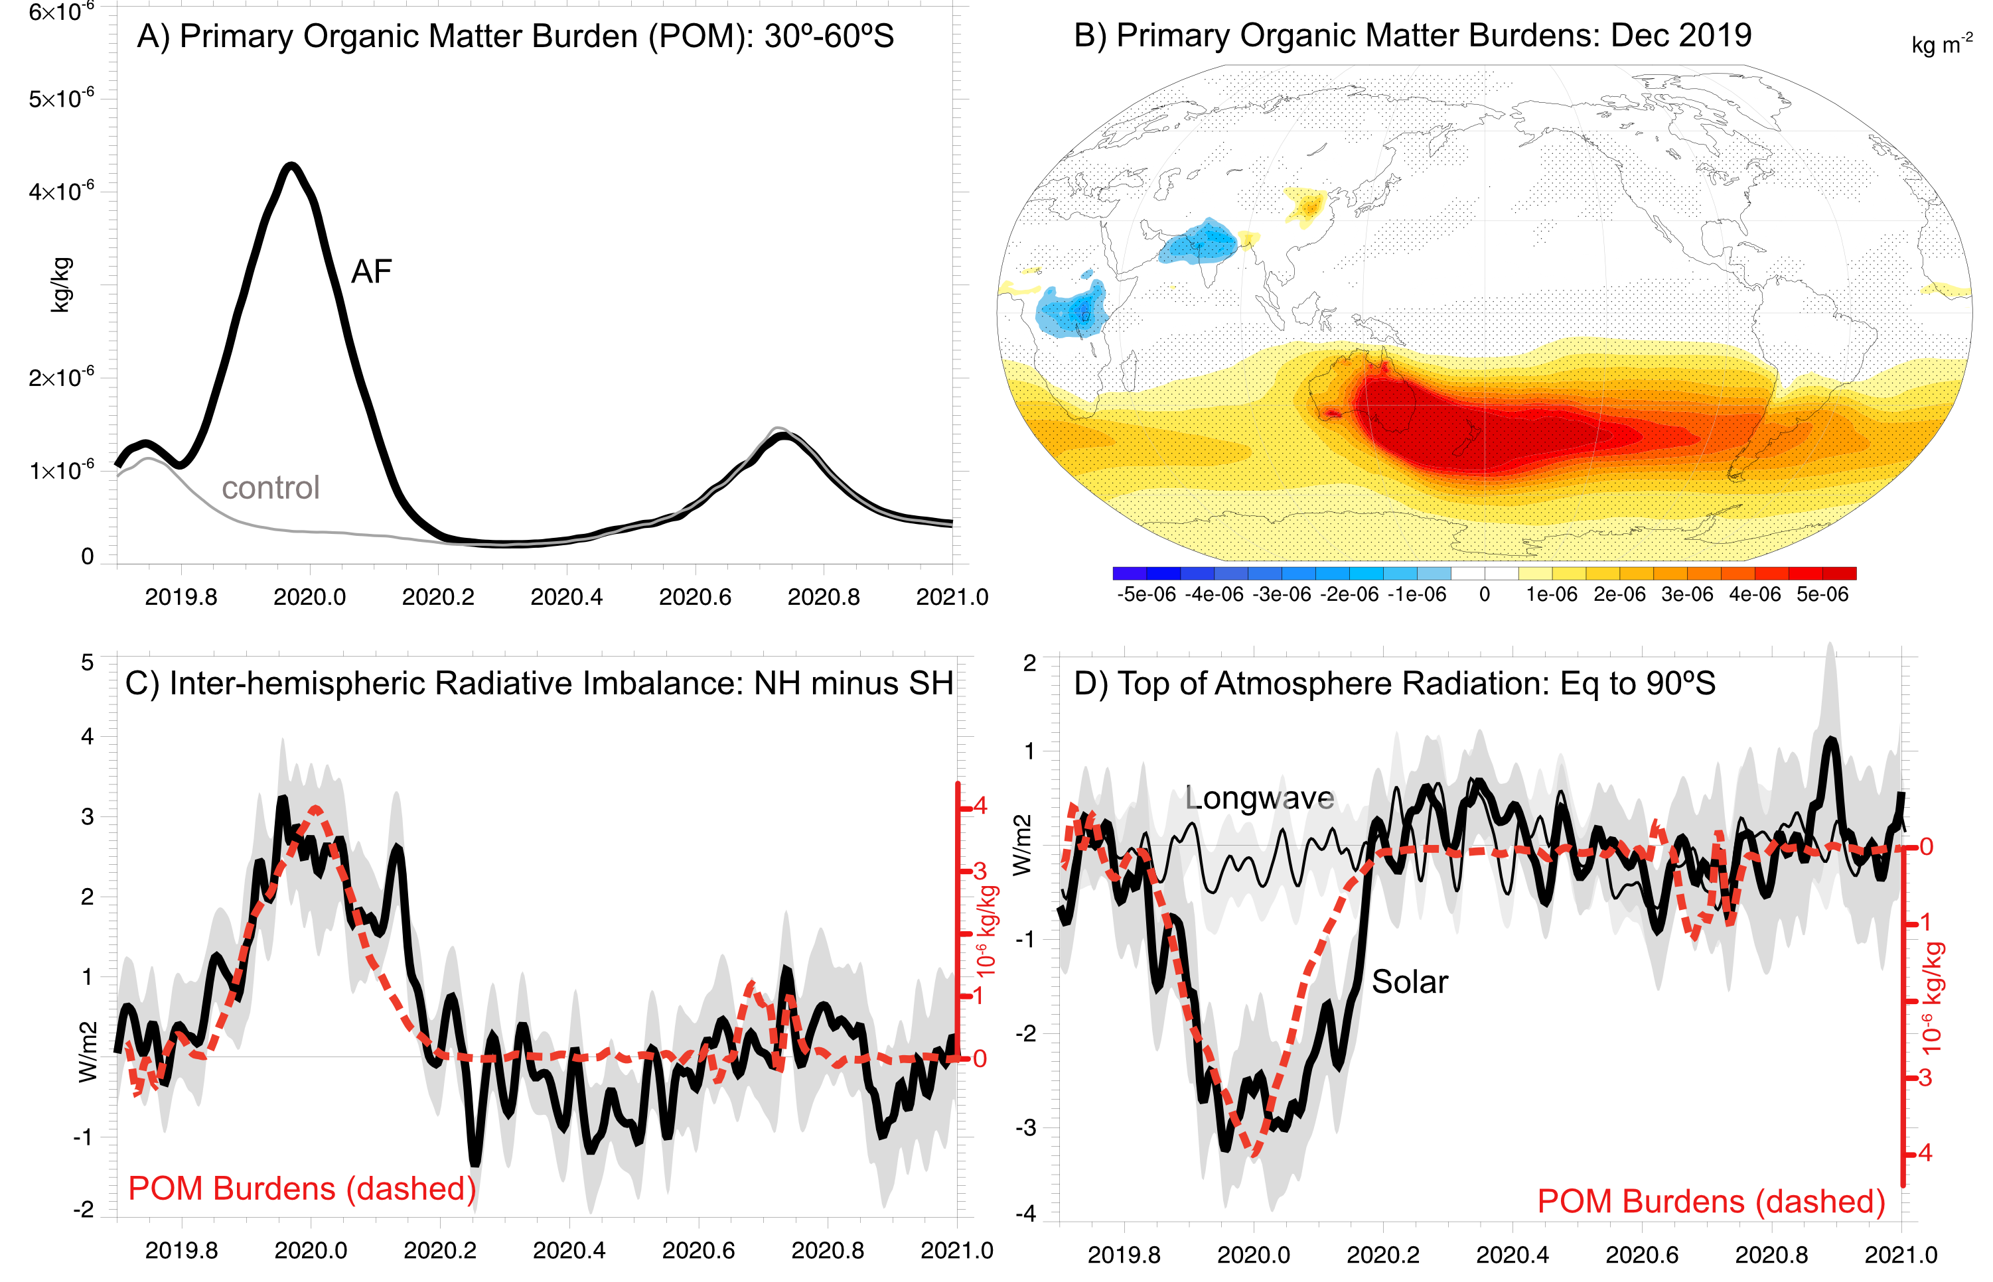
Large-Scale Responses
Eastern Pacific Responses

Slide 3
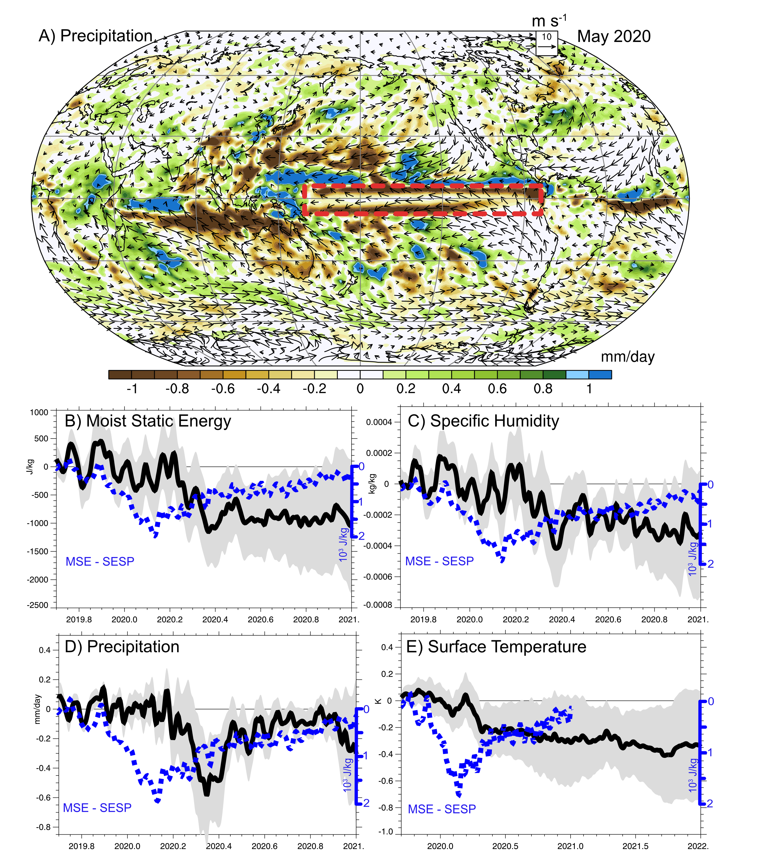
Equatorial Pacific Responses

