Slide 1
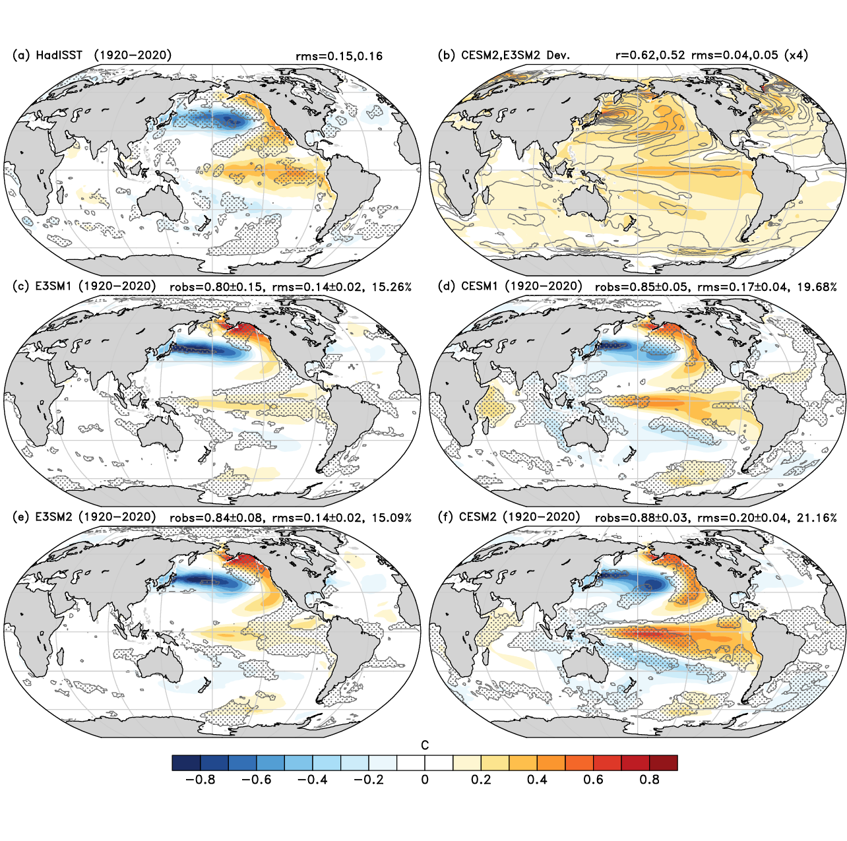
Modes of Variability in E3SM and CESM Large Ensembles
Fasullo, J. T., Caron, J. M., Phillips, A., Li, H., Richter, J. H., Neale, R. B., ... & Arblaster, J. (2024), Modes of Variability in E3SM and CESM Large Ensembles, J. Clim., doi: 10.1175/JCLI-D-23-0454.1.
OBJECTIVE
Large ensembles provide a unique opportunity to assess climate model fidelity in simulating modes of variability and forced responses. In this work, we assess a broad range of modes in the E3SM and CESM versions 1 and 2 large ensembles.
Pacific Decadal Oscillation
Patterns of sea surface temperature variability associated with the Pacific Decadal Oscillation in HadISST (a), E3SM v1(c) and v2(e), and CESM v1(d) and v2(f). Also shown is the inter-member spread from CESM2 (b). Regions where the observed pattern lies outside of the model ensemble are stippled.
APPROACH
We use the recently developed NCAR Climate Variability Diagnostics Package for Large Ensembles and other approaches to account for forced patterns of change and and diagnosis the present-day simulation of the major modes of climate variability.
IMPACT
The analysis reveals 1) the large intrinsic variability of a range of modes across models, 2) the canonical patterns of modes for each model and 3) their respective biases relative to best estimates from observations. As an example, we show the skill of models in simulating the Pacific Decadal Oscillation (figure), which is high in the North Pacific for all models but weak in the Tropics for some models. Biases in E3SM v1 and v2 are characterized by an underestimation of variability in the Tropics and Southern Hemisphere (stippled). A similar characterization of model strengths and weaknesses is presented for a broad range of modes across spatial domains and time scales, allowing users of these ensembles to assess their suitability for a range of applications. Improvement across model generations is identified.

Slide 2
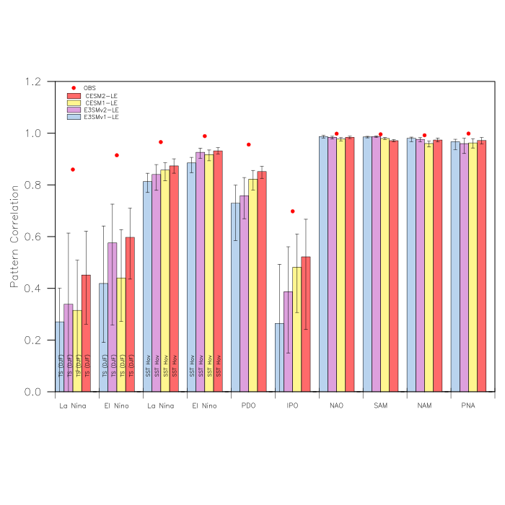
Intrinsic Noise Across Modes:
Ensemble correlations of mode patterns (bars) and their spread across members (whiskers).
Finding: The atmospheric modes have intrinsically high correlations and low spread whereas the coupled modes, and particularly the IPO and seasonal ENSO TS regressions have very low correlations and large spread.
Figure 1: Estimated mode fidelity in E3SM and CESM versions and their robustness in observations. Bars show the mean pattern correlation of various simulated modes of variability for each ensemble versus observed estimates.

Slide 3
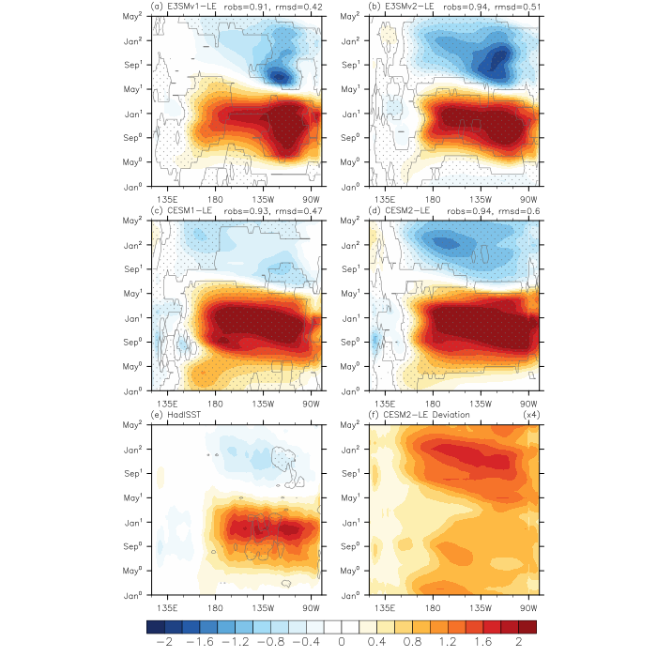
El Niño Time-Space Evolution:
Composite evolution of zonal mean surface temperature anomalies from 5N-5S for El Niño Events in E3SM v1(a) and v2(b), and CESM v1(d) and v2(e). Also shown is the observed composite from 1920-2020 (e) and an estimate of ensemble spread from CESM2 (f).
Finding: E3SM v1 and v2 have a strongly biennial ENSO, with an excessive tendency for La Niña to follow El Niño, whereas power in the Niño3.4 region is too strong in CESM. Improvements in the zonal structure of anomalies from E3SM v1 to v2 are also evident.
Figure 7: Ensemble-mean composite El Niño surface temperature hovmoëllers (5N-5S) from the E3SMv1 (a), E3SMv2 (b), CESM1 (c), and CESM2 (d). Also shown are anomalies from HadISST (e) and the standard deviation across ensemble members for CESM2 (f).

