Slide 1
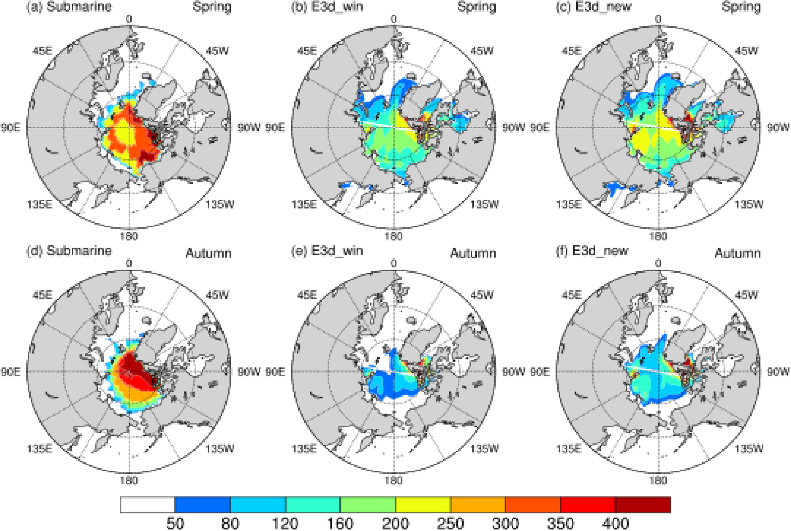
A Modified Thermodynamic Sea Ice Model and its Application
Objective: The original Winton’s three-layer sea ice cannot represent the vertical sea ice thermodynamics well. Here by adding an additional layer and including snow heat capacity, vertically varying sea ice salinity, and a temperature and salinity dependent heat conductivity, we show an improved representation of the sea ice process in simulating sea ice characteristics.
Approach: aims to improve the performance of the sea ice model used in MOM4. By adding an additional sea ice layer and a few improvement in model physics, we show improved performance of the model in simulating the sea ice properties.
Results/Impacts: This paper presents a modified thermodynamic sea ice model based on the Winton’s three-layer model framework. Several improvements focused on the vertical thermodynamics have been made in the model. Results from a series of one-dimensional experiments show that equilibrium ice thickness in our modified model is increased by about 45 cm when compared with the original Winton’s model. Sensitivity tests indicate that all modifications mentioned above contribute to this change of ice thickness, among which the increase of ice layer has the most significant effect followed by the sea ice conductivity parameterization. The modified thermodynamic sea ice model is then coupled into the sea ice component SIS in GFDL MOM4 to exert long-term integration experiments forced by CORE2.0 data. Results indicate that the modified model shows significant improvement in simulating the Arctic sea ice, including an increase in both the sea ice thickness and volume over the whole Arctic region. This confirms the above founding from 1-D simulations.
Figure 1. Arctic ice thickness (unit: cm) in (a, b, c) spring and (d, e, f) autumn from (a, d) Submarine, (b, e) E3d_win, and (c, f) E3d_new.
Fang, Y., T. Wu, and A. Hu, M. Chu, 2022, A Modified Thermodynamic Sea Ice Model and its Application, Ocean Modelling, 178, 102096.

