Slide 1
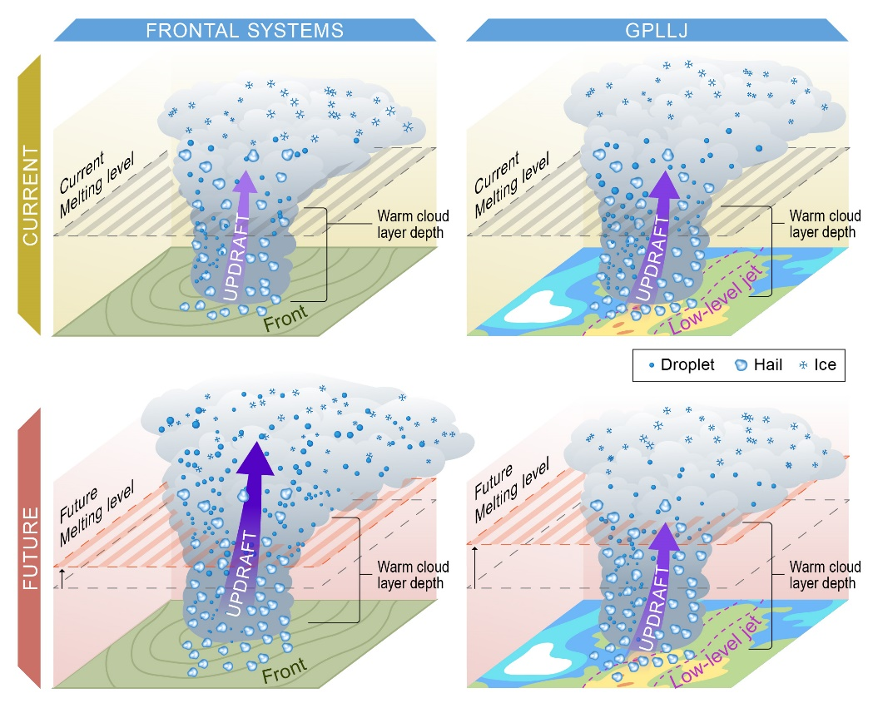
How Do Hailstorms Respond to a Warmer Future?
Objective
Explore how typical hailstorms in Great Plains change by mid-century under the business-as-usual (high-end) anthropogenic emission scenario.
Approach
Employ the Weather Research and Forecasting Model to simulate two typical types of hailstorm cases in Great Plains at 1.2 km grid spacing.
Use the pseudo-global warming methodology to simulate typical storms in the environment determined from global models under anthropogenic warming.
Impact
Large hail in two types of hailstorms that occur in different synoptic-scale weather systems have contrasting responses to anthropogenic warming.
There is a large increase in large hail occurrences for hailstorms under frontal systems and a small increase for those under the Great Plains low-level jet (GPLLJ) systems.
This study advances scientific knowledge of hailstorm predictability in future scenarios, with important implications for risk management.
The results present an important concept connecting hail predictability with synoptic scale systems, which can be used to study climate change impacts in other hail-prone regions.
Occurrences of large hail notably increase in the future climate (bottom) from the current (top) climate in frontal systems (left), mainly due to the enhanced convective intensity and updraft width (purple arrow). Occurrences of large hail for GPLLJ storms (right) are not sensitive to anthropogenic warming because of a very small change in the convective intensity and width as well as a larger increase in warm cloud depth.
J. Fan, Y. Zhang, J. Wang, J.-H. Jeong, X. Chen, S. Zhang, Y. Lin, Z. Feng, R. Adams-Selin. “Contrasting Responses of Hailstorms to Anthropogenic Climate Change in Different Synoptic Weather Systems,” Earth’s Future, 10, e2022EF002768 (2022). [DOI: 10.1029/2022EF002768]
Notes:
http://www.pnnl.gov/science/highlights/highlights.asp?division=749

