Slide 1
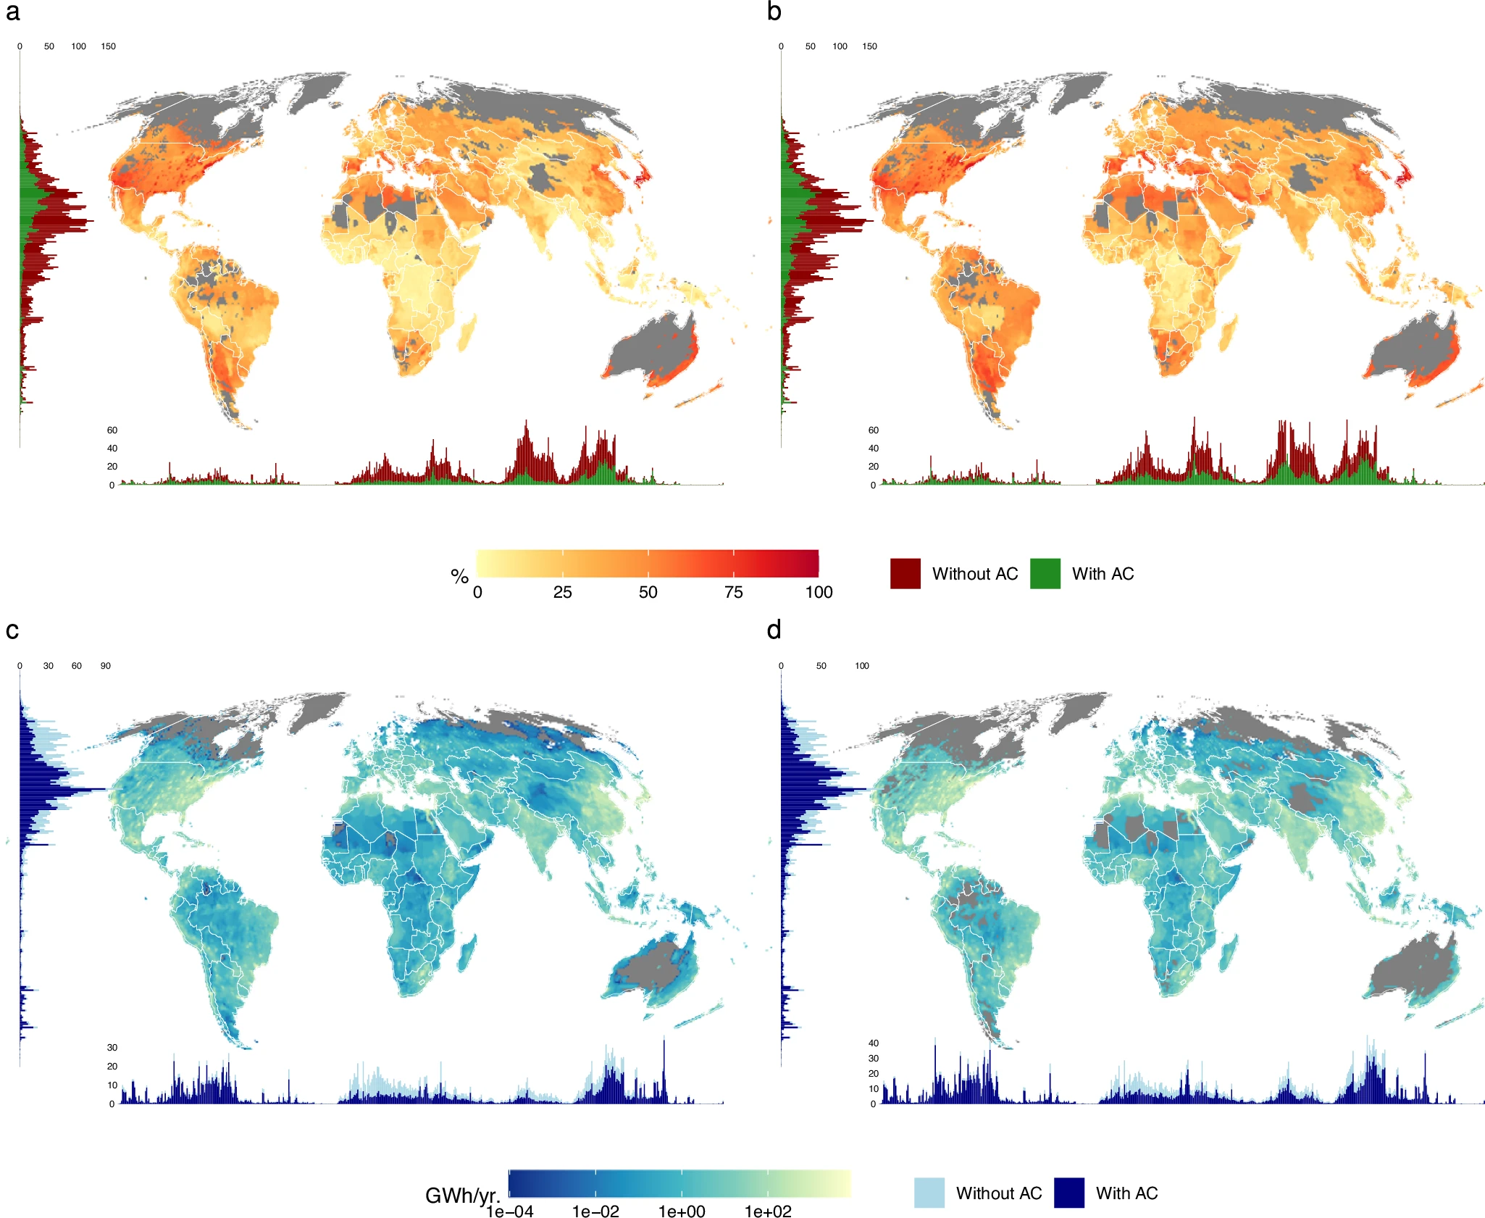
Inequalities in global residential cooling energy use to 2050
Objective
Climate change-driven warming will incentivize household adaptation to increasing heat exposures. Air conditioning (AC) is the main technology for indoor cooling that is widely available at large scale, but household adoption of AC and utilization via consumption of electricity for cooling are constrained by income and adaptive capacity. We project, globally at fine spatial resolution, how high temperatures, income and demographic factors combine to determine AC prevalence and cooling electricity use in current and mid-century climates, and assess the implications for energy demand and greenhouse gas emissions.
2020
2050 SSP245
AC Prevalence
Approach
Using a large dataset of household surveys across 25 countries, we empirically model residential AC ownership, and, conditional on AC adoption, household cooling electricity demand. We use the fitted statistical models to quantify the responses of future AC prevalence and associated residential electricity consumption to income growth, demographic changes and increasing ambient temperatures associated with warming pathways to 2050.
Electricity for Cooling
Impact
Worldwide, AC prevalence could grow from 27% to 33-48%, doubling residential cooling electricity demand from 1220 to 1590-2377 TWh/year, while emitting between 590 and 1,365 million tons of CO₂. AC ownership and utilization are both regressive, and remain highly unequal within and across countries and income groups: by 2050 up to 4 billion people may lack access to cooling. Our global gridded projections facilitate incorporation of cooling adaptation’s effects on energy markets, health, and decarbonization into integrated assessment research.
Figure: Maps and bar charts of (a, b) AC ownership (% and count of households) and (c, d) household AC electricity consumption (GWh/y and TWh/y), current climate (2020) and 2050, shared socioeconomic pathway scenario 245. Results are shown for the median of 14 Coupled Model Intercomparison Project Phase VI (CMIP6) global climate models.
Falchetta G, De Cian E, Pavanello F, Sue Wing I (2024). Inequalities in global residential cooling energy use to 2050, Nature Communications 15: 7874. https://doi.org/10.1038/s41467-024-52028-8

