Slide 1
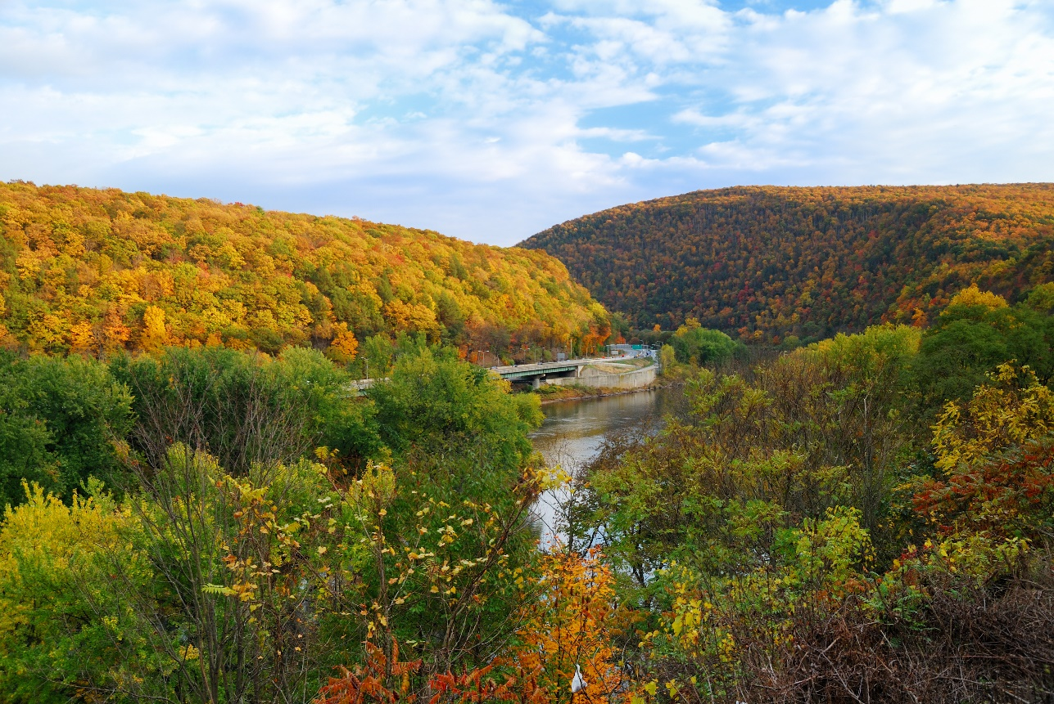
New universal model for multi-scale hydrologic flow routing
Objective
Develop a flow direction model that produces high-quality flow routing parameters in any mesh system.
Approach
Develop a topological relationship-based stream-burning method.
Develop an advanced depression-filling method that is consistent with the stream-burning results.
Evaluate model performance under multiple configurations and observational inputs.
Impact
The first-of-its-kind flow direction model supports both structured and unstructured meshes.
Close the gap for river components in existing Earth system models by supporting all unstructured meshes.
This research closes the gap for supporting river components by enabling the use of all mesh, paving the way for variable resolution mesh-based flow routing in Earth system modeling.
Liao, C., Zhou, T., Xu, D., Tan, Z., Bisht, G., Cooper, M. G., et al. 2023. ”Topological relationship-based flow direction modeling: Stream burning and depression filling.” Journal of Advances in Modeling Earth Systems. 15, e2022MS003487. https://doi.org/10.1029/2022MS003487
Notes:
http://www.pnnl.gov/science/highlights/highlights.asp?division=749

