Slide 1
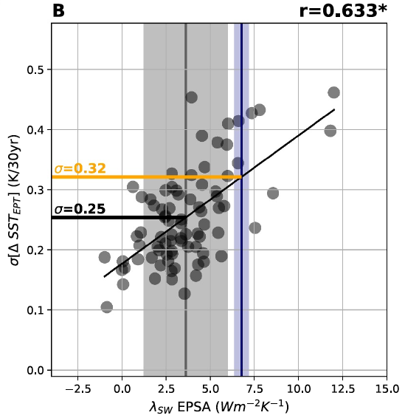
Evaluating Cloud Feedback Components in Observations and
Their Representation in Climate Models
Science Question
Do climate models underestimate unforced variability in tropical Pacific sea surface temperatures (SSTs)?
If so, is it related to biases in cloud feedbacks?
Key Accomplishments
The team found that models disagree substantially on the strength of decadal SST variability, and that it is correlated with the strength of the interannual cloud feedback across models.
Cloud radiative feedbacks amplify multidecadal Pacific sea surface temperature trends by impacting circulation and surface energy fluxes.
Impact
The team found that most models underestimate the cloud feedback, implying that they also underestimate decadal SST variability (see figure).
Correcting this model bias raises the likelihood of internally producing Southeast Pacific cooling as large as has been observed in nature over recent decades.
Standard deviation of 30‐year SST trends in the Eastern Tropical Pacific in each CMIP model scattered against the corresponding interannual shortwave cloud feedback in the Eastern Pacific. Vertical blue line and shading represents the cloud feedback estimate from observations.
Espinosa, Z. and M. D. Zelinka, 2024: The Shortwave Cloud-SST Feedback Amplifies Multi-Decadal Pacific Sea Surface Temperature Trends: Implications for Observed Cooling, Geophys. Res. Lett., 51, doi:10.1029/2024GL111039.
Notes:
The Science
Scientists at PCMDI and University of Washington assessed the magnitude of inter-decadal sea surface temperature (SST) variability in the tropical Pacific ocean in climate model simulations of unforced natural variability. Models disagree substantially on the strength of this variability, and the team showed that this is correlated with the strength of the interannual cloud feedback. In other words, cloud radiative feedbacks amplify multidecadal Pacific sea surface temperature trends by impacting circulation and surface energy fluxes.
The Impact
The emergent relationship between decadal SST variance and short-term cloud feedback, combined with observed estimates of cloud feedback in response to interannual fluctuations, allows for an observational constraint. The team found that most models underestimate the cloud feedback, implying that they also underestimate decadal SST variability. Correcting this model bias raises the likelihood of internally producing Southeast Pacific cooling as large as has been observed in nature over recent decades.
Summary
Climate models struggle to produce sea surface temperature (SST) gradient trends in the tropical Pacific comparable to those seen recently in nature. Here, we find that the magnitude of the cloud‐SST feedback in the subtropical Southeast Pacific is correlated across models with the magnitude of Eastern Pacific multidecadal SST variability. A heat‐budget analysis reveals coupling between cloud‐radiative effects, circulation, and SST gradients in driving multi‐decadal variability in the Eastern Pacific. Using this relationship and observed feedback estimates, we find that internal Eastern Pacific SST variability is underestimated in most models. Adjusting for model bias increases the likelihood of generating a cooling trend at least as large as observations in preindustrial control simulations by ∼56% on average. If models underestimate climate “noise,” as our results suggest, this bias should be accounted for when attributing the relative importance of forced versus unforced changes in the climate.

