Slide 1
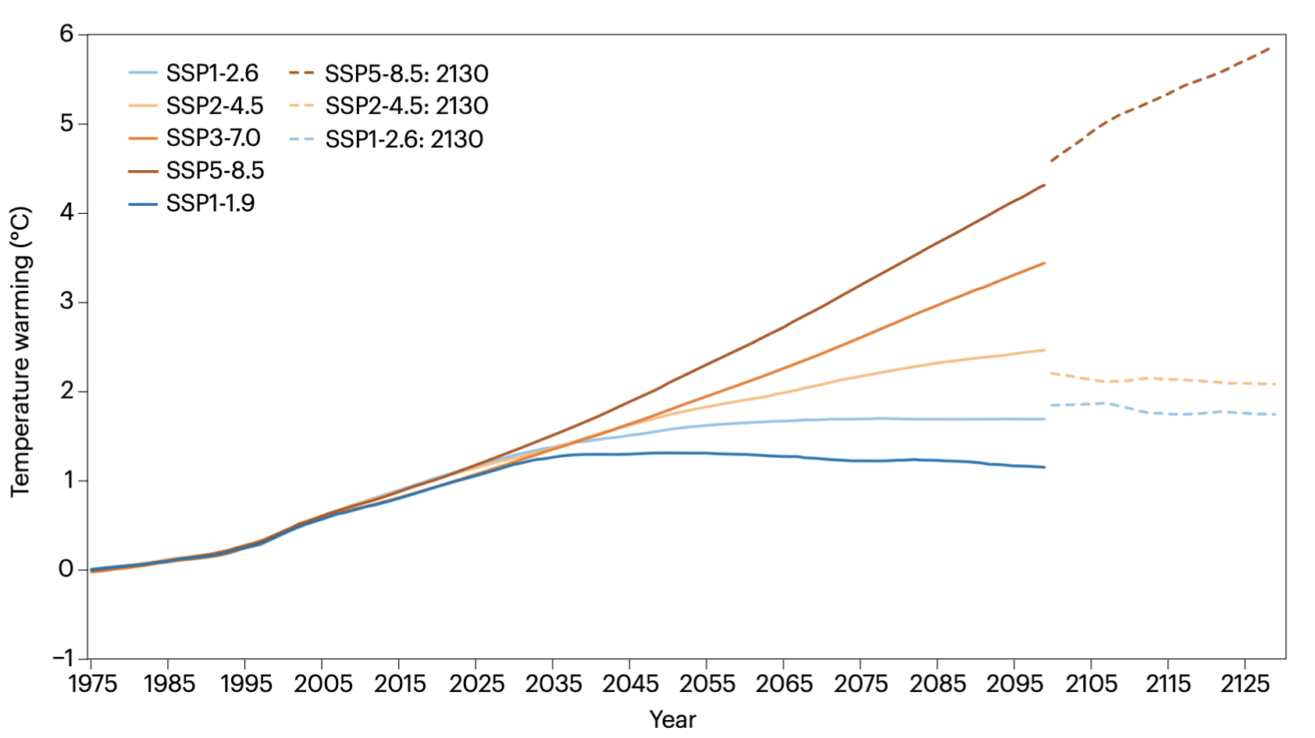
Long-term planning requires climate projections beyond 2100
For some time now, climate scenarios that ran to the end of the century were aimed sufficiently far enough in the future to define long-term climate risks and set international emissions targets. Time has since advanced, while our modeling projection time horizons have not. The projections that were once considered outcomes our grandchildren might face now describe the potential futures of children born today.
There are a wide variety of needs and uses for true century-scale climate projections. These needs include activities such as community planning, forestry and even legal requirements for climate assessments. While there are ample projections to mid-century (now 25 years away), there is a profound lack of climate projections 100 years into the future.
Time series of multi-model averages of mean annual temperature anomalies to 2130 (relative to 1951–1980) for the United States. Forcing scenarios include SSP1-1.9, SSP1-2.6, SSP2-4.5, SSP3-7.0 and. The discontinuities in the time series after 2100 are due to the drastic decrease in the number of available models.
We are now nearing 75 years from the turn of the century. The existing suite of long-term projections, which typically run to the year 2099 or 2100, are insufficient to understand and plan for impacts on key sectors and industries, such as agriculture and forestry, water resource planning, and energy infrastructure.
David R. Easterling, Kenneth E. Kunkel, Allison R. Crimmins, Michael F. Wehner (2024) Long Term Planning Requires Climate Projections Beyond 2100, Nature Climate Change. https://www.nature.com/articles/s41558-024-02085-0

