Slide 1
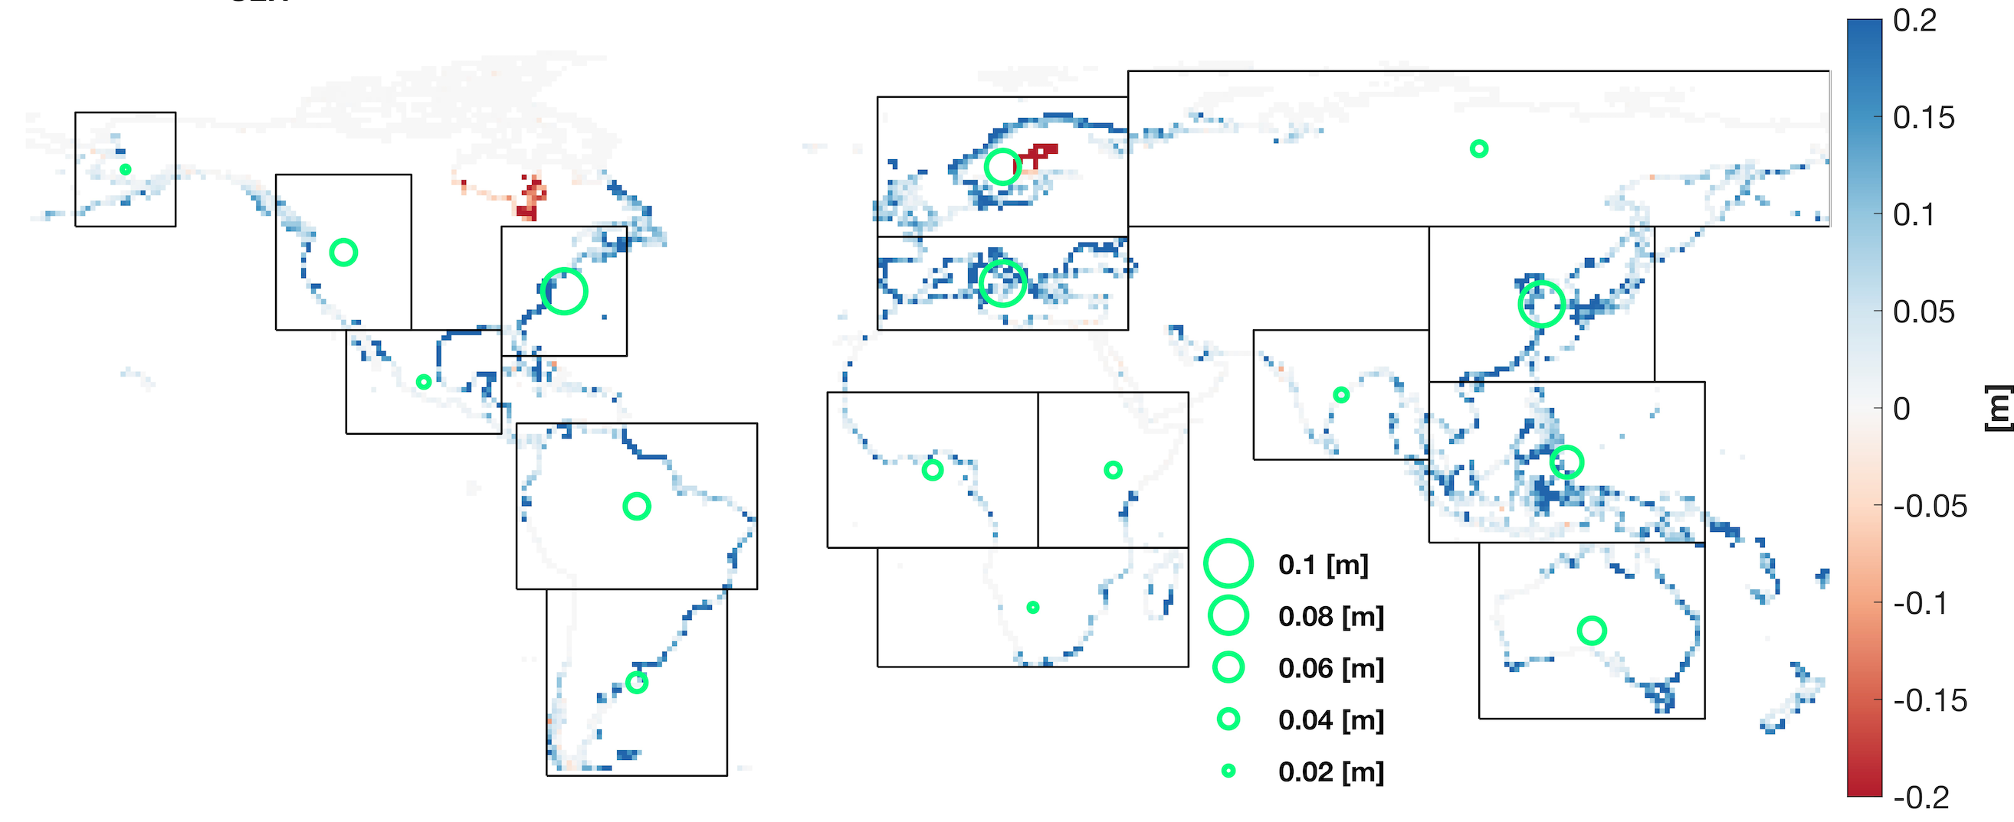
Earth System Model Simulates a Raised Coastal Groundwater Table Caused by Sea-Level Rise
Objective
Evaluate the impacts of sea-level rise on coastal groundwater systems at global scales.
Approach
Use a bathtub model to estimate coastal inundated areas caused by sea-level rise.
Develop a land–ocean coupling scheme in the Energy Exascale Earth System Model (E3SM), including seawater infiltration and lateral exchange.
Use a random forest regression method to uncover the driving factors for the land–ocean coupling process.
Impact
Sea-level rise is projected to raise the coastal groundwater table at global scales.
Results from the coupled model indicate that seawater infiltration from the inundated areas dominates the land–ocean coupling process.
Changes in the groundwater table induced by sea-level rise. The green circles represent the median changes for the black boxes. A positive change means a rise in the groundwater table.
Xu, D., Bisht, G., Feng, D., Tan, Z., Li, L., Qiu, H., & Leung, L. R. (2024). “Impacts of sea-level rise on coastal groundwater table simulated by an Earth system model with a land-ocean coupling scheme.” Earth’s Future, 12, e2024EF004479. [DOI: 10.1029/2024EF004479]

