Slide 1
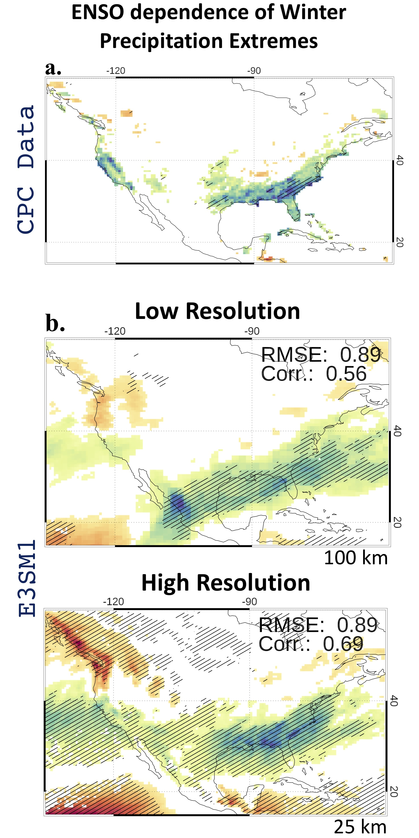
Simulation of Diverse ENSO Teleconnections to Extremes in High Resolution Earth System Models
Objective: Evaluate high resolution (< 50km horizontal resolution) models for their simulation of ENSO diversity and its teleconnections to US winter season precipitation extremes.
New Science: We use the ENSO longitudinal index (ELI) as a measure of ENSO’s spatial diversity. Generalized extreme value modeling is applied to quantify teleconnections of extremes to ELI in historical simulations with seven high resolution models including DOE’s E3SMv1 and E3SMv2.
Results/Impacts: High resolution models credibly capture diverse ENSO teleconnections as observed over Southeast and Southwest US. High resolution models are generally found to improve upon their low-resolution counterparts. This is due to the improved simulation of ENSO dependent moisture transport, storm track activity and vertical mass fluxes. Our results suggest that using high resolution models can enhance seasonal forecasting of regional water cycles.
Precipitation extremes response to ENSO Longitudinal Index in CPC data and low- and high-resolution version of DOE’s E3SMv1. Note the improvement over Southeast and Southwest US in the high-resolution model. Six other high-resolution models show similar improvements over their low-resolution configurations.
Publication: Mahajan, S., L. Passarella, Q. Tang, N. Keen, P. Caldwell, L. van-Roekel and C. Golaz (2023): ENSO diversity and the simulation of its teleconnections to winter precipitation extremes in high resolution Earth System Models, Geophysical Research Letters, 50, e2022GL102657. https://doi.org/10.1029/2022GL102657

