Slide 1
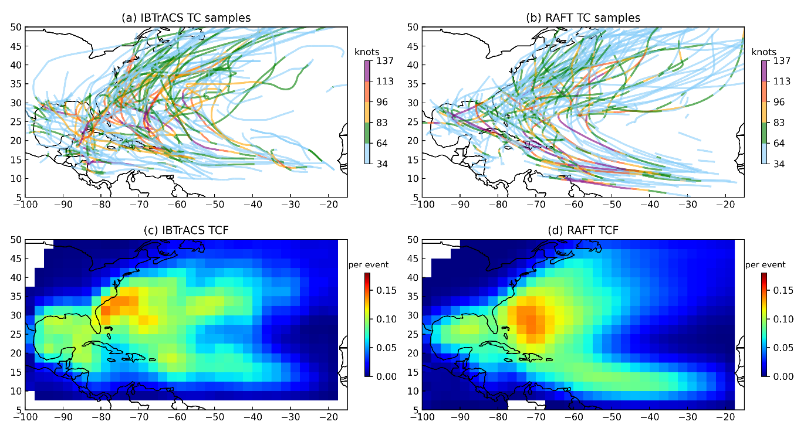
edited
Researchers Develop Groundbreaking Synthetic Database of Tropical Cyclone Events
Objective
Develop a comprehensive database of synthetic tropical cyclones using advanced artificial intelligence (AI), enhancing our ability to assess and prepare for the risks associated with tropical cyclone wind and rainfall in the North Atlantic.
Approach
Refining the Risk Analysis Framework for Tropical Cyclones (RAFT) and leveraging sophisticated AI, led to the creation of a synthetic database that includes 40,000 tropical cyclones, each detailed with their individual tracks, intensities, and precipitation patterns.
Conducting thorough validations to ensure that the synthetic database accurately reflects historical behavior and patterns.
Making the database user-friendly and publicly available for wider use and application.
Impact
Addressed the challenge of sparse historical data on tropical cyclones, enhancing capabilities in disaster preparedness and climate risk evaluation.
Pioneered the use of advanced AI to create a comprehensive synthetic database of tropical cyclones, detailed with track patterns, strength metrics, and precipitation data.
Offers a tool for tropical cyclone risk prediction and mitigation with broad sectoral applications, notably in urban and infrastructure planning as well as in the insurance industry.
PNNL's RAFT has produced 40,000 synthetic storm events, accurately emulating the dynamics of North Atlantic tropical cyclones. Panels (a) and (b) display a random selection of 200 storm samples, comparing observed data to model simulations, whereas panels (c) and (d) illustrate the density distribution.
Xu, W., Balaguru, K., Judi, D. R., Rice, J., Leung, L. R., & Lipari, S. (2024) “A North Atlantic synthetic tropical cyclone track, intensity, and rainfall dataset.” Sci Data 11, 130. [DOI: 10.1038/s41597-024-02952-7]
Notes:
http://www.pnnl.gov/science/highlights/highlights.asp?division=749

