Slide 1
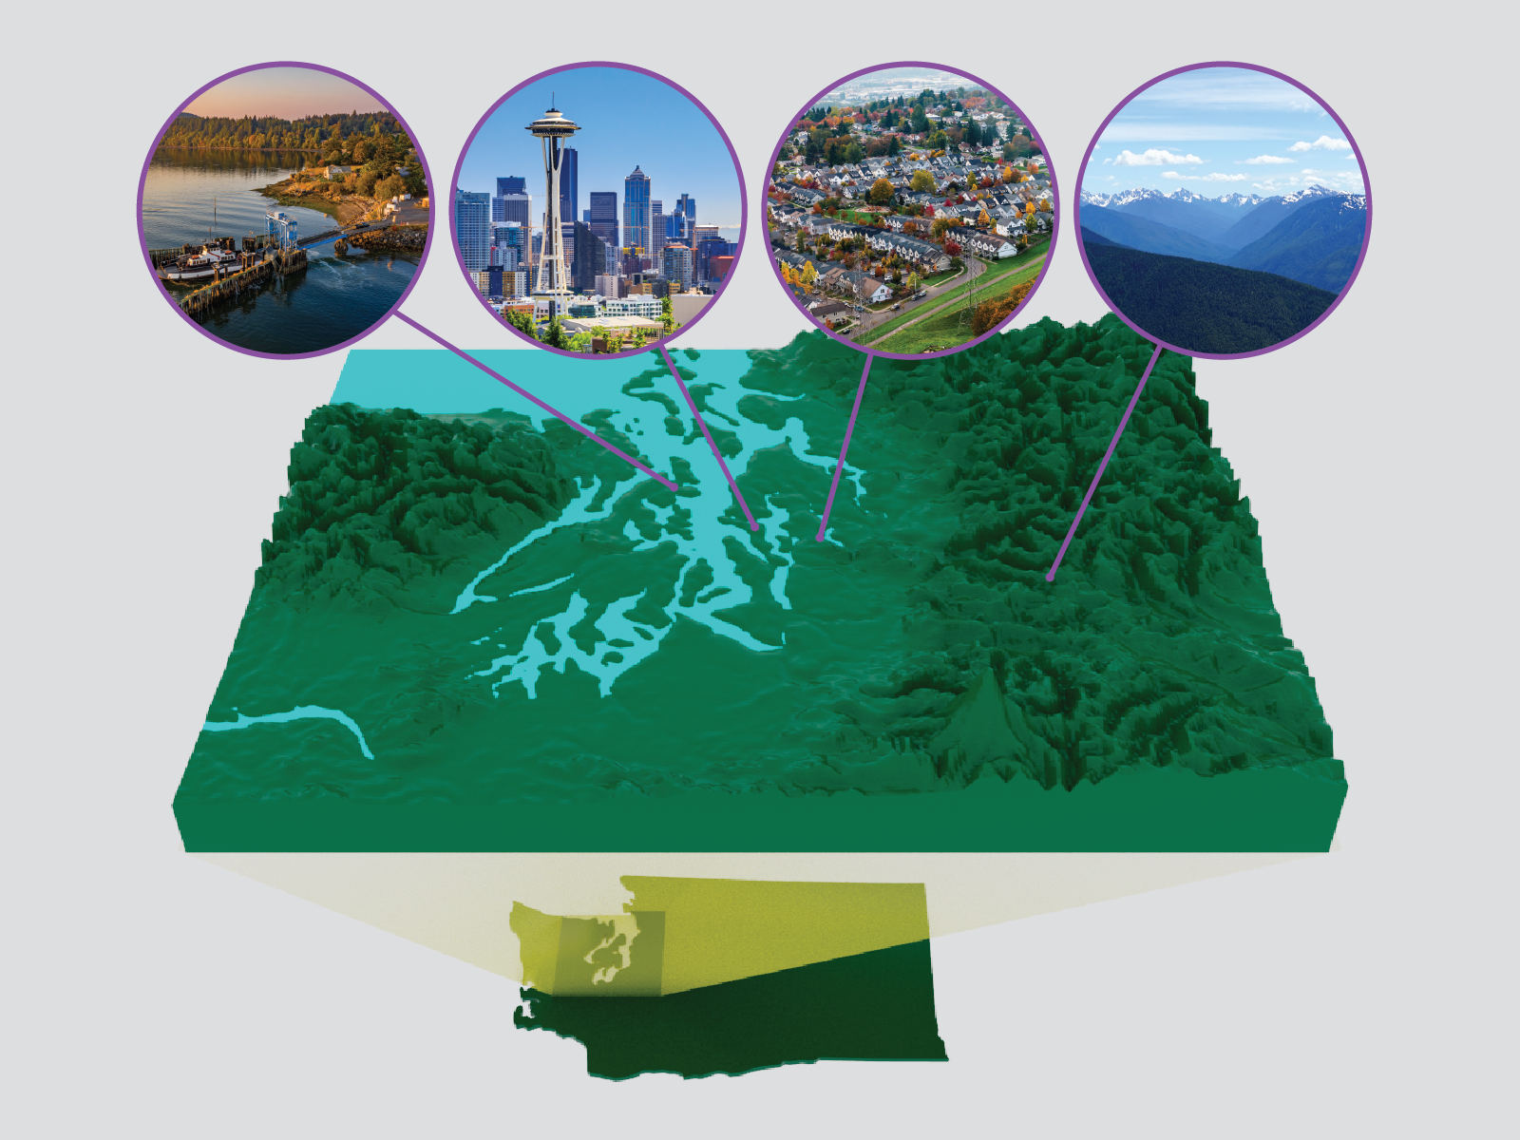
Exploring Multiscale Earth System and Human–Earth System Dynamics in the Puget Sound Region
Objective
Perform a 1-year scoping study to elucidate and highlight the rich opportunities Puget Sound offers to advance scientific understanding of and the ability to simulate Earth system changes and human–Earth system interactions.
Approach
Review over 200 studies from the scientific literature.
Engage with external input, including an assembled science committee.
Convene a multiday community workshop with local and extra regional experts.
Produce a report that represents an obtained community consensus.
Impact
Established scientific understanding associated with regional extreme events as well as major regional Earth and human systems, including how these systems interact and change over time.
Identified knowledge gaps and key research opportunities for Earth and environmental systems modeling in, above, and around Puget Sound.
One of the research directions is a typology of human system processes and their interactions with Earth systems for accelerating a research-to-operations-to research paradigm.
The Puget Sound region presents opportunities to explore a variety of natural and human system processes and interactions shaped by complex geographic, hydroclimatic, and landscape characteristics.
Voisin, Nathalie, Rose, Deborah J., Broman, Daniel P., Sun, Ning, and Kraucunas, Ian P. “Exploring Multiscale Earth System and Human-Earth System Dynamics in the Puget Sound Region.” United States: N. p., 2023. Web. doi:10.2172/1906804. PNNL-33801.

