Slide 1
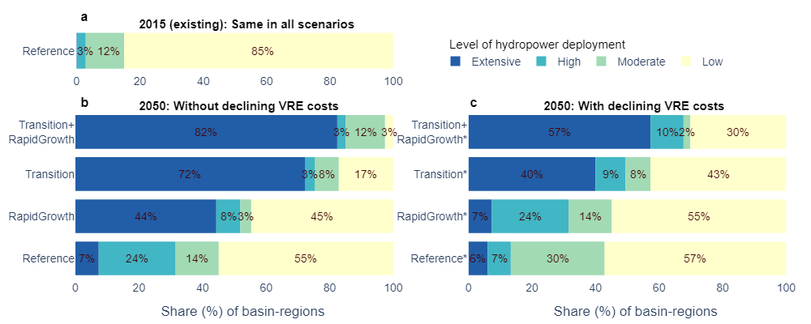
Major Eco-sensitive Rivers Could See Substantial Hydropower Expansion in a Growing and Transitioning Energy System
Objective
This study investigated how hydropower may evolve in the world’s top 20 eco-sensitive river basins under major energy-economic changes, including rapid economic growth, a transitioning energy system, and a rapid decline in the costs of variable renewable energy (VRE).
Approach
First, we identified the top 20 eco-sensitive basins by deriving an eco-sensitivity rank based on four basin-scale parameters, namely, untapped hydropower potential, planned hydropower capacity, fish species richness, and annual fish catch.
Then, we used the Global Change Analysis Model (GCAM) to evaluate hydropower development under eight scenarios comprising different combinations of drivers, including rapid economic growth, rapid decline in VRE costs, and a transition to a lower-carbon energy system.
Impact
We show that higher deployment of VRE can partially offset hydropower expansion, but it is mostly insufficient to offset demand increases in the energy transition scenarios, especially in the Global South.
Our balanced, multi-sector perspective explores multiple forces that could shape hydropower expansion. This work could inform hydropower development by quantifying the tradeoffs between meeting energy demands and conservation of rivers’ biodiversity and ecosystem services.
Over 72% of the eco-sensitive basins could see substantial hydropower expansion by 2050 under scenarios with a transitioning energy system. Such effects could be seen in 44% of the basins under rapid economic growth. A higher level of deployment of VRE could partially reduce the future expansion, but it would not completely offset the hydropower growth seen in the energy transition scenario.
Chowdhury, AK, Wild, TB, Zhang, Y., Binsted, M., Iyer, G., Kim, S., and Lamontagne, J. (2024). Hydropower expansion in eco-sensitive river basins under global energy-economic change. Nature Sustainability. DOI: https://doi.org/10.1038/s41893-023-01260-z
Notes:
http://www.pnnl.gov/science/highlights/highlights.asp?division=749

