Slide 1
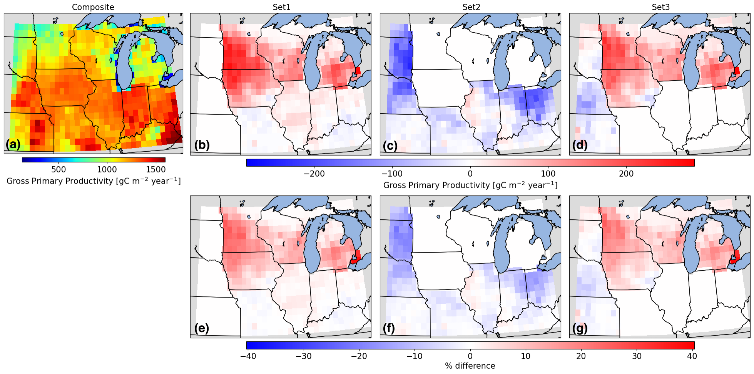
Modeling Agriculture Matters for Carbon Cycling
Objective
Understand how using constant versus spatially varying crop parameters affects carbon and energy fluxes in a realistic crop-rotation scenario in an Earth system model.
Approach
Enhanced the crop modeling capability of the Energy Exascale Earth System Model land component version 2 (ELMv2) by implementing corn and soybean rotation in ELM.
Calibrated and validated the model using observational data from multiple sites.
Quantified the impact of different parameterization schemes on the carbon and energy fluxes in a simulation of North America.
Impact
Spatially varying crop parameters can have a large impact on flux estimation from agricultural land in ELM.
Carbon and energy fluxes can vary by up to 40% when using spatially varying parameters as opposed to constant parameters.
Implementing crop rotation and calibrating crop parameters can improve estimation of site-level fluxes, providing a more realistic picture of agricultural processes.
The use of spatially varying as opposed to constant crop parameters can have a large impact on carbon fluxes. The top left sub-panel shows gross primary productivity simulated based on spatially varying parameters. The rest of the sub-panels show the difference (top row) and percent difference (bottom row) between gross primary productivity simulated using spatially varying and constant parameters.
Sinha, Eva, Ben Bond‐Lamberty, Katherine V. Calvin, Beth A. Drewniak, Gautam Bisht, Carl Bernacchi, Bethany J. Blakely, and Caitlin E. Moore. "The Impact of Crop Rotation and Spatially Varying Crop Parameters in the E3SM Land Model (ELMv2)." Journal of Geophysical Research: Biogeosciences, e2022JG007187 (2023). [DOI: 10.1029/2022JG007187]

