Slide 1
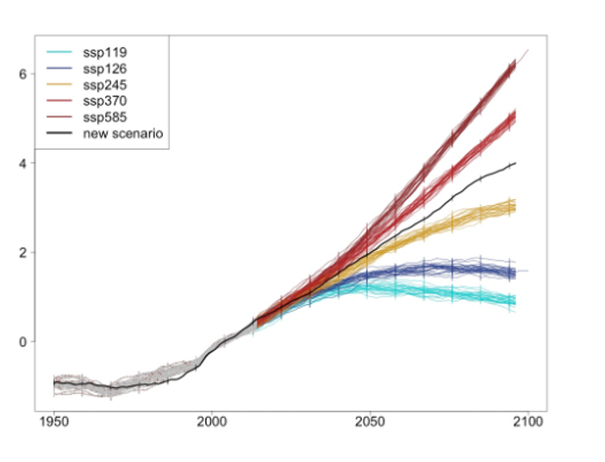
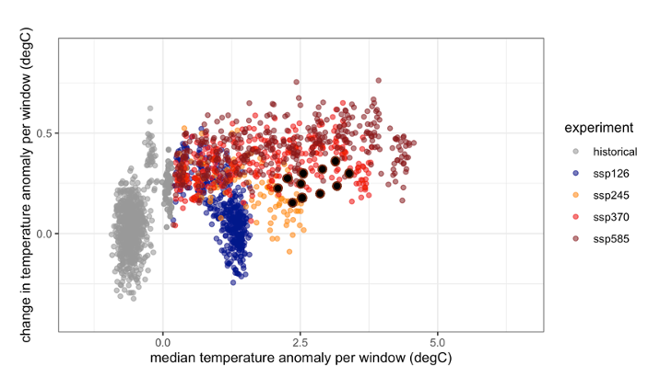
STITCHES: A comprehensive solution to climate model output emulation
Objective
Develop a computationally efficient and fast emulator that preserves the temporal resolution, spatial resolution, and joint coherence of multiple variables of climate model output for use in integrated modeling studies of impacts and mitigation under arbitrary target scenarios.
Approach
Use existing archived simulations, rather than estimating the distributional characteristics of their output, as building blocks to emulate climate models.
Identify a sequence of experiment-time-window combinations from existing scenario runs that recombined (STITCHED TOGETHER) have the same behavior of a specific scenario.
Map sequences according to global temperature (GSAT) behavior, as all variables that we know to be directly tied to GSAT can be recombined/stitched together according to the sequence identified as the building blocks of the target GSAT trajectory.
Impact
Integrated modeling of climate impacts can be performed in a more coherent fashion, enabling more comprehensive exploration of uncertainties driven by scenarios and internal variability.
Feedback between climate and socioeconomic processes can be explored through tight coupling.
Climate modeling centers can more efficiently allocate resources by relying on emulators for intermediate scenarios.
The emulator works by identifying windows in existing simulations that match the windows of a new scenario in terms of GSAT behavior (top panel). The behavior of global temperature in each window can be characterized by temperature (T) and rate of change in temperature (dT) so that each window can be represented by a point in the 2D space (T, dT), and the matching occurs in this 2D space (bottom panel).
Tebaldi, C., Snyder, A., and Dorheim, K. “STITCHES: creating new scenarios of climate model output by stitching together pieces of existing simulations,” Earth Syst. Dynam., 13, 1557–1609 (2022). [DOI: 10.5194/esd-13-1557-2022]
Notes:
http://www.pnnl.gov/science/highlights/highlights.asp?division=749

