Slide 1
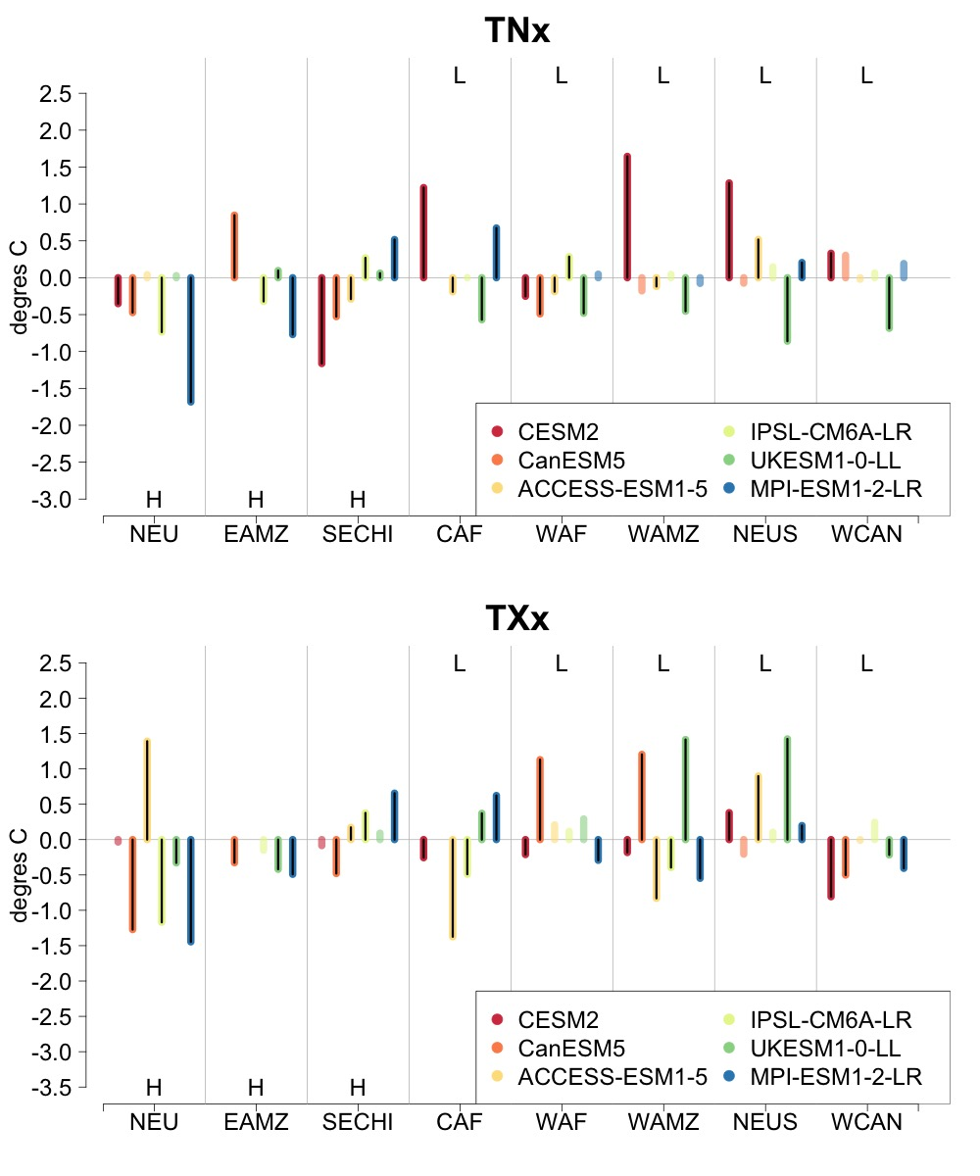
Do Models Produce Consistently Different Outcomes Between Scenarios with Different Land Use Change Patterns?
Objective
Analyze a multi-model ensemble under two scenarios that only differ in land use change patterns and search for robust differences in the behavior at regional scale of daily temperature and precipitation extremes between the outcomes.
Approach
Analyze output from six Earth system models ran under a scenario characterized by strong land use change along the 21st century and a scenario variant that only differs in afforestation/deforestation patterns. Compute six extreme metrics (cold and hot day/night temperatures, intense daily precipitation) and determine if their statistics show significant (within a model) and robust (across models) differences by the end of the century in areas where land use change differs significantly between scenarios.
Impact
For 20-year event outcomes across the models at eight locations with strong afforestation/deforestation signals, precipitation extremes do not show significant differences. For temperature extremes, the behavior across models is not consistent even when significance is detected within models.
The outcome of this analysis is relevant for the impact research community, supporting the use of different shared socioeconomic pathways (SSPs) in conjunction with different representative concentration pathways (RCPs) for integrated risk analysis. This work confirms the assumption by the SSP-RCP framework that decouples human and physical climate components of risk for most scenario outcomes, thus allowing researchers to explore risk outcomes for different combinations of SSPs and RCPs.
The size and significance of the difference in the 20-year return level of the hottest night and day of the year (TNx and TXx, respectively) for each of eight regions along the x-axis and each of the six models (one colored bar for each model in each region). The behavior is similar for indices characterizing coldest days and nights. Indices related to precipitation intensity show very few significant differences across regions/models. H or L indicates that the region experiences afforestation or deforestation and their position suggests the expected sign of the change.
Tebaldi C., M. F. Wehner, R. L. Leung, and D. M. Lawrence. “Is land use producing robust signals in future projections from earth system models, all else being equal?” Environmental Research Letters, 18, 084009 (2023). [DOI: 10.1088/1748-9326/ace3da]

