Slide 1
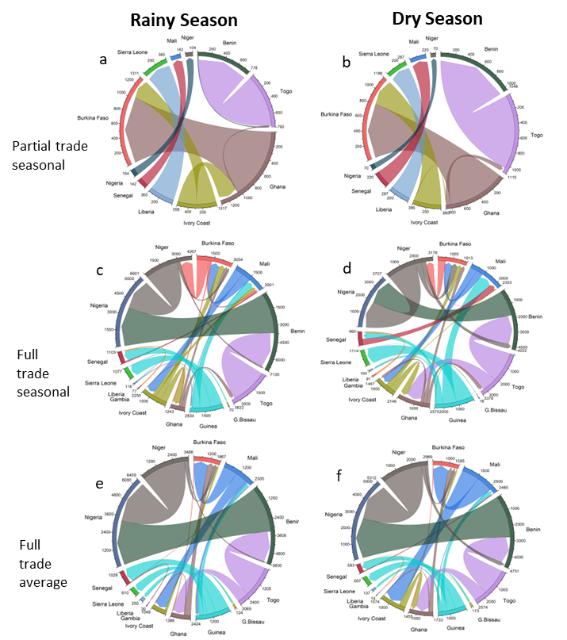
Seasonality and Trade in Hydro-Heavy Electricity Markets: a Case Study of the West Africa Power Pool
Objective
Demonstrate the consequences of increased regional power systems integration and alternative hydrologic representations in hydropower-heavy systems subject to extreme hydrologic seasonality.
Approach
Couple the global hydrologic model Xanthos with a capacity expansion and power trade model of West Africa. Drive the coupled models with hydrologic and demand projections through 2050.
Simulate capacity expansion within West Africa under varying levels of energy trade between nations and with alternative hydropower seasonality representations.
Identify the cost of meeting projected energy demands with and without expanded regional energy trade as well as identify the effects of ignoring monsoon driven seasonality in hydropower generation for costs, energy mixes, and cross-national power flows.
Impact
Capacity expansion studies often ignore the impact of hydrologic seasonality on hydropower generation, which is particularly critical in monsoon-driven regions like West Africa.
Ignoring seasonality may not impact the projected cost of capacity expansion but can result in misrepresentations of important dynamics, such as the inter-regional flow of power.
Capturing these types of dynamics can improve multisector dynamics models and scenario analysis in regions with hydropower potential.
This case study focuses on the West Africa Power pool, composed of several nations and subject to seasonal monsoons. Simulations project costs, energy mixes, and power trade through 2050. The study considered the impact of increased system integration on bilateral energy trade (rows 1 and 2), and how this depends on season (columns). The analysis also considered the implications of ignoring hydrologic seasonality on power systems projections (row 3), showing that ignoring seasonality can misrepresent power flows and key dependencies.
Kanyako, F., J. Lamontagne, E. Baker, S. Turner, and T. Wild. “Seasonality and trade in hydro-heavy electricity markets: A case study with the West Africa Power Pool (ECOWAPP).” Applied Energy, 329 (2023). [DOI: 10.1016/j.apenergy.2022.120214]
Notes:
http://www.pnnl.gov/science/highlights/highlights.asp?division=749

