Slide 1
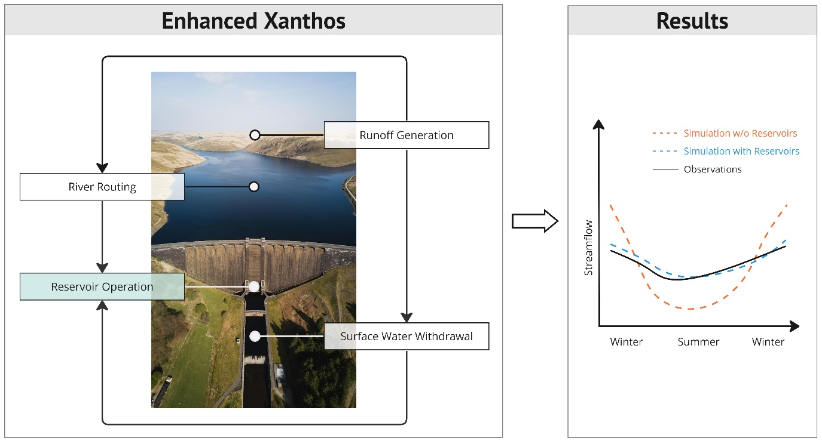
Representing Hydropower Reservoir Operations in Global Hydrological Models Improves Freshwater Projections
Objective
To enhance Xanthos, a global hydrological model (GHM), by adding a new water management module that distinguishes between the operational characteristics of irrigation, hydropower, and flood control reservoirs.
To demonstrate the importance of carefully representing hydropower reservoir operation in GHMs.
Approach
Re-map reservoirs in the Global Reservoir and Dam database to Xanthos' 0.5-degree spatial resolution and derive and apply a unique operation rule for each reservoir based on its primary purpose.
Determine the operational rules for hydropower reservoirs via optimization that maximizes long-term hydropower production.
Calibrate the model’s water balances using streamflow data from the Global Runoff Data Centre.
Impact
The improved Xanthos reproduces observed water balances with higher fidelity, and can thus better support coupled human–Earth system science using the Global Change Analysis Model, which relies on Xanthos.
The model is now better positioned to explore the current and future role that reservoir storage could play in managing climate-driven variability in the water supply to meet human water demands (including for hydropower generation), on both regional and global scales.
PNNL’s enhanced Xanthos now explicitly represents hydropower reservoirs, along with irrigation and flood control reservoirs, leading to better simulation of streamflow and reservoir storage.
Abeshu, G. W., Tian, F., Wild, T., Zhao, M., Turner, S., Chowdhury, A. F. M. K., Vernon, C. R., Hu, H., Zhuang, Y., Hejazi, M., and Li, H.-Y.: Enhancing the representation of water management in global hydrological models, Geosci. Model Dev., 16, 5449–5472, https://doi.org/10.5194/gmd-16-5449-2023, 2023.
Notes:
http://www.pnnl.gov/science/highlights/highlights.asp?division=749

