Slide 1
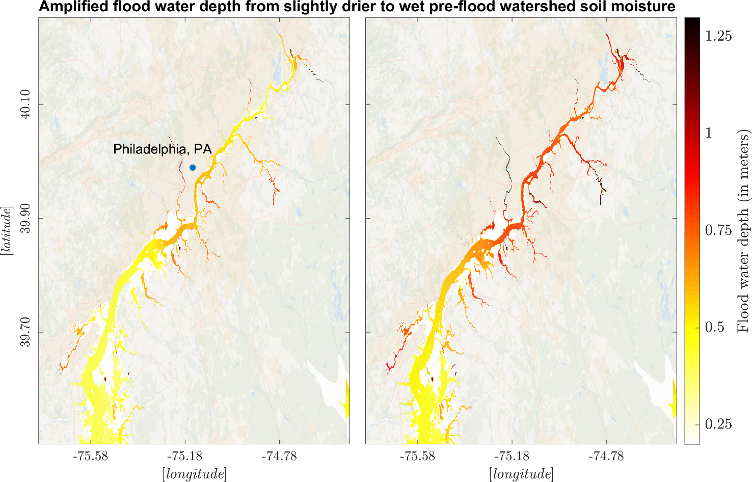
Fluvial-Coastal Flooding in a Changing Climate
Objective
In an evolving climate, changes to watershed drainage characteristics and estuarine tidal dynamics can interact and modulate the compound flood potential. Integrating two high-resolution numerical modeling frameworks can help explain how changes to watershed and estuarine properties could influence a historical compound flood event from Hurricane Irene.
Approach
High-resolution, integrated watershed–coastal numerical modeling frameworks were fully evaluated using a variety of field data sets, illustrating the necessity of regional-scale model nesting to enhance accuracy in hazard analysis.
In the model experiment design, researchers first represented a range of plausible soil moisture conditions corresponding to a drier or wetter future in the basin. Then, they developed sea level rise scenarios under different global warming conditions to represent changes to the estuarine dynamics.
Impact
Results showed that changes in watershed and estuarine characteristics play a critical role in flood generation. Increasing global temperatures and rainfall intensity may not lead to more extreme flooding.
Studies focusing on large-scale future compound flooding hazard assessment need to adequately address the interacting watershed-coastal processes to have higher fidelity projections.
Moving from drier to wetter antecedent soil moisture conditions in the Delaware River Watershed during Hurricane Irene (2011) increases the compound flooding in the Delaware Bay and River, U.S.
Deb, M., Sun, N., Yang, Z., Wang, T., Judi, D., Xiao, Z., and Wigmosta, M. S. “Interacting Effects of Watershed and Coastal Processes on the Evolution of Compound Flooding During Hurricane Irene,” Earth’s Future, 11, e2022EF002947 (2023). [DOI: 10.1029/2022EF002947]

