Slide 1
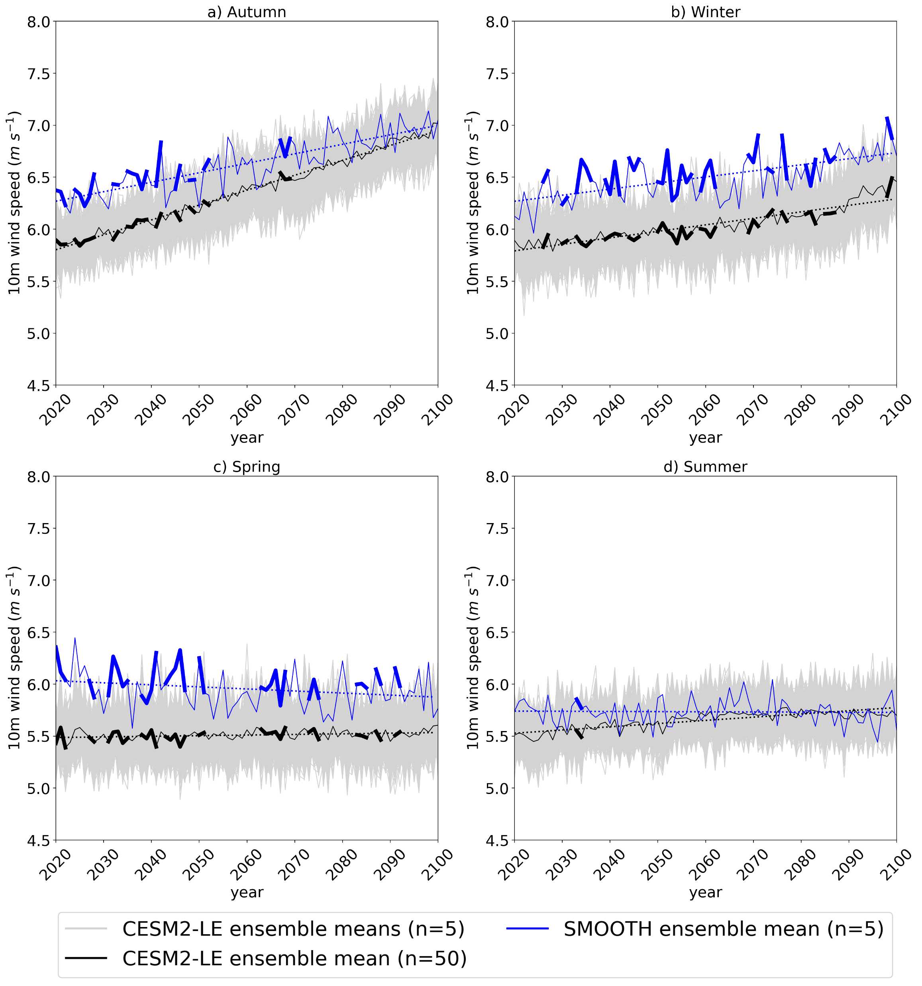
Investigating future Arctic sea ice loss and near-surface wind speed changes related to surface roughness using the Community Earth System Model
DuVivier, A.K., Vavrus, S.J., Holland, M.M., Landrum, L., Shields, C. A., Thaker, R. (2023). Investigating future Arctic sea ice loss and near-surface wind speed changes related to surface roughness using the Community Earth System Model. Journal of Geophysical Research - Atmospheres, 50, e2023JD038824. https://doi.org/10.1029/2023JD038824
OBJECTIVE
Quantify how the near surface wind trends may be driven by changing surface roughness and/or stability in different Arctic regions and seasons.
CESM2-LE and SMOOTH seasonal time series of Central Arctic average 10m wind speed (m s⁻¹). Blue solid lines indicate SMOOTH ensemble mean (n=5), black solid lines indicate CESM2-LE ensemble mean (n=50), and grey solid lines indicate 1000 CESM2-LE bootstrapped ensemble means (n=5). The blue and black solid lines are thick for years in which the differences are significant at the 95% confidence level. Dashed lines indicated linear regressions for the ensemble means from 2020-2100.
APPROACH
Comparison of 50 experiments from the Community Earth System Model version 2 Large Ensemble (CESM2-LE) and five experiments using CESM2 with an artificially decreased sea ice roughness to match that of the open ocean (SMOOTH).
IMPACT
The surface roughness change from sea ice loss drives about 30-60% of the near surface wind trends in autumn and winter, with the remaining changes primarily from decreased stability as surface temperature warms. Surface roughness changes do not significantly impact Arctic sea ice mean state and trends.

