Slide 1
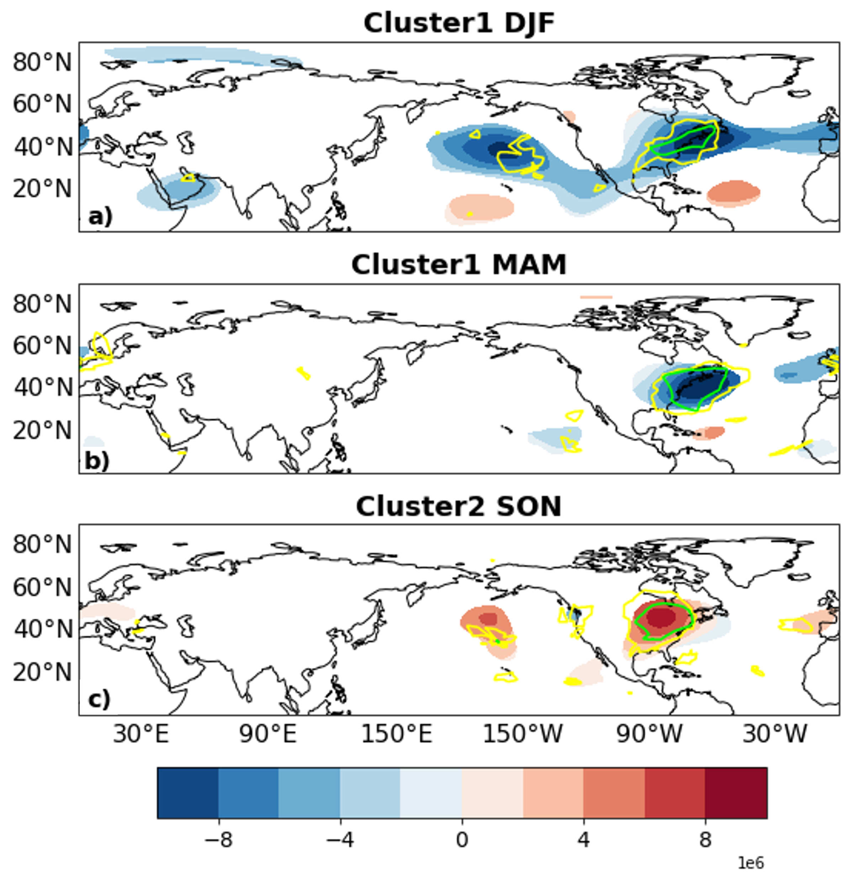
Two Large-Scale Meteorological Patterns Are Associated with Short-Duration Dry Spells in the Northeastern United States
Objective
Large-scale meteorological pattern (LSMP) analysis is used in a novel way to identify the patterns and large-scale meteorology associated with persistent dryness in the northeastern United States.
Insights are obtained into the meteorological conditions that reduce precipitation over the region and they can assist in dry spell prediction.
Approach
LSMP analysis is implemented using k-means clustering on the 500-hPa stream function anomaly field for dry events lasting 12 days or longer.
The approach identifies two clusters: Cluster 1 is related to a strong low-pressure anomaly in the midlatitude Atlantic Ocean, and Cluster 2 is associated with a strong high-pressure in eastern North America.
Other fields, such as low-level moisture, temperature advection, and extratropical cyclone storm tracks, are also analyzed in relation to these clusters.
Impact
LSMP analysis emerges as a useful tool for understanding dry spells in the northeastern United States and can be utilized for other regions.
Useful as a validation tool of models’ representation of dry spell characteristics.
Fig. Large-scale meteorological patterns (LSMPs), defined by the 500 hPa stream function anomaly field ($m^{2}$/s; contours), for the short-duration dry spell events in Cluster 1 in a) DJF (20 events) and b) MAM (18 events), and c) Cluster 2 in SON (17 events). Contour shading indicates areas of significance determined by bootstrap resampling. Yellow and green contours indicate: sign count magnitude of 0.6 and 0.8, such that 80% and 90% of the members in the cluster have the same sign, respectively. Stream function values are scaled by 10⁶
Sukhdeo, R., Grotjahn, R., and Ullrich, P.A., Two Large-Scale Meteorological Patterns Are Associated with Short-Duration Dry Spells in the Northeastern United States. Monthly Weather Review (2023). doi: 10.1175/MWR-D-23-0141.1
Notes:
http://www.pnnl.gov/science/highlights/highlights.asp?division=749

