Slide 1
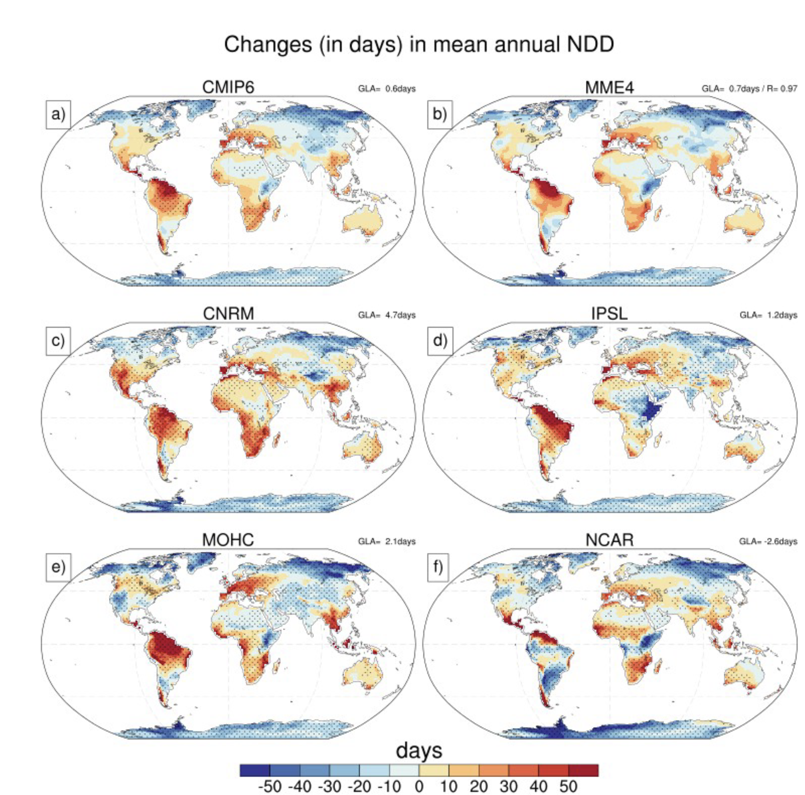
Drivers of dry day sensitivity to increased CO₂
H. Douville, R. Chadwick, M. Saint-Lu, and B. Medeiros, 2023, Geophys. Res. Lett., 50, e2023GL103200
OBJECTIVE
Understand changes in the annual number of dry days (NDD) and the annual maximum length of dry spells (MCDD) due to a quadrupling of atmospheric CO₂.
APPROACH
The CMIP6 piControl and abrupt-4xCO2 experiments from 32 models are used to quantify changes in NDD and consecutive dry day spells under increased forcing. A subset of 4 models that provided CFMIP Tier 2 experiments allow an additive decomposition of the response into 3 terms: fast response, slow uniform, and slow patterned response.
IMPACT
The models simulate an overall increase in NDD and MCDD over land in response to CO2 quadrupling. None of the three components consistently dominates the global land response of dry days across the selected models. This study shows that regional responses are not tied to the global hydrologic sensitivity, and there are substantial uncertainties in the mechanisms that govern the regional hydrologic response to warming.

