Slide 1
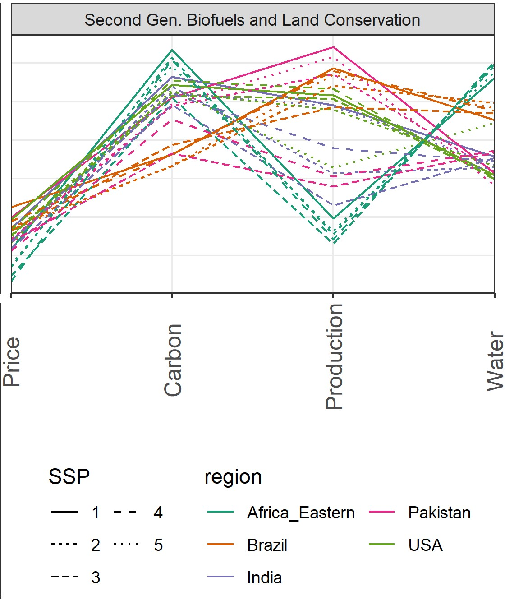
Modeling the Impacts of Land Scarcity under Deep Uncertainty
Objective
Quantify impacts of land scarcity from the supply (conservation) and demand (biofuel production) side drivers as well as their combined effects on food prices and production, water withdrawals, and carbon emissions.
Evaluate how these impacts are shaped by diverse uncertainties.
Approach
Create an ensemble of scenarios that samples socioeconomic, technological, hydroclimatic, and biophysical uncertainties.
Model each scenario using the Global Change Analysis Model (GCAM) to represent interactions and feedbacks between the economy and the physical Earth system.
Calculate the impacts of scarcity by finding the difference in food prices, food production, water withdrawals, and carbon emissions between a scenario with land constraints imposed and the corresponding baseline scenario.
Analyze impacts at both global and regional scales.
Impact
Increasing food demands coupled with land conservation measures work together to exacerbate land scarcity.
Land scarcity can prompt tradeoffs between environmental and economic metrics of interest.
The impacts of land scarcity can manifest disproportionately across regions.
1
0
-1
Log modulus % change
The log modulus of percent change in metrics for different regions from implementing a biofuel constraint from nonfood sources and the land conservation constraint. Positive values indicate favorable outcomes (e.g., lower water withdrawals, higher food production, lower food prices, and decreases in carbon emissions).
F. Dolan, J. Lamontagne, K. Calvin, A. Snyder, K. B. Narayan, A. V. Di Vittorio, and C. R. VernonF. Dolan, et al. “Modeling The Economic And Environmental Impacts Of Land Scarcity Under Deep Uncertainty.” Earth’s Future, 10(2), e2021EF002466 (2022). [DOI: 10.1029/2021EF002466]

