Slide 1
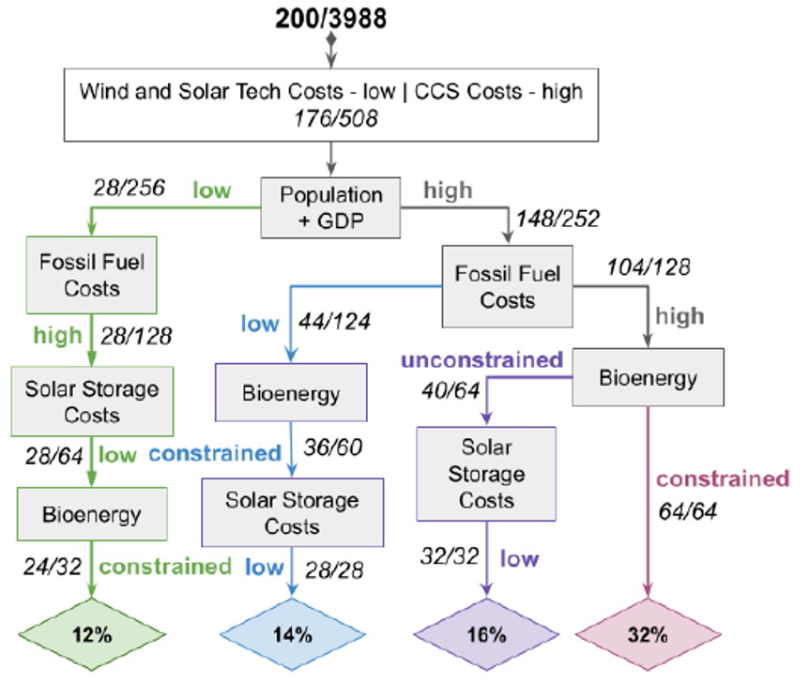
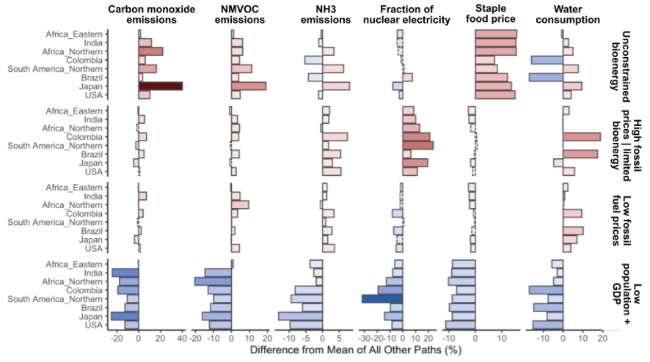
Scenario Discovery Analysis of Drivers of Solar and Wind Energy Transitions Through 2050
Objective
Identify the most important factors globally and regionally in creating certain energy capacity mixes, and explore the interconnected effects on other sectors, including water and land.
Approach
Use Global Change Analysis Model (GCAM) model with variety of the different sectors including energy, agriculture, land use, and water.
Create a set of nearly 4,000 scenarios that span a wide range of possible futures. Each scenario is driven by a combination of different parameter inputs chosen based on factors expected to impact energy shares.
Leverage scenario discovery tools to find the most important single drivers, and combinations of drivers, globally and in each of the 32 different regions represented in GCAM. Identify pathways that result in energy capacity mixes with high rates of renewables adoption and characterize each pathway across sectors and regions.
Impact
Four different multisectoral futures (labeled in the bottom panel of the figure to the right) identified that are all characterized by high renewable adoption but that feature very different consequences across other sectors and regions.
Many traditional modeling approaches would miss some or more portions of these potential futures.
Using Scenario Discovery, identified four paths to high wind & solar adoption (top panel). Each pathway has its own consequences for different sectors in different regions (bottom panel).
Woodard, D. L., Snyder, A., Lamontagne, J. R., Tebaldi, C., Morris, J., Calvin, K. V., et al. (2023). Scenario discovery analysis of drivers of solar and wind energy transitions through 2050. Earth's Future, 11, e2022EF003442. https://doi.org/10.1029/2022EF003442

