Slide 1
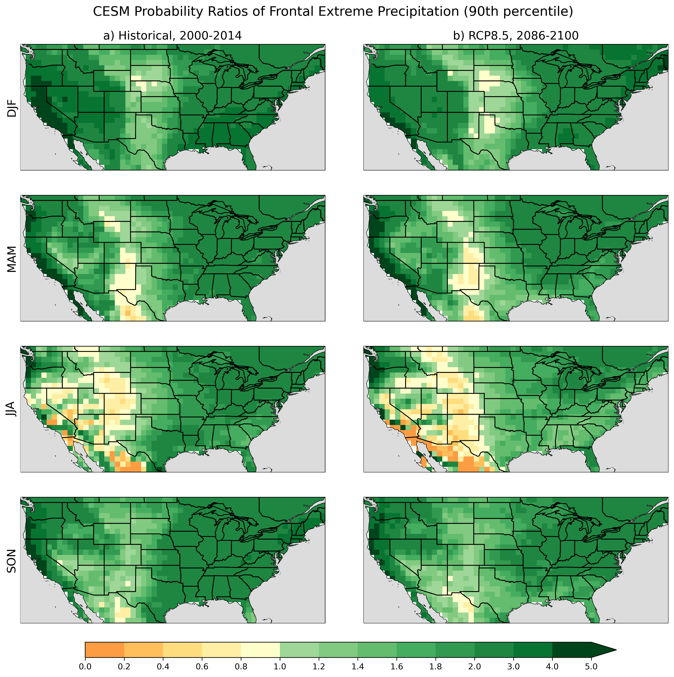
Machine Learning-Based Detection of Weather Fronts and Associated Extreme Precipitation in Historical and Future Climates
Dagon, K., Truesdale, J., Biard, J. C., Kunkel, K. E., Meehl, G. A., and Molina, M. J. (2022). Journal of Geophysical Research: Atmospheres,
doi: 10.1029/2022JD037038
OBJECTIVE
Extreme precipitation has significant impacts and is expected to increase in intensity with climate change. In the midlatitudes, extreme precipitation is often associated with weather fronts, pointing to a need for analyzing regional and seasonal changes in fronts of different types as an important component to understanding how total and extreme precipitation, and their associated impacts, might change in the future.
Probability ratios (PR) comparing the conditional probability of frontal extreme precipitation (greater than 90th percentile) over land to the climatological probability of extreme precipitation. PR >1 implies extreme precipitation is more likely to be associated with a front, where PR < 1 implies extreme precipitation is less likely to be associated with a front. (a) CESM historical simulation (2000–2014). (b) CESM RCP8.5 simulation (2086–2100).
APPROACH
We use a machine learning-based detection algorithm to identify weather fronts over the contiguous United States in high resolution Community Earth System Model (CESM) simulations of historical and future climates. We further associate the detected fronts with total and extreme precipitation, studying responses across seasons and front types, to understand how climate change impacts the intersection of synoptic-scale features with extreme events.
IMPACT
Our results demonstrate how automated detection of synoptic weather features can enable greater understanding of precipitation sources and mechanisms. By investigating modeled changes in total and extreme frontal precipitation, we advance the understanding of extreme precipitation events, their intersection with frontal systems of different types, and how those associations are changing with climate change.

