Slide 1
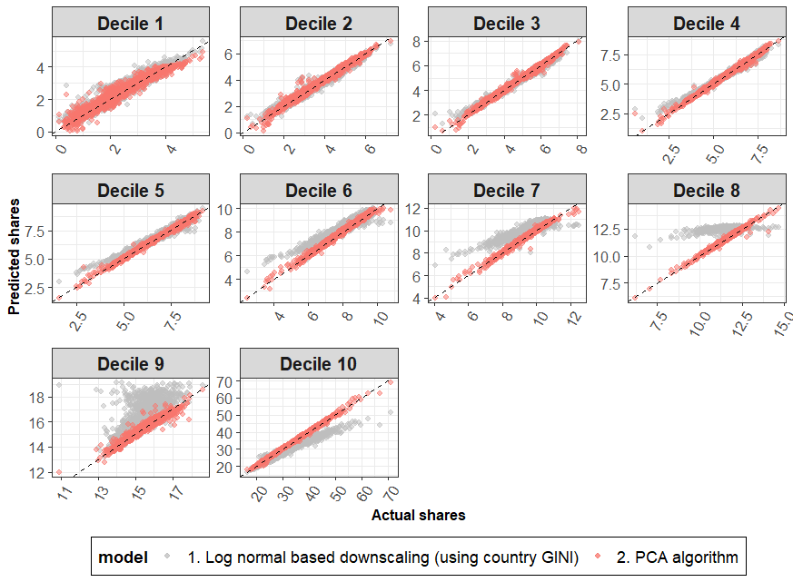
New projections of national income distributions across different socio-economic scenarios
Objective
Develop a new model for projecting distributions of income within countries. This new model will enable a better representation of consumption and distributional impacts in the Global Change Analysis Model (GCAM).
Approach
We first developed a dataset of income distributions that represented a single concept of income across countries, namely net income
We then trained a non-parametric model which uses Principal Component Analysis (or PCA) on this new dataset. This allowed us to generate future projections of income distribution (by decile) for all countries
Our PCA model is driven by changes in the GINI coefficient (summary measure of inequality) and other variables such as the labor share of Gross Domestic Product (GDP) across countries, all quantities for which future projections exist.
We compared our results to current approaches in the literature (See Figure)
Impact
Our model generates a much better fit to the latest data on income distributions compared to other parametric approaches such as the lognormal model.
We generated distributions of income across different socioeconomic scenarios, namely the Shared Socioeconomic Pathways (SSPs), to represent a wide range of uncertainty.
Fit based on lognormal functional form (parametric model in literature)
Fit based on our new PCA model
Comparison of fit of lognormal functional form (grey dots) with PCA based fit (red dots) with data on income shares for each income decile (facet). Lines represent 1 to 1 fit between x and y axis. Income shares are expressed as a percent of total income. Each dot represents a country-year observation between 1958 and 2015. We find that our model improves the fit across countries and income groups.
Narayan, K. B., O’Neill, B. C., Waldhoff, S. T., & Tebaldi, C. (2023). Non-parametric projections of national income distribution consistent with the Shared Socioeconomic Pathways. Environmental Research Letters, 18(4), 044013. https://doi.org/10.1088/1748-9326/acbdb0

