Slide 1
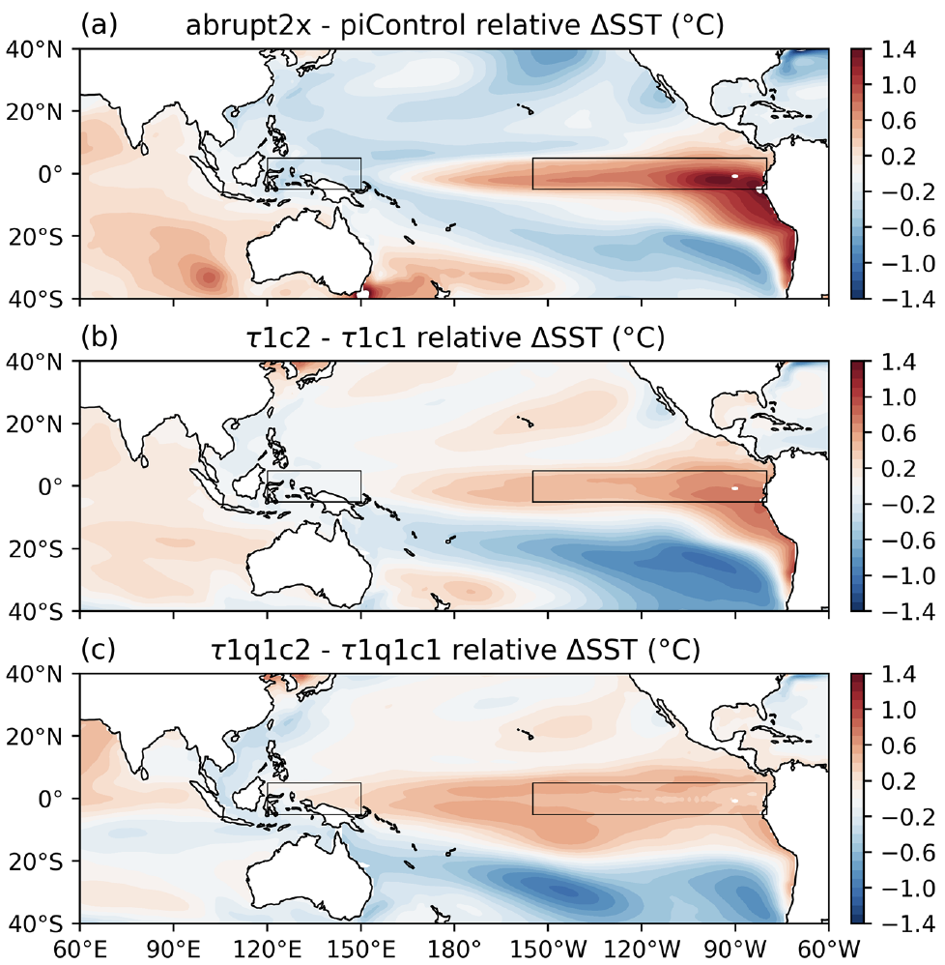
The Role of Bjerknes and Shortwave Feedbacks in the Tropical Pacific SST Response to Global Warming
Scientific Challenge
The evolution of tropical sea surface temperatures (SSTs) in response to greenhouse warming is of great societal and scientific interest. Most state-of-the-art climate models predict a mean “El Niño-like” warming pattern by century-end. However, it is unclear which proposed mechanism dominates in this response.
Approach and Findings
Here, we present partially coupled abrupt CO2 doubling experiments in which surface wind stress and shortwave heating are overridden to values from a control simulation. We find that experiments with overriding of surface wind stress exhibit only 58% of the full reduction in east-west SST contrast. When both surface wind stress and shortwave flux are overridden, only 34% of the full reduction remains, controlled by spatially-varying evaporative cooling.
Significance and Impact
Sea surface temperature patterns over the tropical Pacific have an outsized impact on regional and global climates, as exemplified by the impact of El Niño events. This research proposes a method that allows quantifying the role of different feedbacks in shaping the future pattern of change in the tropical Pacific. Our results underscore the importance of Bjerknes (wind-SST) and shortwave feedbacks in the tropical Pacific SST response to global warming.
(a) The pattern of tropical warming, with mean warming subtracted in 2xCO2 experiments; (b) the same pattern but with the Bjerknes (wind-SST) feedback suppressed; (c) with both Bjerknes and shortwave feedbacks suppressed
Fu, M. and Fedorov, A., 2023. The role of Bjerknes and shortwave feedbacks in the tropical Pacific SST response to global warming. Geophysical Research Letters, 50(19), p.e2023GL105061.
Department of Energy • Office of Science • Biological and Environmental Research
Notes:
SCIENCE
How tropical SST patterns will evolve under global warming has been a topic of keen scientific interest and scrutiny. While most state-of-the-art climate models show a transition to a more “El Niño-like” mean state by the end of the century, the precise reason why remains debated. Here, we present a method that estimates the contributions of changing surface winds and solar radiation to the tropical ocean warming pattern simulated by a state-of-the-art climate model. While some previous studies have argued that changes in surface winds are unimportant, here we show that the weakening of surface easterly winds that maintain a colder eastern Pacific is a major factor leading to a reduced east-west temperature contrast.
IMPACT
Sea surface temperature patterns over the tropical Pacific have an outsized impact on regional and global climates, as exemplified by the impact of El Niño events. This research proposes a method that allows quantifying the role of different feedbacks in shaping the future pattern of change in the tropical Pacific.
SUMMARY
The evolution of tropical sea surface temperatures (SSTs) in response to greenhouse warming is of great societal and scientific interest. Most state-of-the-art climate models predict a mean “El Niño-like” warming pattern by century-end, characterized by greater warming over the Pacific cold tongue compared to the western warm pool. However, it is unclear which proposed mechanism dominates in this response. Here, we present partially coupled abrupt CO2 doubling experiments in which surface wind stress and shortwave heating are overridden to values from a control simulation. Contrary to previous studies, we find that experiments with overriding of surface wind stress exhibit only 58% of the full reduction in east-west SST contrast. When both surface wind stress and shortwave flux are overridden, only 34% of the full reduction remains, controlled by spatially-varying evaporative cooling. These results underscore the importance of Bjerknes and shortwave feedbacks in the tropical Pacific SST response to global warming.

