Slide 1
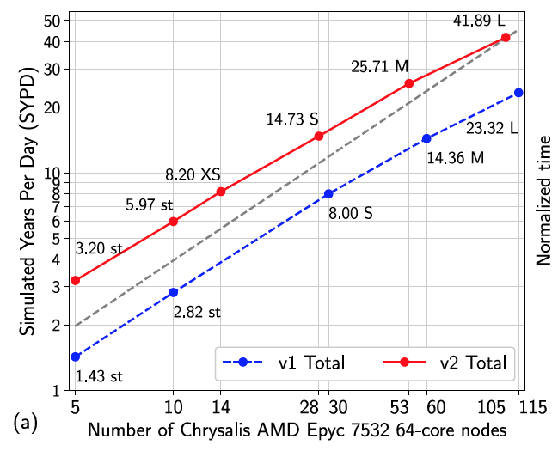
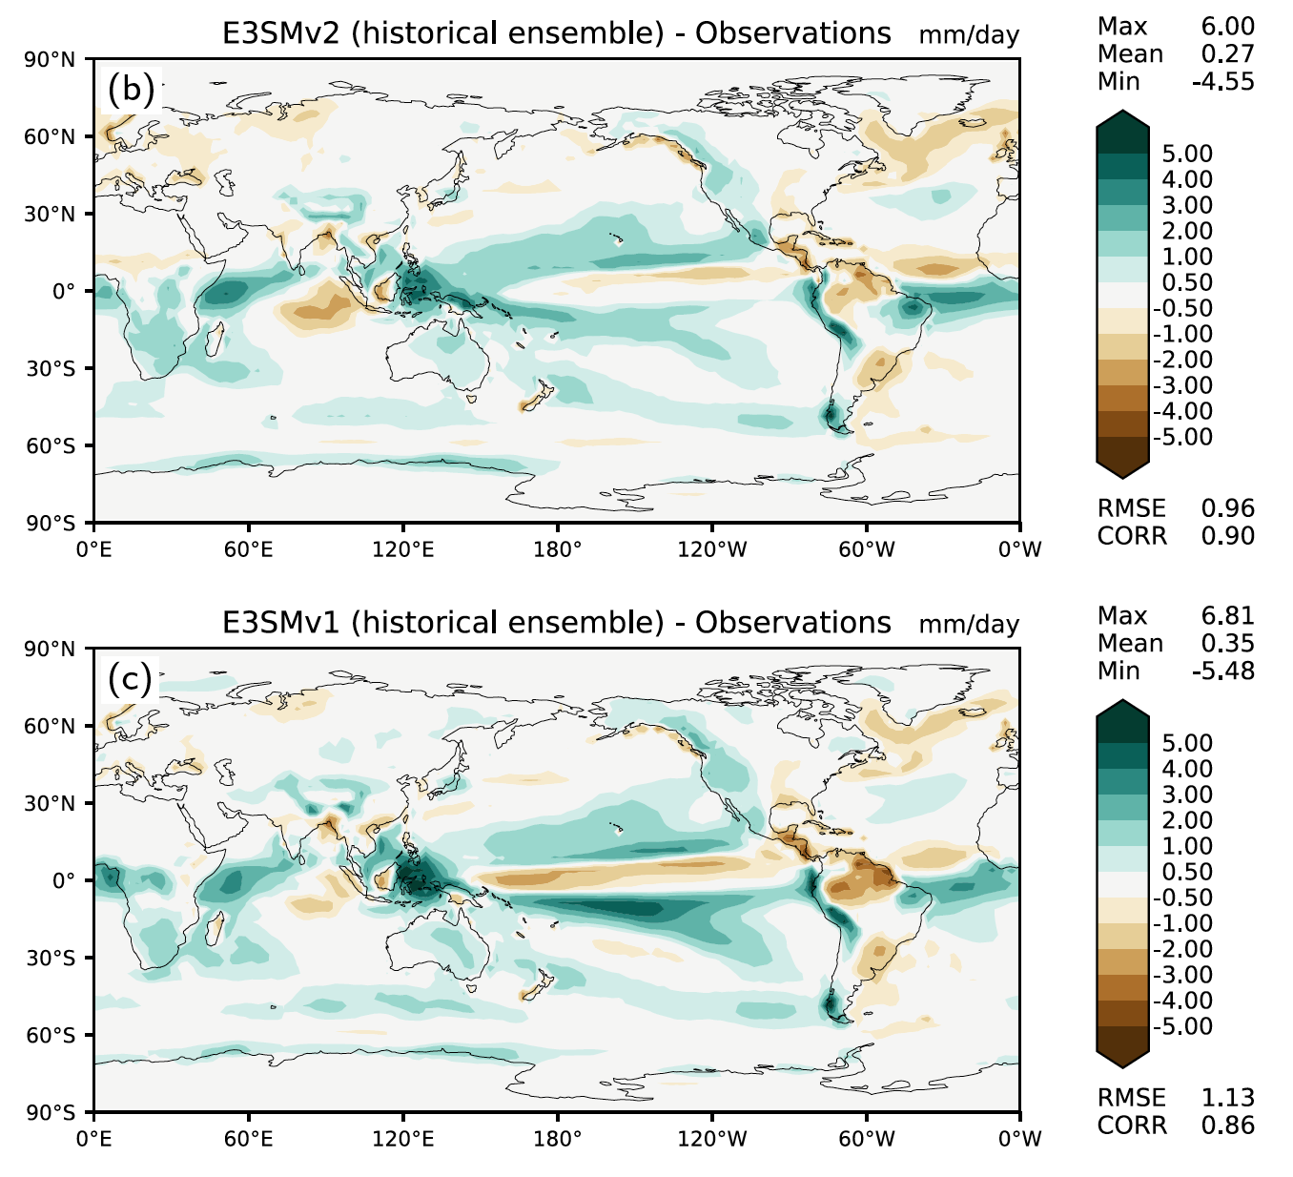
The DOE E3SM Model Version 2: Overview of the Physical Model and Initial Model Evaluation
Objective
Documentation and initial evaluation of E3SMv2, the second version of the DOE Energy Exascale Earth System Model:
Fully coupled physical model.
110 km atmosphere, 165 km land, 55 km river, 60 to 30 km ocean and sea-ice.
Fig 1: Performance comparison for E3SMv1 and E3SMv2: throughput vs. number of nodes.
Approach and Results
Computational performance
Twice as fast as E3SMv1.
New semi-Lagrangian tracer transport.
New grid for atmospheric physics calculations.
Extensive simulation campaign
Over 5000 years based on CMIP6 protocol.
Simulation data available publicly.
Simulated climate
Improved clouds and precipitation, including diurnal cycle.
More realistic Equilibrium Climate Sensitivity of 4.0 K instead of 5.3 K.
Remaining biases
Weak Atlantic Meridional Overturning Circulation (AMOC) in the ocean.
Underestimation of surface warming in second half of 20th century due to excessive aerosol forcing.
Fig 2: Annual precipitation model bias (mm/day, 1985-2014) relative to GPCP v2.3 for the
5-member ensemble of E3SMv2 historical coupled simulations (b), and E3SMv1 (c). Global root mean square error (RMSE) is reduced by 15% in v2 compared to v1.
Impact
E3SMv2 provides DOE with improved capabilities to examine long-term changes in environmental variables impacting the energy sector.
Golaz, J.-C., Van Roekel, L. P., Zheng, X., Roberts, A. F., Wolfe, J. D., Lin, W., et al. (2022). The DOE E3SM Model version 2: Overview of the physical model and initial model evaluation. Journal of Advances in Modeling Earth Systems, 14, e2022MS003156. https://doi.org/10.1029/2022MS003156

