Slide 1
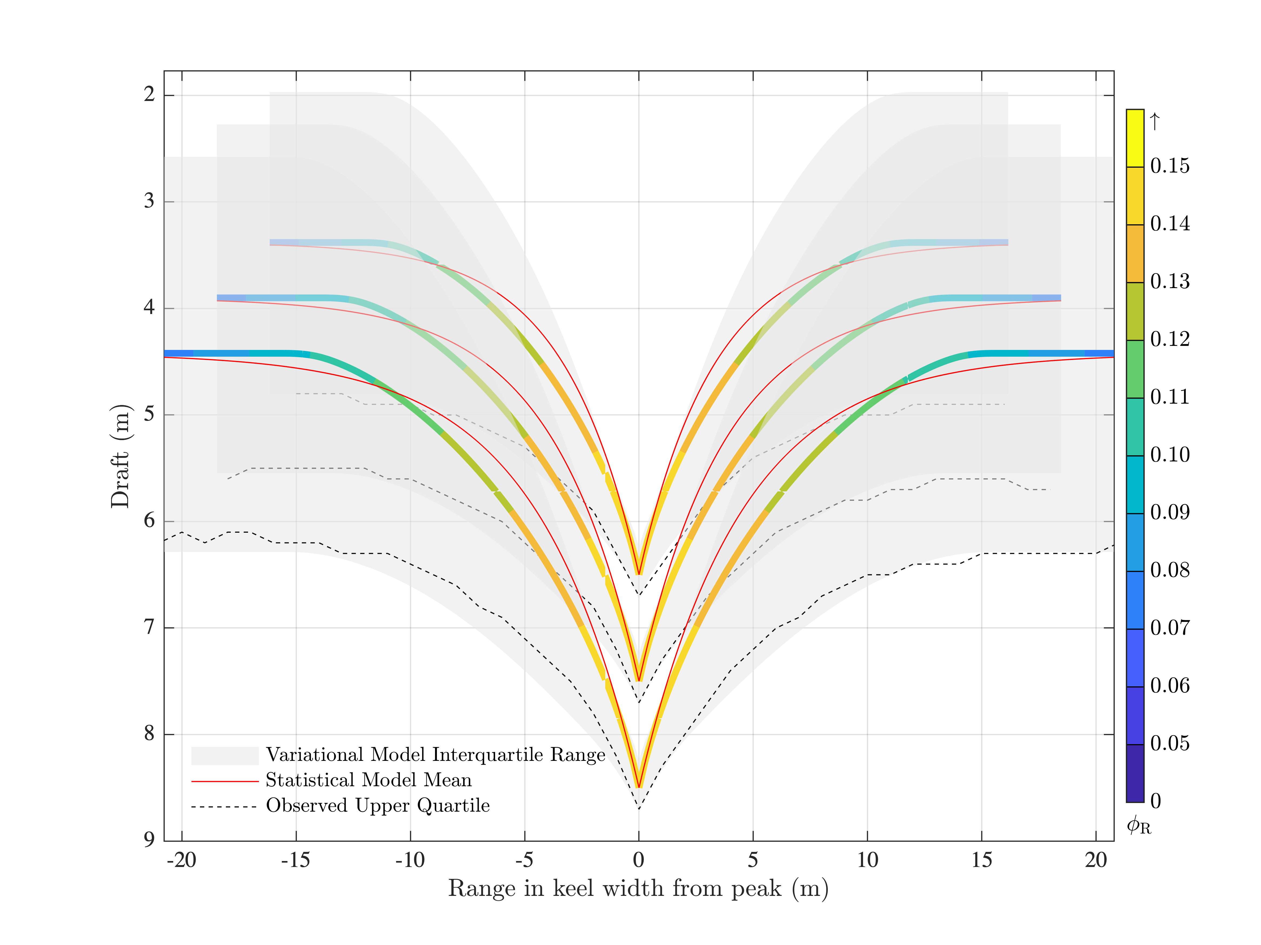
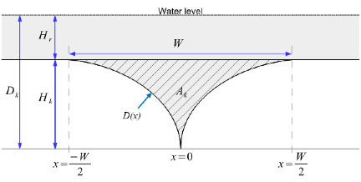
Measuring and modeling keels in the 21st century
Metzger, A. T., Mahoney, A. R., & Roberts, A. F. (2021). The average shape of sea ice ridge keels. Geophysical Research Letters, 48, 1–9. doi:10.1029/2021gl095100
Statistical model
Variational Model
Notes:
Development feedbacks make it fundamental for all E3SM scientists to be actively engaged in fully coupled model development and integration, understanding how their domain of expertise fits into the overall coupled system. Small (large) domain model problems frequently become large (small) problems in the fully coupled system. The days of domain model development irrespective of the coupled system are over.

