Slide 1
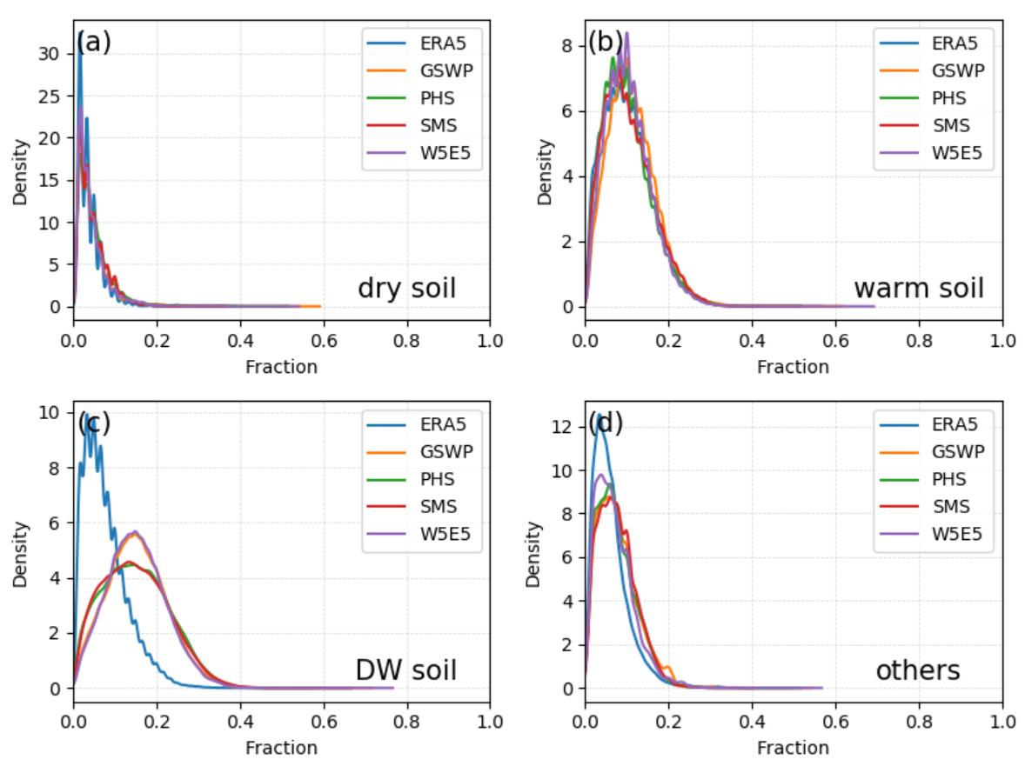
Snow Droughts Are Not Solely Driven by Abnormal Snowfall and Temperature
Objective
Understand the drivers of snow drought in the past by conducting systematic data-model comparisons of snow water equivalent (SWE) simulations by Energy Exascale Earth System Model (E3SM) and the climate dataset ERA5-Land data in 1980–2014.
Approach
The empirical Gringorten plotting position for the ranked 3-month SWEs in ascending order was used to compute the standardized snow water equivalent index (SSWEI) for characterizing drought.
Gridded SSWEI derived from E3SM simulations were benchmarked against those from ERA5-Land in 1980–2014.
Four E3SM simulations were conducted, aiming to evaluate the impact of climate-forcing uncertainty on snow drought predictions.
Impact
The results show snow droughts in Northern Hemisphere land are predominantly driven by low snowfall, warm temperature, or both.
However, 20–30% of snow droughts are attributed to factors such as anomalous soil moisture and soil temperature.
El Niño-Southern Oscillation events can exacerbate snow drought conditions in various regions, despite some discrepancies between model results.
Many factors can contribute to snow droughts besides low snowfall and warm air temperature. Based on ERA5-Land (blue) and various E3SM simulations (orange, green, red, purple), the probability density functions of snow drought fraction associated with dry soil (a), warm soil (b), dry and warm (DW) soil (c), and unexplained (d) show that 20–30% of snow droughts can be attributed to dry soil and/or warm soil.
Fang, Y., & Leung, L. R. (2023). Northern Hemisphere snow drought in Earth system model simulations and ERA5-Land data in 1980–2014. Journal of Geophysical Research: Atmospheres, 128, e2023JD039308. https://doi.org/10.1029/2023JD039308

