Slide 1
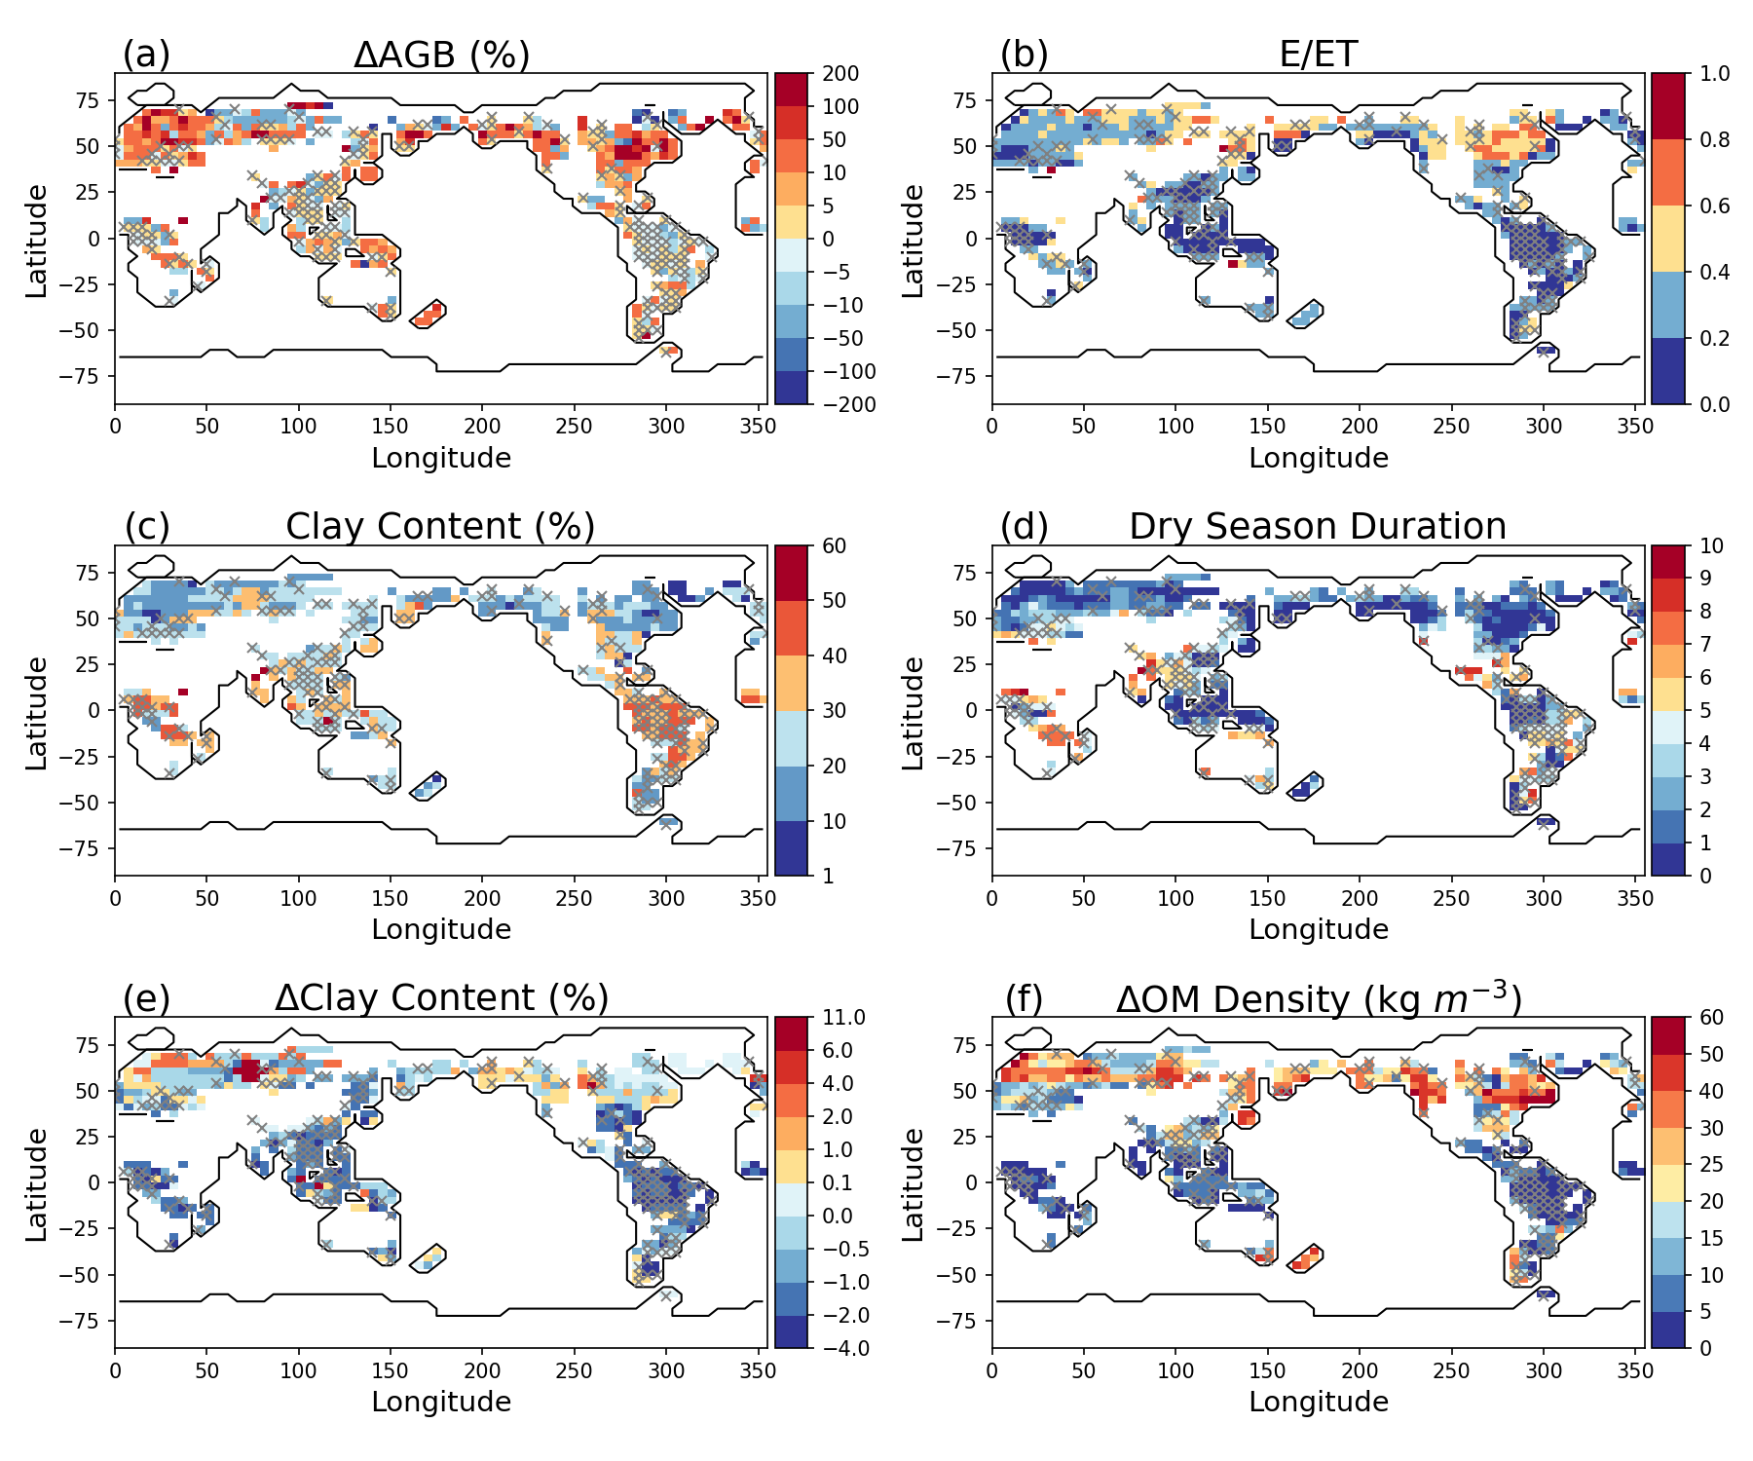
Understanding How Algorithms for Simulating Water Transport in Plants Affect Vegetation Modeling
Objective
Evaluate how different numerical solution options for the plant hydrodynamics module of the Functionally Assembled Terrestrial Ecosystem Simulator (FATES-Hydro), an ecosystem dynamics model, affect modeled vegetation dynamics.
Approach
Implement multiple solver options in FATES-hydro that are coupled to the Energy Exascale Earth System Model Land Model for computational cost and numerical stability:
Include implicit and explicit approaches in the numerical solution methods, and
Aggregate vertical layers to solve fewer equations.
Impact
The results show that modelers need to be cautious when configuring near surface root zone soil grid sizes, as they can significantly overestimate above ground biomass (AGB) in most temperate forest locations and underestimate AGB in boreal forest locations.
Inaccurate results can be caused by different numerical approximations that change soil hydraulic properties.
Large gradients in soil properties such as clay content and organic matter density can affect hydraulic properties at different grid resolutions. Together with precipitation seasonality and ice impacts on soil, these gradients can change the simulated soil evaporation-to-evapotranspiration ratio and root accessible soil moisture states. This consequentially causes large differences in simulated AGB.
Fang, Y., Leung, L. R., Knox, R., Koven, C., and Bond-Lamberty, B. “Impact of the numerical solution approach of a plant hydrodynamic model (v0.1) on vegetation dynamics,” Geosci. Model Dev., 15, 6385–6398, (2022). [DOI:10.5194/gmd-15-6385-2022].

