Slide 1
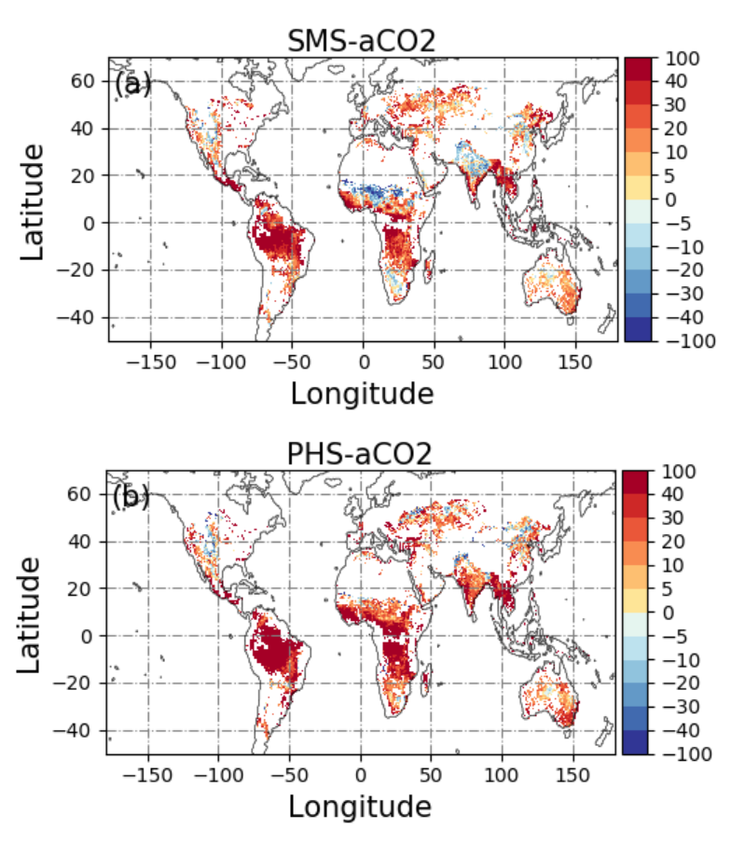
Understanding How Plants Respond to Coexisting Soil and Air Dryness in Global Simulations
Objective
Evaluate the relative roles of the soil water stress and vapor pressure deficit (VPD) for limiting canopy conductance (Gc) in coupled land-atmosphere simulations using the Energy Exascale Earth System Model (E3SM).
Approach
Perform global simulations in E3SM with the atmosphere model applied at ~100-kilometer resolution and the land model applied at 0.5-degree resolution.
Simulations were performed under historical air carbon dioxide (aCO₂), CO₂ concentration, and elevated CO₂ (4 × aCO₂) conditions with plant response either represented empirically or regulated by plant hydraulics.
Develop a multiplicative model of Gc dependence on atmospheric VPD and soil water saturation at daily scale in the growing season to evaluate the Gc response to changes in VPD and soil water saturation for each simulated grid containing vegetation.
Impact
Soil water limits Gc more than VPD, except in grasslands under wetter soil water conditions.
Plant hydraulics may accentuate soil water stress limitations on Gc by increasing soil wetness and evapotranspiration and lowering VPD.
Elevated CO₂ levels reduce Gc by increasing water use efficiency, mitigating soil water stress on Gc.
Soil water dominance (positive values) in limiting Gc is much more extensive than VPD dominance (negative values) under dry soil water conditions. VPD dominated regions are mainly located in cropland near India and grassland in the Sahel for soil moisture representation of plant response to water stress. More areas in the northern hemisphere experience soil water stress if the model represents plant water stress response mechanistically (bottom) compared to empirical representation (top).
Fang, Y. and L. R. Leung. “Relative controls of vapor pressure deficit and soil water stress on canopy conductance in global simulations by an Earth system model,” Earth's Future, 10, e2022EF002810, (2022). [DOI: 10.1029/2022EF002810]

