Slide 1
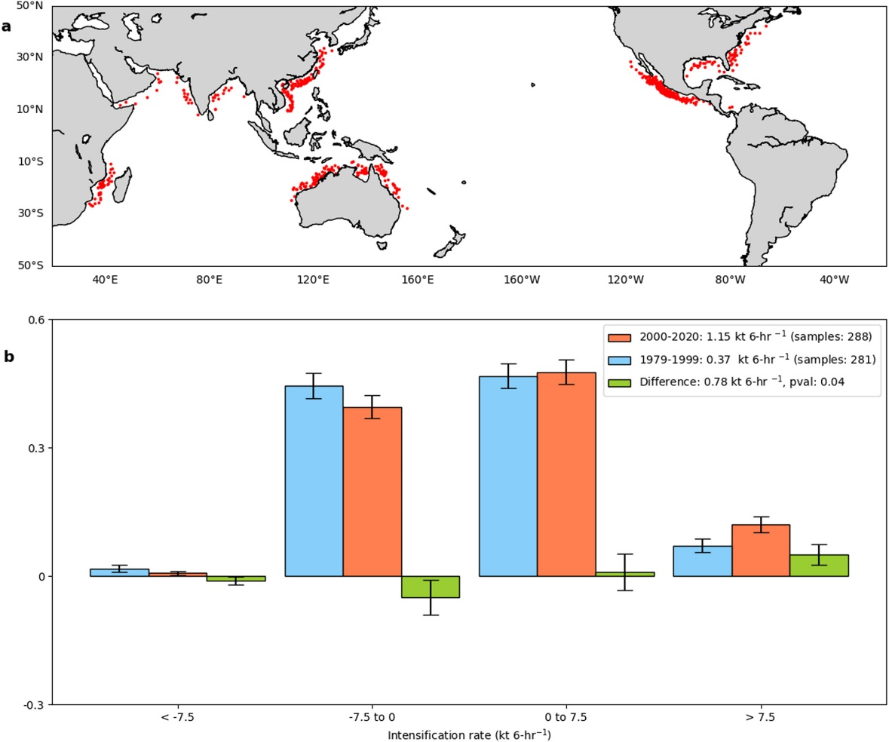
A global increase in nearshore tropical cyclone intensification
Objective
Examine tropical cyclone (TC) intensification rate changes in the global nearshore regions.
Explore changes in the large-scale TC environment to explain them.
Approach
Analyze hurricane track data for the 42-year satellite period 1979-2020 and explore changes in TC intensification.
Examine the large-scale TC environment using reanalysis.
Perform similar analysis using an ensemble of HighResMIP and CMIP6 climate models.
Conduct a suite of idealized experiments using the Stationary Wave Model to understand mechanisms.
Impact
Nearshore TC intensification rates have increased globally by about 3 knots per 24 hours over 1979-2020.
Stronger increases in relative humidity and stronger decreases in vertical wind shear (VWS) are primarily responsible.
Climate models suggest that these changes in TC intensification may continue in the future.
Increasing atmospheric stability and warming ocean patterns are responsible for VWS decreases.
(a) Nearshore TC track locations used in this analysis. (b) Probability distributions of 24-hr TC intensification rates for the initial period (1979–1999) in blue, the later period (2000–2020) in orange, and the difference in green. The mean TC intensification rates for the two periods and the corresponding sample sizes, and the mean difference, including the p-value, are shown in the figure legend.
Balaguru, K., Chang, C.-C., Leung, L. R., Foltz, G. R., Hagos, S. M., Wehner, M. F., et al. (2024). A global increase in nearshore tropical cyclone intensification. Earth's Future, 12, e2023EF004230. https://doi.org/10.1029/2023EF004230
Notes:
http://www.pnnl.gov/science/highlights/highlights.asp?division=749

