Slide 1
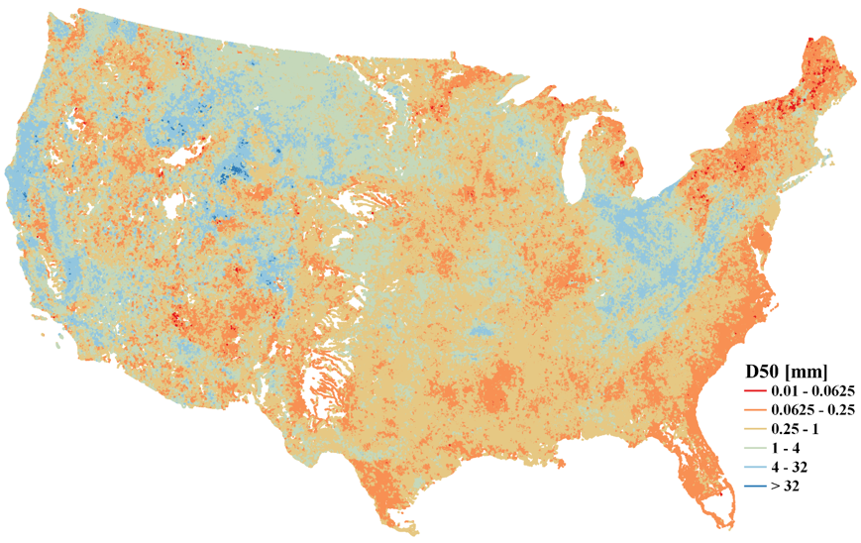
Median bed-material sediment particle size across rivers in the contiguous U.S.
Objective
Develop a national map of median bed-material sediment particle size (D50) to facilitate riverine sediment modeling at the regional and larger scales
Approach
Collect and process the observed D50 data from 2577 field sampling locations distributed over the contiguous U.S.
Develop a predictive model using a machine learning method based on the observed D50 data and the corresponding climate, hydrology, geology and other attributes that are extensively available
Derive a continuous map of D50 by applying the predictive model over the contiguous U.S.
Impact
The new D50 map captures spatial variability of sediment particle size in a statistically robust way
The new D50 map is critical in modeling suspended, fine-size sediment discharge (and attached particulate carbon and nutrient) in land-river-ocean continuum
It can also be used for large-scale geomorphological modeling to track the spatial shifting of river channels, river deltas and coastal lines in the U.S.
A new map of median bed-material sediment particle size over the contiguous U.S. in a vector format that corresponds to approximately 2.7 million river segments in the National Hydrography Dataset Plus dataset
Abeshu, G. W., Li, H.-Y., Zhu, Z., Tan, Z., and Leung, L. R.: Median bed-material sediment particle size across rivers in the contiguous U.S., Earth Syst. Sci. Data, https://doi.org/10.5194/essd-2021-201, accepted, 2022.

