Slide 1
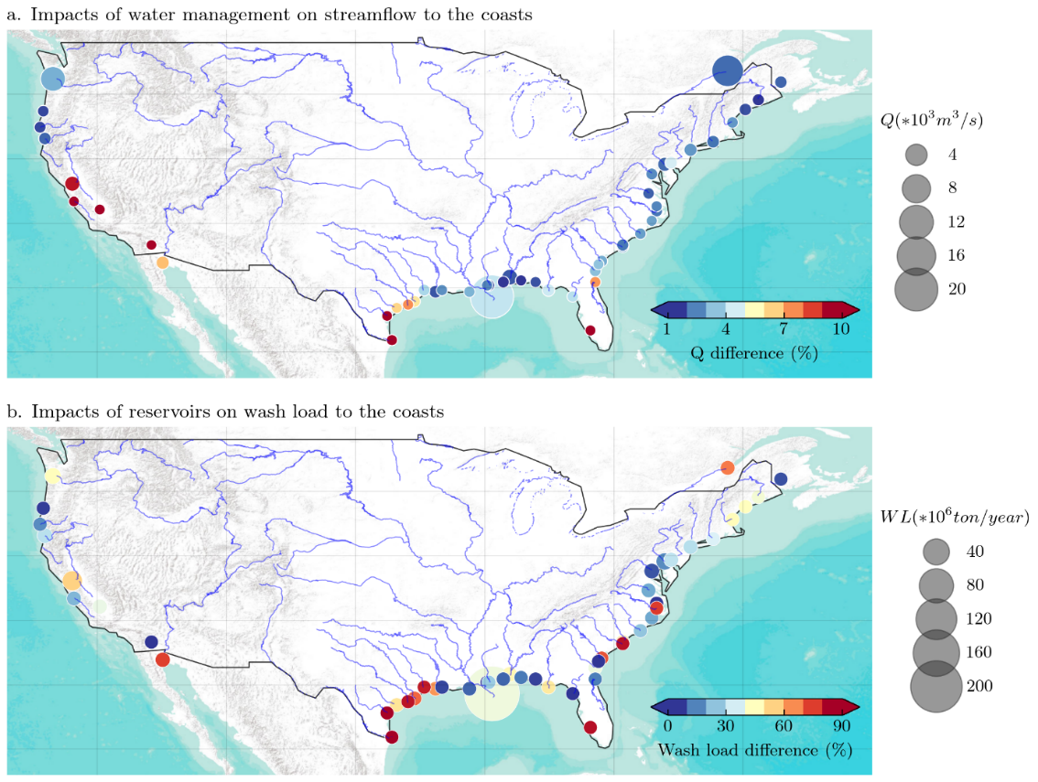
A new large-scale suspended sediment model and its application over the United States
Objective
Develop a new suspended sediment module within E3SM-MOSART that captures first-order processes and their driving factors in a physically-based way
Approach
Separate description of suspended sediment transport from hillslope into streams, through river networks, and to the coasts, and in-channel erosion and deposition processes.
Explicitly accounting for sediment trapping (direct) and flow regulation (indirect) effects by cascading reservoirs along river networks
All parameters estimated a priori without calibration
Impact
The model reasonably well captures the long-term balance and seasonal variations of suspended sediment at multiple stations in large river systems.
Suspended sediment discharge in managed rivers is affected more by reservoirs' direct trapping of sediment particles than by their flow regulation
The new sediment module enables future modeling of carbon and nutrients carried by fine sediment discharge along the river-ocean continuum to close the global carbon and nutrients cycles
a. Impacts of water management on streamflow to the coasts
b. Impacts of reservoirs on very-fine-sediment discharge to the coasts
Impacts of reservoirs on (a) streamflow and (b) very-fine-sediment discharge to the coasts. Each dot represents the river mouth of a river system. The larger the dot size, the larger the simulated freshwater or suspended sediment discharge. The color of each dot represents the percentage of freshwater or suspended sediment discharge that is reduced by reservoirs or water managements.
Li, H.-Y., Tan, Z., Ma, H., Zhu, Z., Abeshu, G., Zhu, S., Cohen, S., Zhou, T., Xu, D., and Leung, L.-Y. R.: A new large-scale suspended sediment model and its application over the United States, Hydrol. Earth Syst. Sci. https://doi.org/10.5194/hess-2021-491, accepted, 2022.

