Slide 1
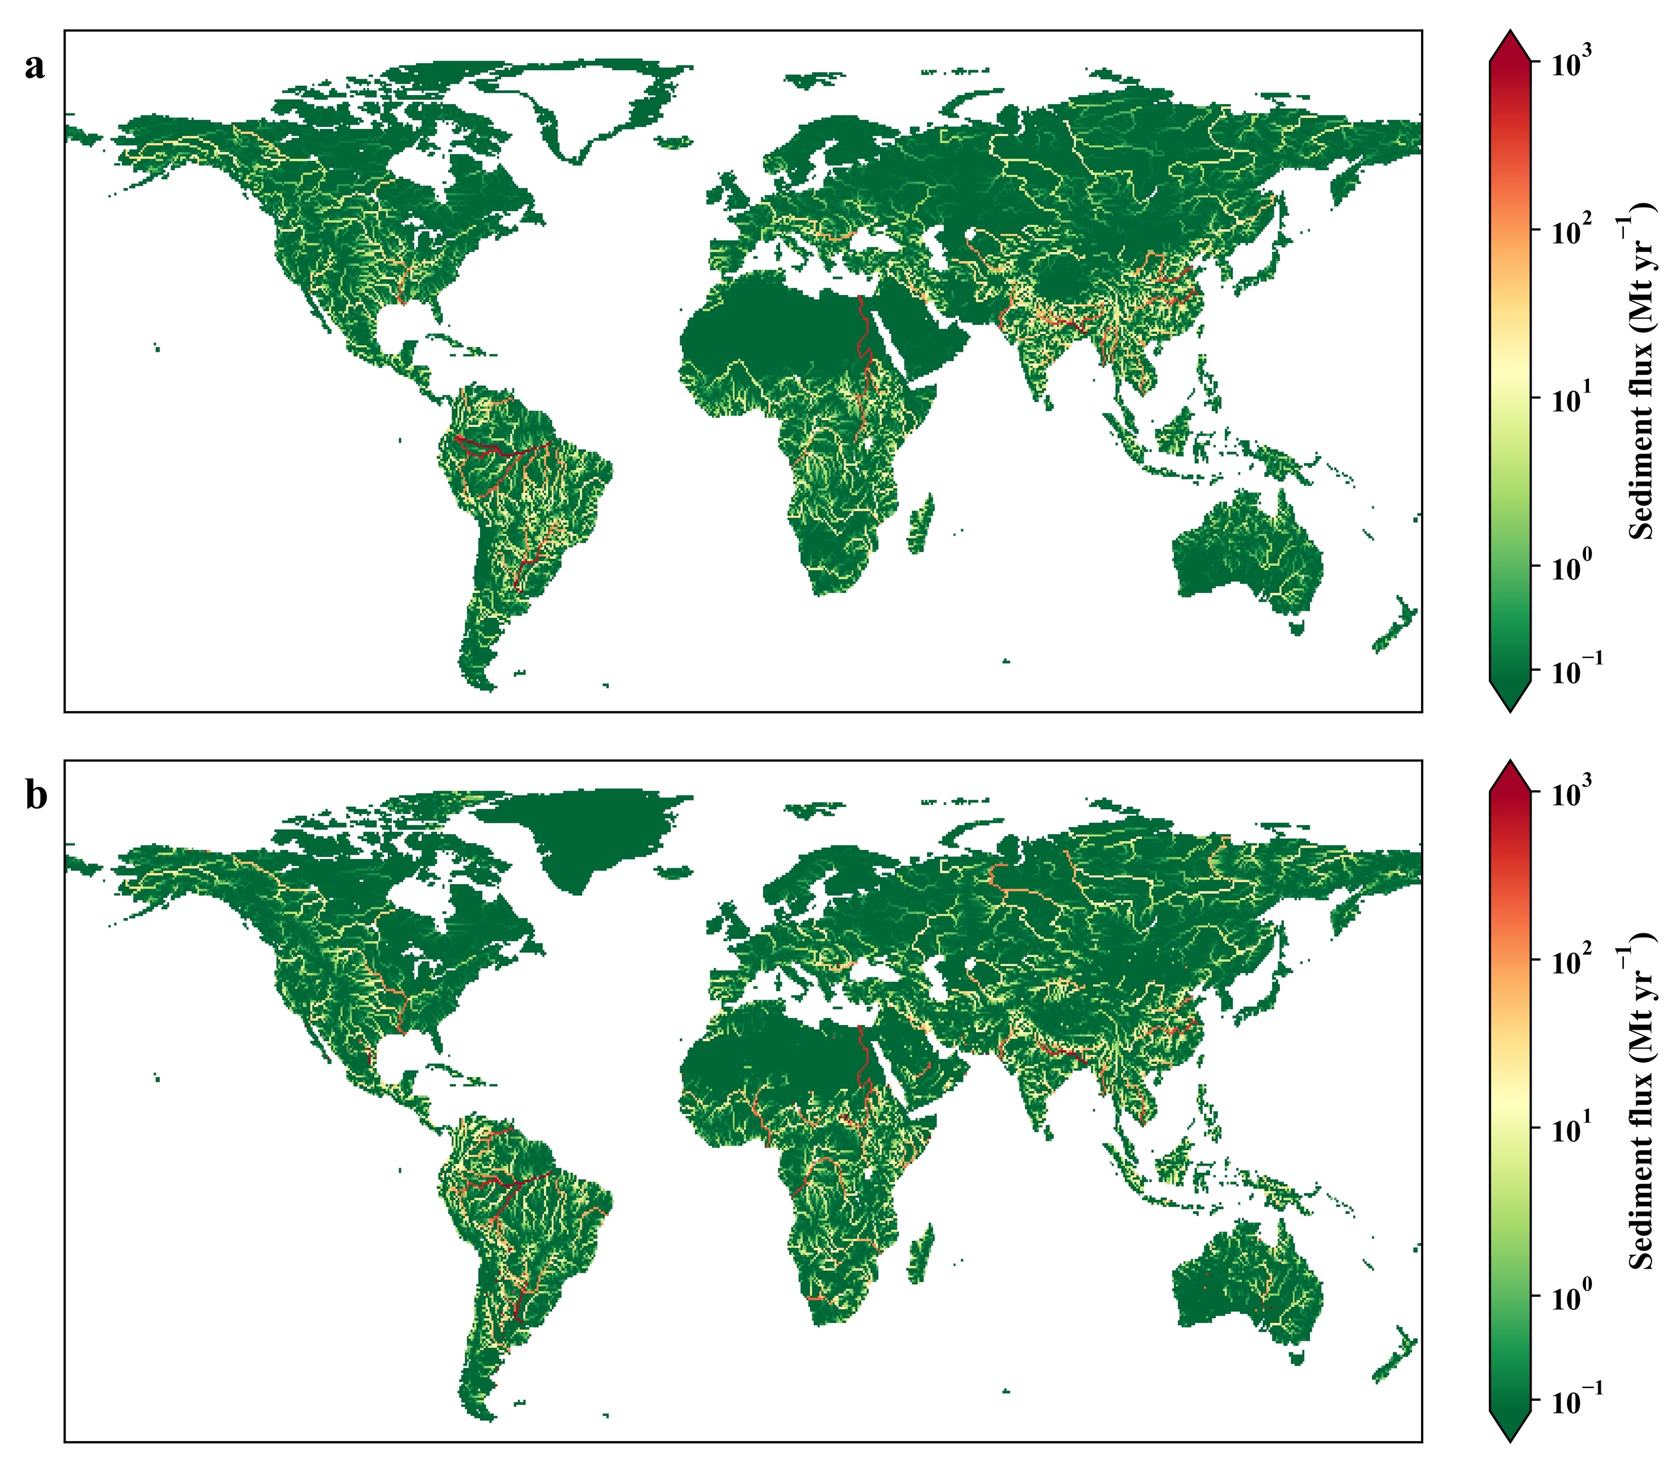
A Global Soil Erosion and Sediment Flux Model
Objective
Develop and evaluate a new soil erosion and sediment flux model in the Energy Exascale Earth System Model (E3SM) for modeling the impact of climate change and land use land cover change on land, river, and ocean geomorphology and biogeochemistry.
Approach
Improve the E3SM soil erosion model by explicitly representing the effects of conservation agriculture, irrigation, crop residue management, and glaciers on soil erosion.
Validate the model against global soil erosion and sediment flux benchmarks and observations.
Conduct numerical experiments to quantify the importance of conservation agriculture, irrigation, and land use land cover change to soil erosion and sediment flux.
Impact
The new E3SM soil erosion model reproduces the global soil erosion and sediment flux seen in observational data and benchmark models.
Conservation agriculture has greatly reduced soil erosion in countries where it is well-adopted, such as the United States and Argentina.
Deforestation will rapidly increase sediment flux in tropical river basins that currently have large rainforest coverage.
The E3SM soil erosion model and a benchmark model (WBMsed) are consistent in their predictions of sediment flux variations. (a) shows the E3SM simulated basin-scale sediment flux. (b) shows the WBMsed simulated basin-scale sediment flux.
Tan Z, LR Leung, H-Y Li, and S Cohen. 2022. “Representing global soil erosion and sediment flux in Earth System Models,” Journal of Advances in Modeling Earth Systems, 14:e2021MS002756. [DOI: 10.1029/2021MS002756]

